Slide 1
Grouping and sharing
Recognising the connection between sharing and grouping and solving practical problems
Mathematics Independent Task
Mrs Khaira

Slide 2
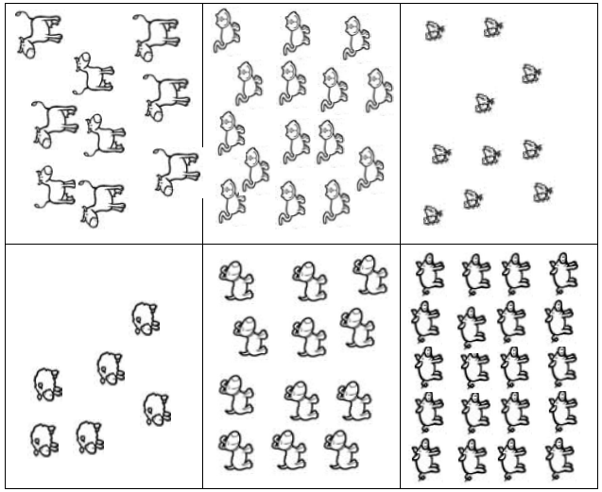
Activity 1

Slide 3
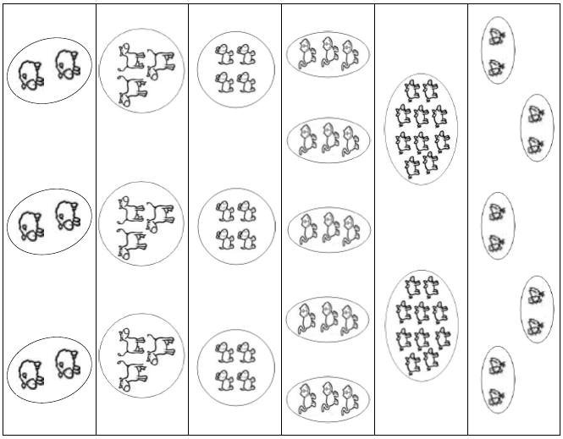
Activity 2

Slide 4
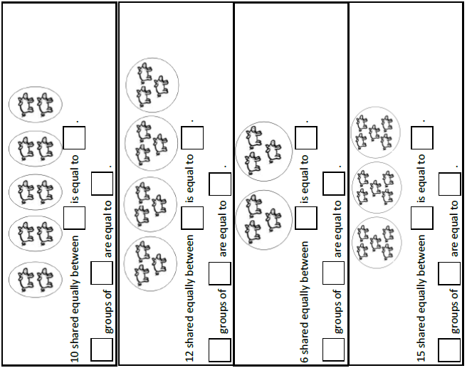
Activity 3

