Slide 1
Physics - Key Stage 3
Lesson 3 - Electricity and Magnetism
Current & Parallel Circuits - Download
Miss White

Slide 2
Slides from video

Slide 3
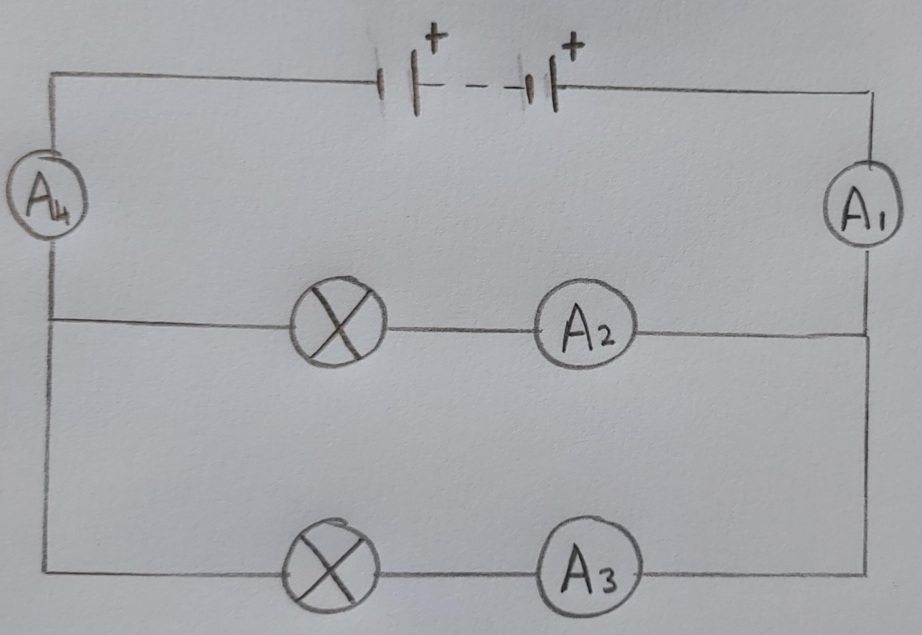
Investigating current in parallel circuits
An ammeter was placed in 4 positions
Source: Miss White

Slide 4
Investigating current in parallel circuits
Describe the results
Explain what this tells your about current in parallel circuits
Position | Current (A)
A1 | 6.00
A2 | 3.00
A3 | 3.00
A4 | 6.00
Notes:
Write down how each of the four currents relate to one another e.g A1= A4…
A2 =A3
A2 + A3 = A1 or A4

Slide 5
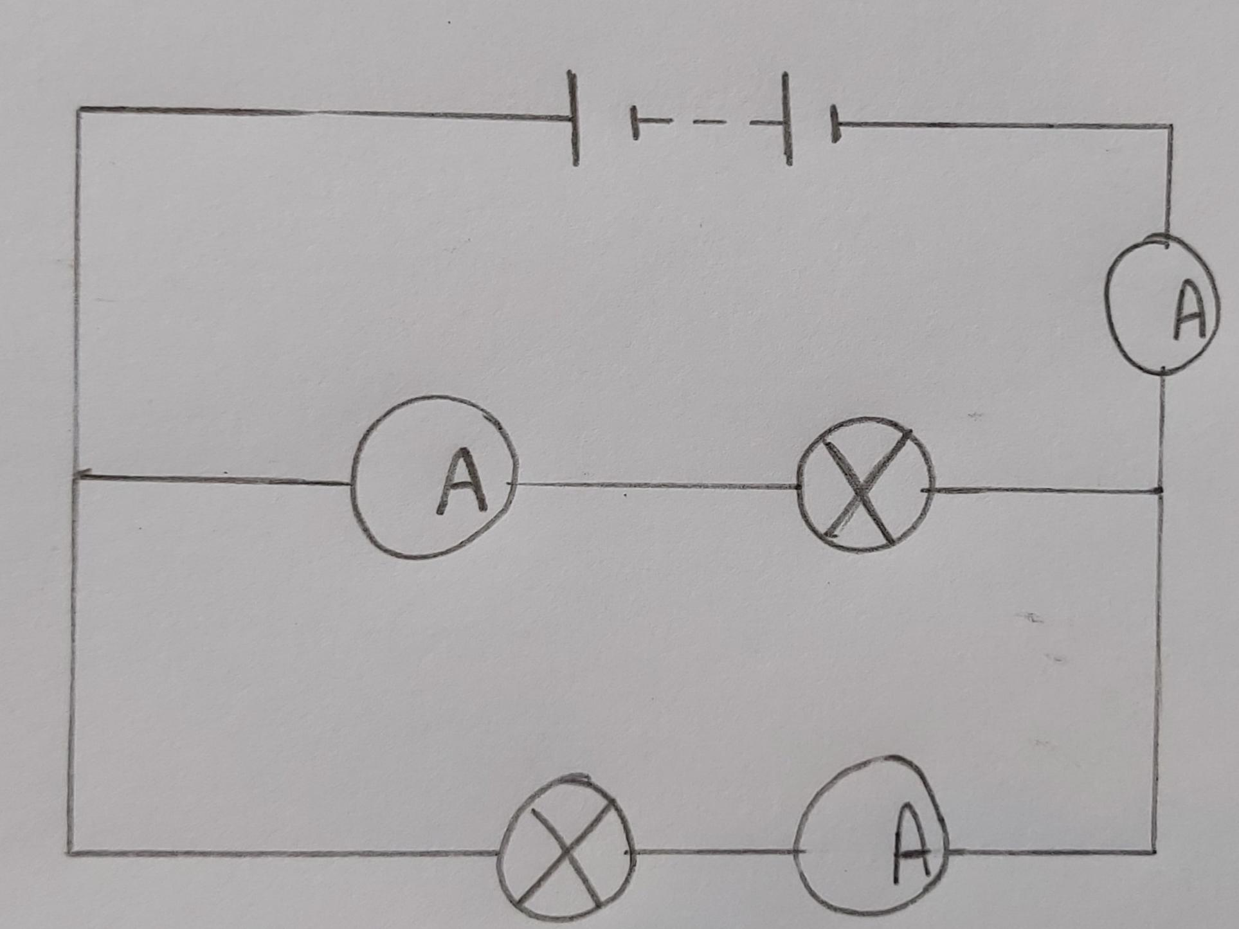
Fill in the missing value 1
Source: Miss White
4
2
?

Slide 6
Fill in the missing value 2
Source: Miss White
10
5
?

Slide 7
Fill in the missing value 3
Source: Miss White
8
?
5

Slide 8
Fill in the missing value 4
Source: Miss White
?
7
6

Slide 9
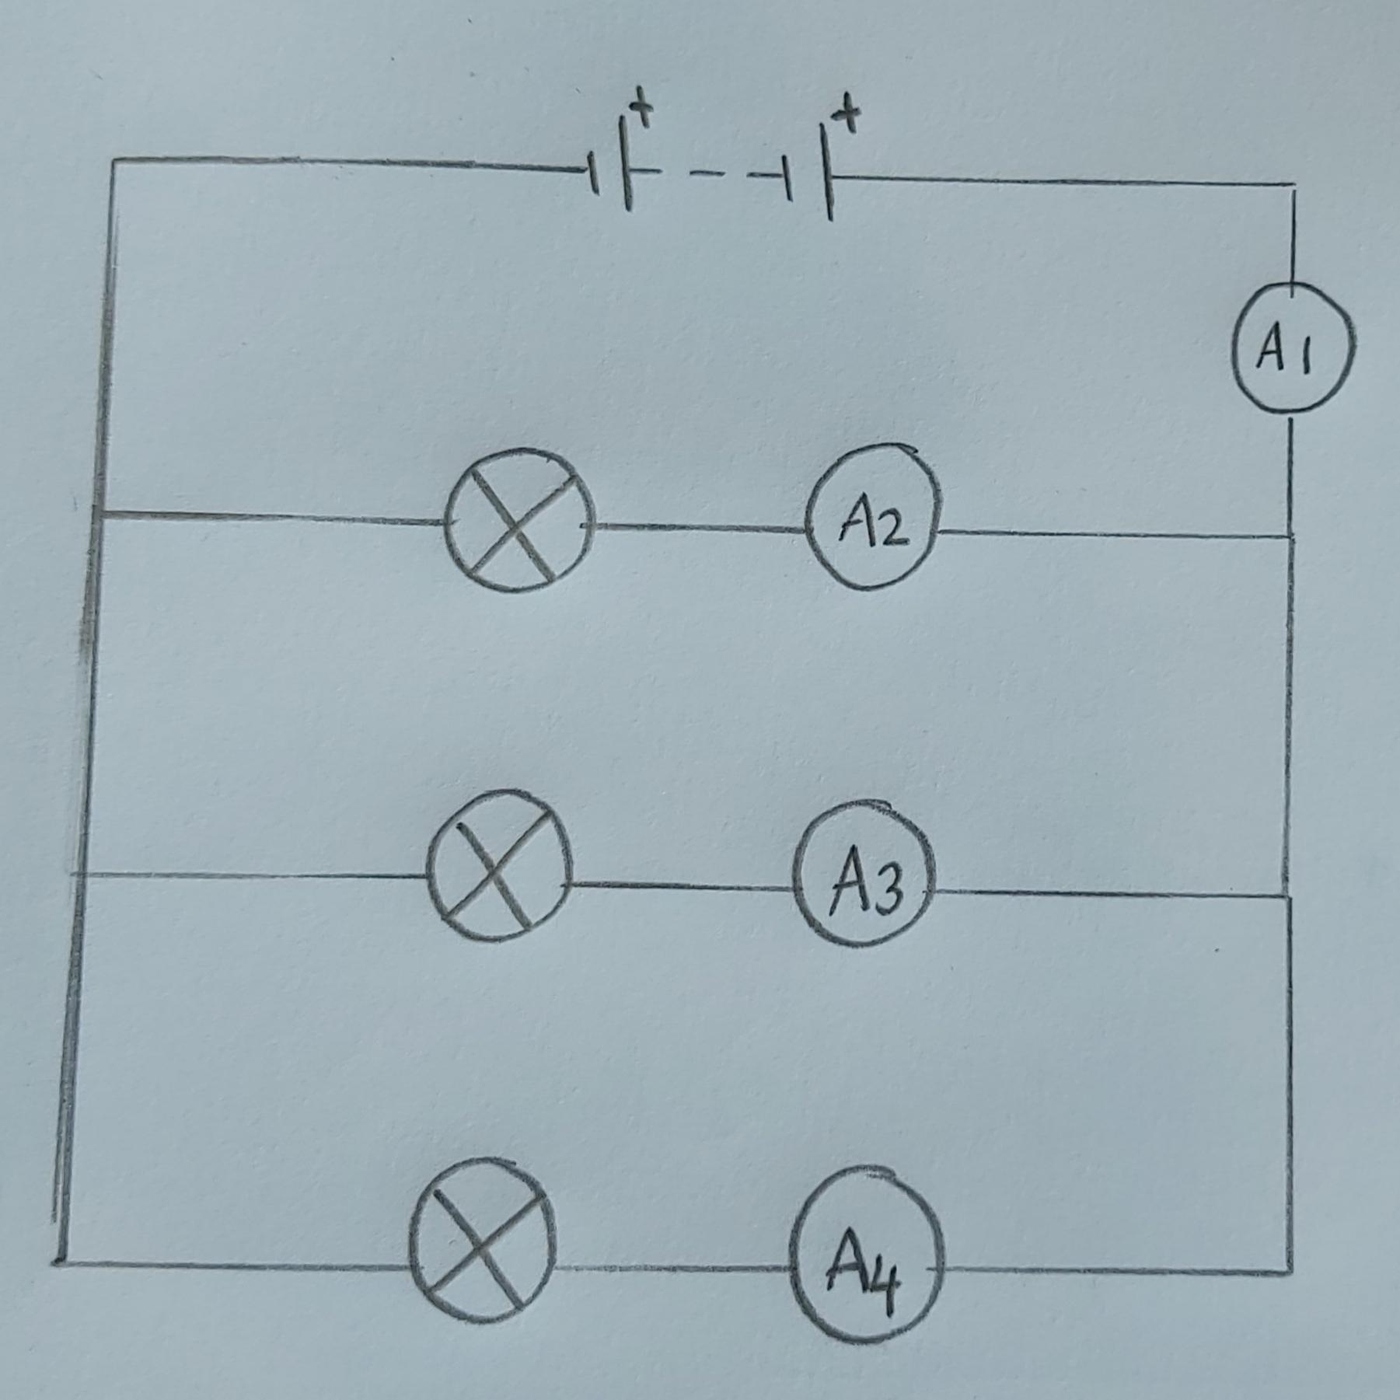
More branches 1
Fill in the blank
Position | Current (A)
A1 | 15.00
A2 | 7.00
A3 | 4.00
A4
Source: Miss White

Slide 10
More branches 2
Fill in the blank
Position | Current (A)
A1 | 10.00
A2 | 2.00
A3
A4 | 5.00
Source: Miss White

Slide 11
More branches 3
Fill in the blank
Position | Current (A)
A1
A2 | 4.00
A3 | 4.00
A4 | 6.00
Source: Miss White

Slide 12
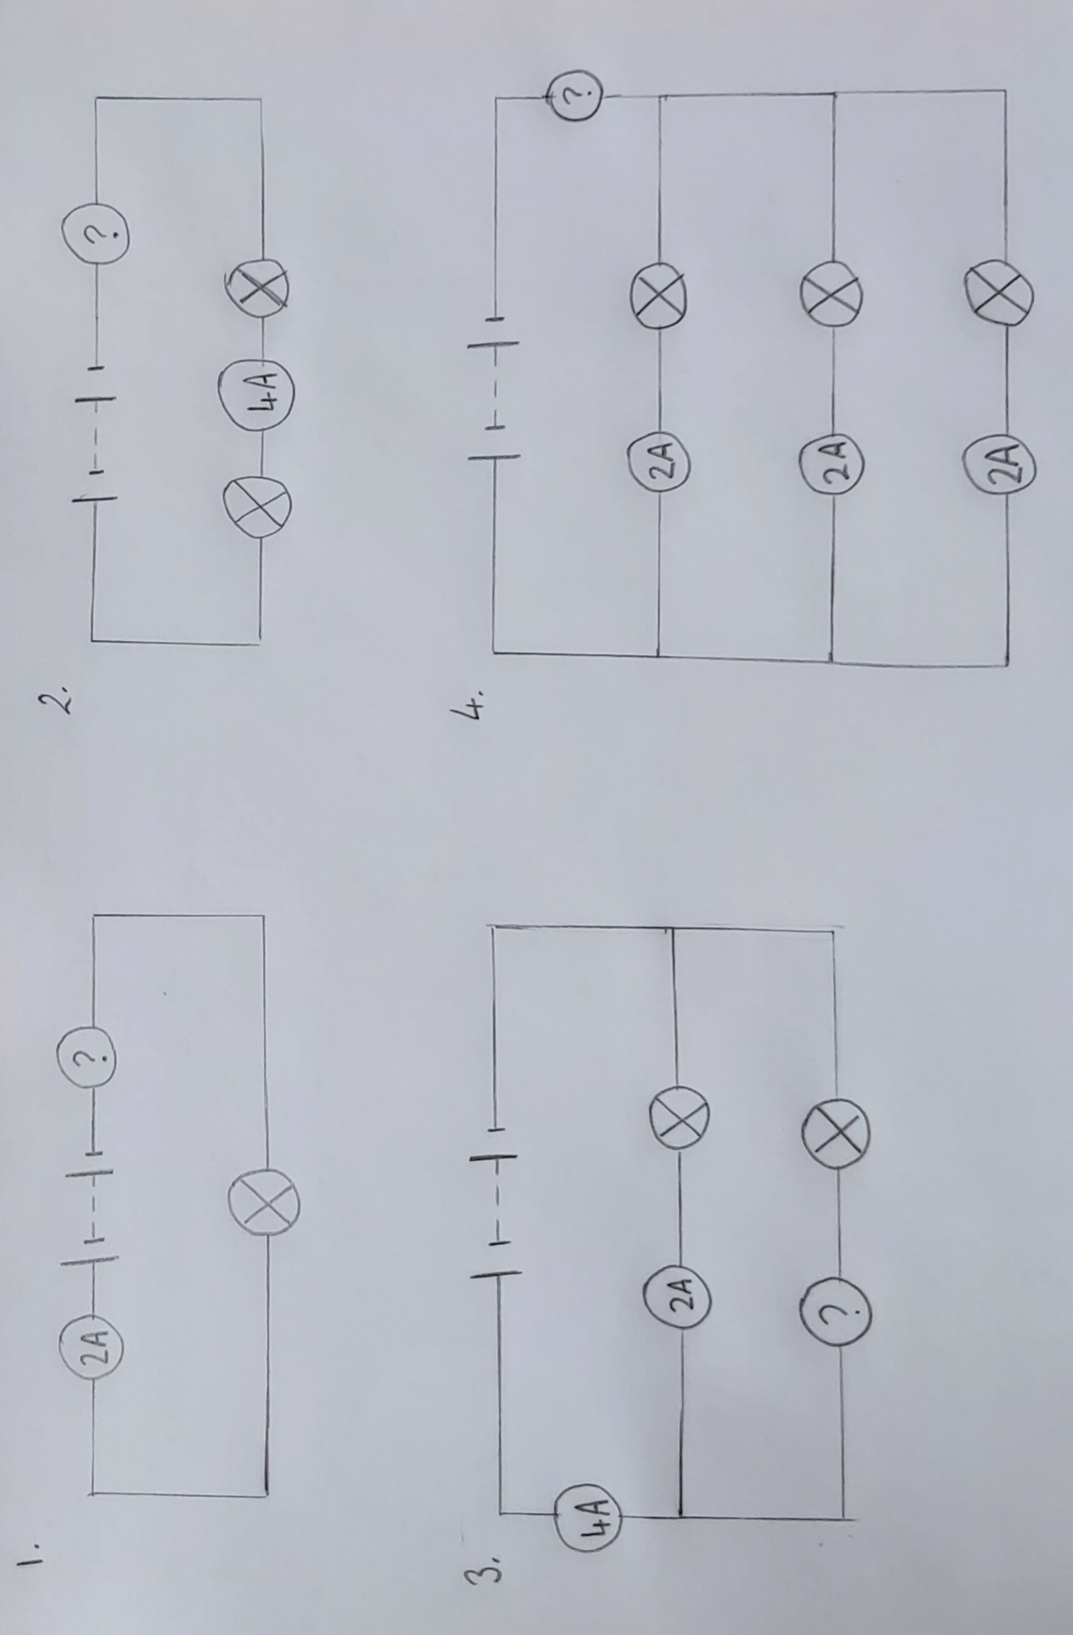
Independent Task
Find the missing value and explain your answer
Source: Miss White

Slide 13
Answers

Slide 14
Investigating current in parallel circuits - Answer
The current is the same at A1 and A4 and the same at A2 and A3.
A2 + A3 = A1 or A4
Position | Current (A)
A1 | 6.00
A2 | 3.00
A3 | 3.00
A4 | 6.00

Slide 15
Investigating current in parallel circuits
In parallel circuits, the current entering the branches is equal to the current leaving the branches
Position | Current (A)
A1 | 6.00
A2 | 3.00
A3 | 3.00
A4 | 6.00
Source: Miss White
Notes:
•The total current in the circuit (the current leaving the battery and returning to it) is equal to the sum of the current in all the branches. •Assuming all the bulbs are identical, they draw the same current as one another. •The total current entering a junction of wires = the total current leaving the junction
•The total charge (per sec) entering a junction of wires = the total charge (per sec) leaving the junction

Slide 16
Fill in the missing value - answers
(4 - 2 =) 2A
(10 - 5 =) 5A
(8 - 5 =) 3A
(7 + 6 =) 13A

Slide 17
More branches 1 - answers
Fill in the blank
Position | Current (A)
A1 | 15.00
A2 | 7.00
A3 | 4.00
A4 | 4.00
Source: Miss White

Slide 18
More branches 2 - answers
Fill in the blank
Position | Current (A)
A1 | 10.00
A2 | 2.00
A3 | 3.00
A4 | 5.00
Source: Miss White

Slide 19
More branches 3 -answers
Fill in the blank
Position | Current (A)
A1 | 14.00
A2 | 4.00
A3 | 4.00
A4 | 6.00
Source: Miss White

Slide 20
Independent task - answers
2. 4A - Current is the same everywhere in a series circuit
Source: Miss White
2A - Current is the same everywhere in a series circuit
4. 6A - Total current is the sum of the branches in a parallel circuit
3. 2A - Total current leaving the cell equals the sum of the branches

