Slide 1
Mathematics
Subtracting Two 2-Digit Numbers
Independent Task
Miss Hughes

Slide 2
Example
9 - 5 = 4
7 - 2 = 5
70 - 20 = 50
54

Slide 3
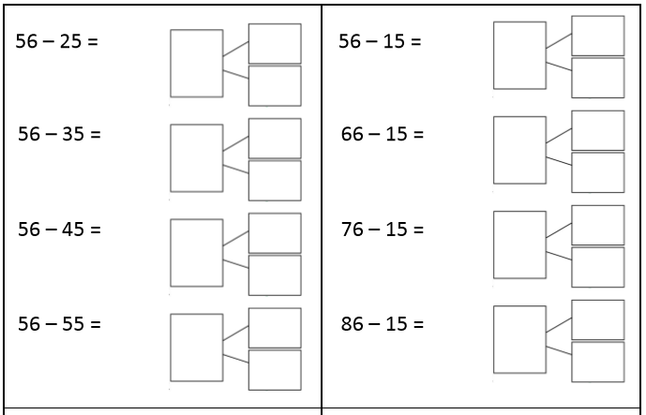
Part 1 of 2

Slide 4
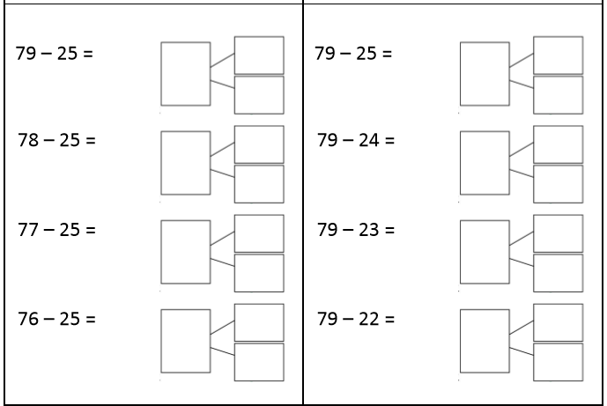
Part 2 of 2

