Slide 1
Flame Emission Spectroscopy
Worksheet
Separate Science - Chemistry - Key Stage 4
C8 Chemical Analysis
Mr Robbins

Slide 2
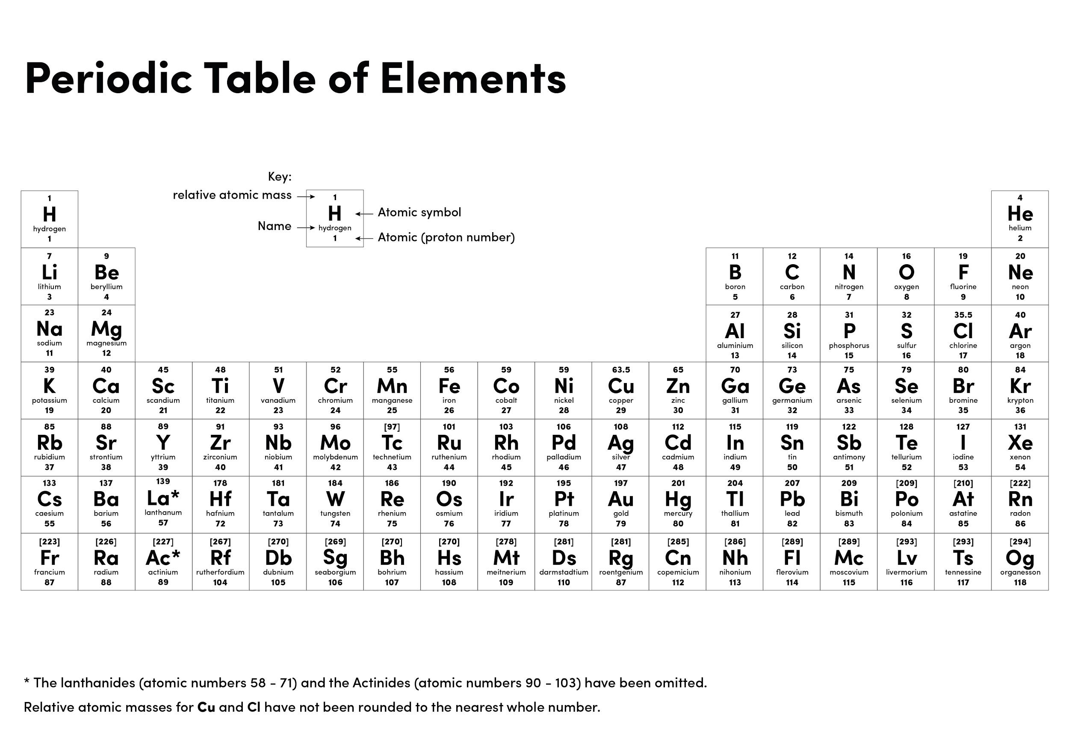

Slide 3
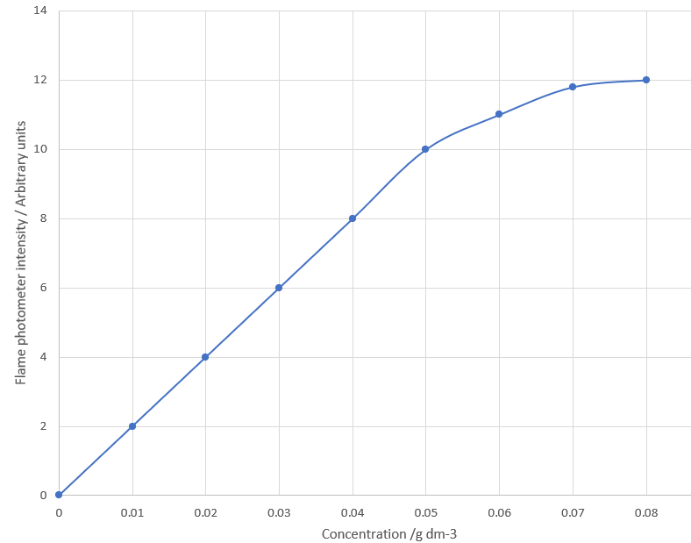
Determine the concentration of copper ions that produce a photometer reading of 12 units.
If a student dissolved 0.06g of lithium into 1 dm³ of water. What photometer reading would a sample produce when placed into a flame emission spectrometer?
A student says “the relationship between concentration and photometer readings is directly proportional.” Do you agree? Justify your response.
Credit [A.Robbins]

Slide 4
Answers
0.08 g dm⁻³
11
No
It does begin directly proportional because of a straight line through the origin (allow values or description)
However after 0.05 g dm⁻³ the line curves

Slide 5
Independent task
Why are instrumental methods better than chemical tests?

Slide 6
Determining concentrations quick check
2. A sample of lithium produces an intensity of 8 units. What is the concentration?
Credit [A.Robbins]

