Slide 1
Calculate the area of rectangles
Mathematics
Mr Kelsall

Slide 2
What is area? When is it used?
How is area different to perimeter?
Notes:
Pause and have a think about the definition of area. Click for definition.

Slide 3
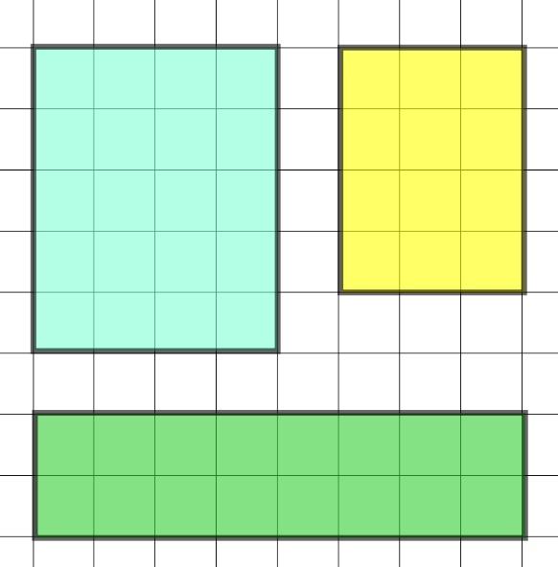
How can we calculate the area of these rectangles?
5 x 4 = 20 units²
3 x 4 = 12 units²
4 units
3 units
We could count the squares that the shape covers.
12 units
5 units
20 units
4 units
2. We could think of them as arrays and we can work out the number of squares in the array by multiplying the length by the width.
16 units
2 units
8 units
2 x 8 = 16 units²
Notes:
Model counting the squares - click for solutions.
Model labelling length and width - click for solutions.

Slide 4
Can you apply our work on the previous slide to create a formula for the area of a rectangle?
width
length x width = area
length
Notes:
Click for formula

Slide 5
Calculate the area of the rectangles below
Remember to give your answer in units².
length x width = area
3 cm
4 m
9 mm
3 mm
5 cm
Example: 3 x 5 = 15 cm²
Notes:
Talk through example, emphasise the answer in units squared.
Give them time to do next two then click for solutions.

Slide 6
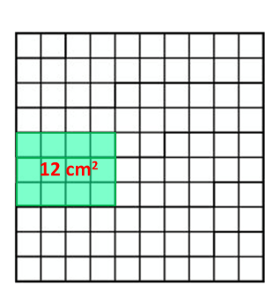
Independent task
Calculate the perimeter of the compound shape.
Close to 100
Roll a dice twice and draw a rectangle with side lengths matching the dice.
Record the area in cm²
Keep going until you cannot fit a rectangle in for three rolls in a row.
At the end of the game work out the area of the grid that is filled and the area that is not filled.
EXAMPLE:
Source of all images : Mr Kelsall or Oak National Academy
Notes:
Lesson Agenda:

