Slide 1
Interpret gradient and intercept on real life graphs
Miss Parnham
Maths
‹#›

Slide 2
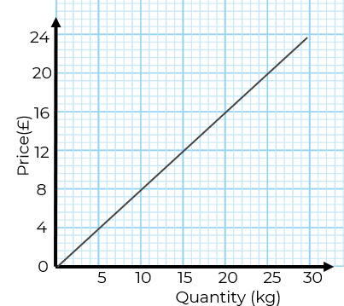
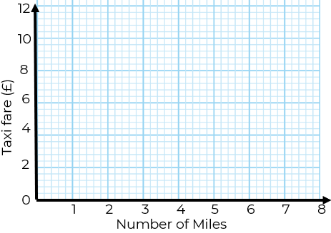
Interpret gradient and intercept on real life graphs
1. The graph shows the cost of buying .
bananas at a shop.
a)What is the gradient of the graph?
b)What does the gradient represent?
2. The graph shows the cost of a taxi per journey.
a)Work out the gradient of the line
b)Work out the y-intercept
c)What do the gradient and y-intercept represent?
‹#›

Slide 3
Answers
‹#›

Slide 4
Interpret gradient and intercept on real life graphs
1. The graph shows the cost of buying .
bananas at a shop.
a)What is the gradient of the graph?
b)What does the gradient represent?
2. The graph shows the cost of a taxi per journey.
a)Work out the gradient of the line
b)Work out the y-intercept
c)What do the gradient and y-intercept represent?
1
2
0.8
The gradient is the price per mile of £1.
Price per kg of the bananas, £0.8 per kg
Intercept is the standing charge of £2.
‹#›

