Slide 1
Gamelan - interlocking melodies
Music - Pulse, beat, rhythm and structure
Miss Kilpatrick

Slide 2
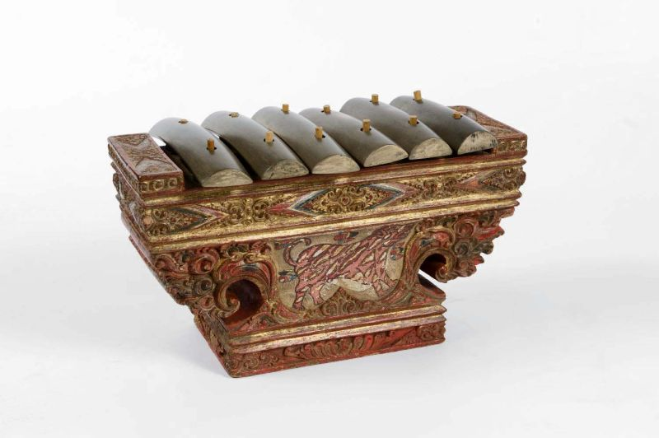
Interlocking melodies for the Saron using the Slendro scale (pentatonic)
 | 1 | 2 | 3 | 4 | 5 | 6 | 7 | 8
Melody 1
Melody 2
Compose two interlocking saron melodies using the grid score above.
Use only the notes of the slendro scale (C D E G A, 1 2 3 5 6)
Remember to add rest beats (silences) in each melody - shade the rest squares
Choose two or three unison note points in the two melodies
Tropenmuseum, part of the National Museum of World Cultures, CC BY-SA 3.0, via Wikimedia Commons

