Slide 1
Mathematics
Calculating the probability of combined events
Downloadable Resource
Mr Langton

Slide 2
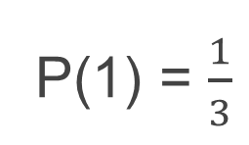
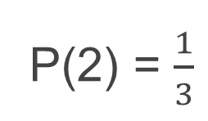
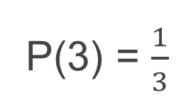
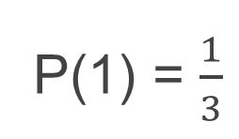
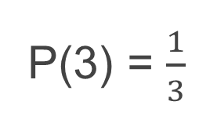
Calculating the probability of combined events
Bag A Bag B
I spin two spinners. They are equally likely to land on a 1, 2, or 3. Complete the probabilities for the sample space.
Bag B
1
2
3
Bag A
1
2
3
a) Complete the probabilities for each outcome.
b) What is the probability that I pick one of each colour?
Calculate the probability that both spinners score greater than 1

