Slide 1
Sentence Overview
English
Lesson 30 of Grammar
Ms Richards

Slide 2
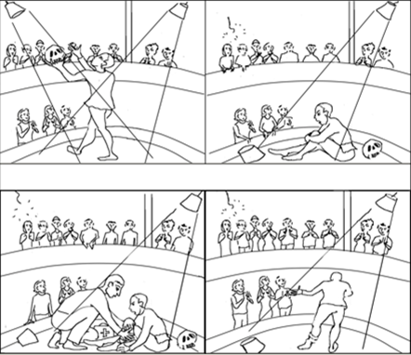
Write a story!
Plummeted
Theatre
Audience
Bandage
Tripped
Knelt
Wires
Actor
Medic
Performed
Notes:
I’ll talk through the picture first. Reminder - add in subordinate clauses. Avoid Fragments. List etc.

