Slide 1
Oak Specialist - Applying Learning
Independent Living Unit 3 - Daily Living Skills
Melanie

Slide 2
Unit 3 - Daily Living Skills
Lesson 1- Recycling
Lesson 2- Managing a Routine
Learning about why we recycle and how to do it at home.
Understanding what makes a balanced daily routine.
Lesson 3- Sending a parcel or email
Lesson 4- Preparing for a Trip
Option 3
Option 4
Learning how to address, stamp and send a letter or parcel, and how to send an email.
Understanding what to pack for a trip and how it differs depending on the destination.
Option 3
Lesson 5- Preparing a Simple Meal
Lesson 6- Meals for Different Times
Option 4
Learning to read a simple recipe to create a simple meal.
Understanding why we eat different meals at different times of the day.

Slide 3
Lesson 2- Managing your own routine

Slide 4
Teacher notes- Lesson 2
Learning intention: to understand what makes a balanced daily routine.
Thinking about our current daily routine. Beginning by breaking the day into morning routine, afternoon routine and evening routine.
Thinking of the activities we enjoy doing the most and the activities we need to do to maintain a balanced routine. E.g. playing on the computer and exercising.
Writing a list of the things we enjoy and a list of the things that we should be doing. E.g. staying active, keeping our home clean, spending time with loved ones.
Creating a new routine to include one of the things from the list of things we enjoy and one of the things from our list of things we should be doing.
Additional resources: pen, paper, colouring pencils (optional)
Notes:
This is the equivalent to a loose lesson plan/overview for teachers before starting the lesson.

Slide 5
Oak Specialist
Managing your own routine
Applying Learning

Slide 6
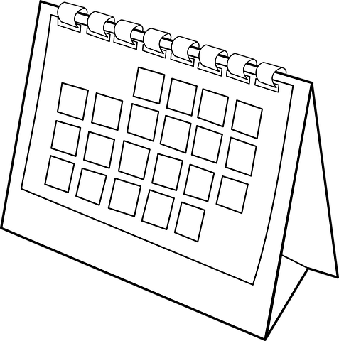
Lesson Activity Stages
This lesson will be taught in 4 stages-
Sequence a typical day - morning, afternoon and evening
List the activities that you enjoy most
List the activities you should do for a healthy, balanced routine
Starting with Monday, choose 1 activity, and begin creating your healthy routine
Images from: Pixabay

Slide 7
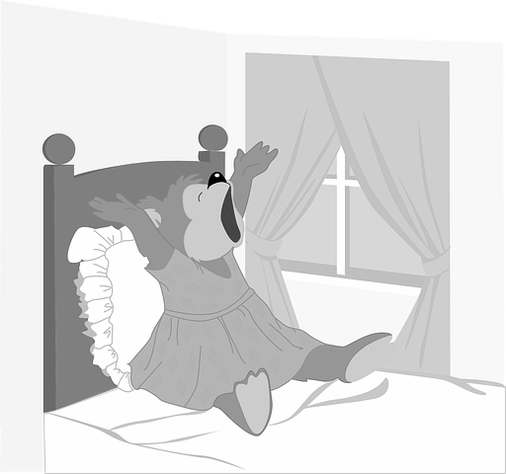
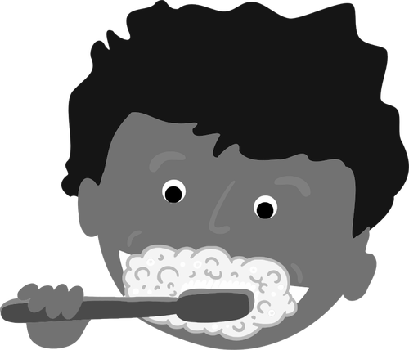
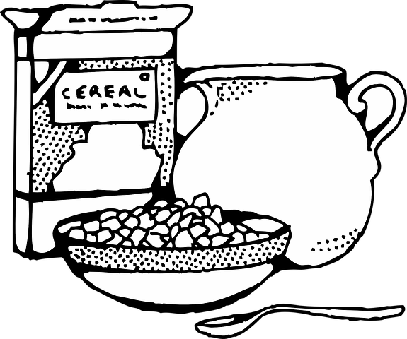
Here is a list of my morning routine...
Morning
9am to 12pm
(3 Hours)
AM Work Wake-up Wash Brush Teeth Eat Breakfast
Images from: Pixabay, FreeSVG
Notes:
Note: Please add images or symbols as best suit your learners.
Discuss;
What is a routine?
*A routine is a make up of activities that you do frequently at a similar time each week. This can be self-care tasks, school, work, the time you eat or relax.
This is my current morning routine.
What is your current morning routine?

Slide 8
Afternoon
12pm to 4pm
(4 Hours)
Here is a list of my afternoon routines...
PM Eat Lunch Watch TV Work
Images from: Pixabay
Notes:
Note: Please add images or symbols as best suit your learners.
Discuss;
Here is my afternoon routine.
What do you do in the afternoon?
Is there one activity that you do more than others?

Slide 9
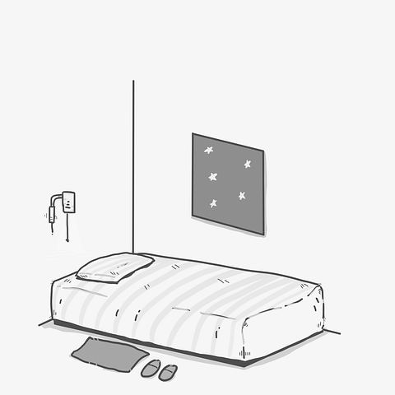
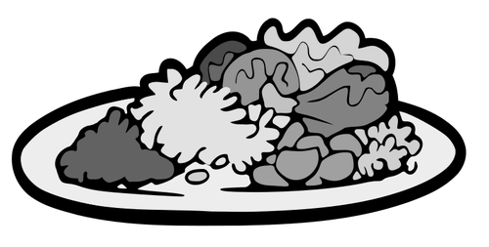
Here is a list of my evening routines...
Evening
4pm to 10pm
(6 Hours)
PM Shower Watch TV Eat Dinner Watch TV Go to Bed
Images from: Pixabay, FreeSVG
Notes:
Note: Please add images or symbols as best suit your learners.
Discuss;
This is my evening routine.
Can you spot the activity that I might be doing too much?
Do you think my routine is balanced?
What do you do in your evening routine?

Slide 10
Activity 1
What do you like to do in your free time?
Write a list of some of your favourite activities that you like to do in your free time.

Slide 11
Playstation or Xbox Ipad or Iphone
Watching TV Listening to Music
Images from: Pixabay
Notes:
Note: Please add images or symbols as best suit your learners.
Discuss;
Here are some examples of the things people enjoy doing in their free time.
What did you choose?
*Although we would like to do these fun activities all the time, we have to make time to do other activities around the home,or as part of our self-care.

Slide 12
Activity 2
What do we need to do as part of a healthy routine?
Make a list of some of the chores and things that you need to do as part of a balanced routine.

Slide 13
Exercising Tidying up
Learning Family and friends
Images from: Pixabay
Notes:
Note: Please add images or symbols as best suit your learners.
Discuss;
These are some of the things that we should do as part of a balanced routine.
What did you think of?
My routine did not include any chores, exercise or time with my family and friends.

Slide 14
Activity 3
Create your own balanced routine.
Using your list of activities that you enjoy and activities you need to do, pick one from each to create a balanced routine of your own.

Slide 15
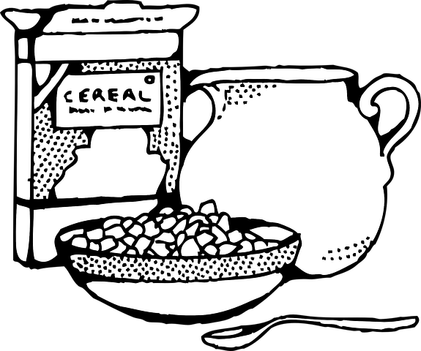
Monday
Morning wash and brush my teeth breakfast work
Afternoon lunch watch TV work exercise
Evening dinner relax shower go to bed
Images from: Pixabay
Notes:
Note: Please add images or symbols as best suit your learners.
Discuss;
Can you see which 2 activities I have added to my routine to make it balanced and which activity I was doing too much that I took out?
*Watching TV, replaced with exercise and relaxation time.
What activities did you put in your routine to make it balanced?

Slide 16
Independent Living
Applying Learning
Routines - Managing your own routine
Make it easier
Make it harder
More ideas
Make a visual routine for one day of the week, drawing your activities instead of writing them.
Create a routine including the time you will start and finish each activity.
Prioritise your activities from most to least important.
Make one routine for a work day and a different routine for a weekend.
Find out if people with different jobs have different routines.

Slide 17
Signposting
Independent Living:
Applying Learning- Balanced leisure activities (Unit 2)
Building Understanding- Creating a visual schedule (Unit 3)
Building Understanding- Morning hygiene routine (Unit 2)
Occupational Therapy:
Executive functioning/organisation (Unit 5)
Activities of daily Living (Unit 6)
Numeracy:
Building Understanding/Applying Learning- Time (Unit 4)
Notes:
Insert info for subject/lesson name/stage (if appropriate)

