Slide 1
German
Discussing subjects and teachers [2/2]
Introducing weil
Herr Jones

Slide 2
s
sollen
Steve Clarke / Rachel Hawkes

Slide 3
s
Gesetz
Seite
sollen
54
reisen
Satz
Subjekt
Verb
Objekt
langsam
Ich habe Hunger.

Slide 4
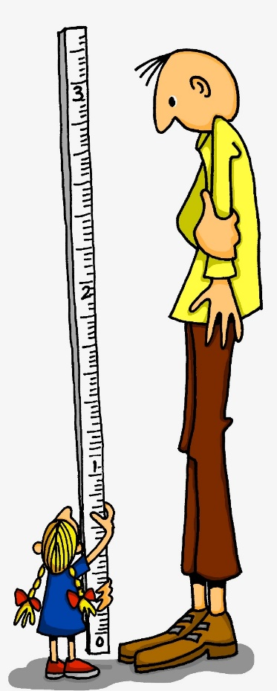
ß
groß
Steve Clarke / Rachel Hawkes

Slide 5
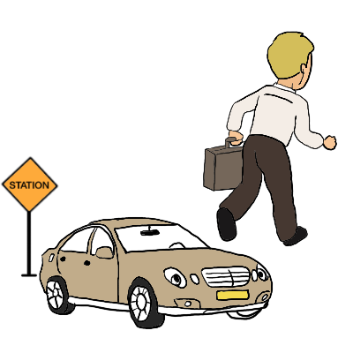
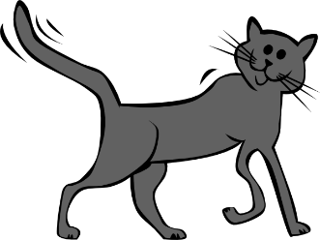
ß
Fußball
ein bisschen
groß
heißen
lassen
Misky
damals
1919
2019
Rachel Hawkes

Slide 6
weil | because
guten Sinn für Humor | good sense of humour
helfen | to help, helping
unterstützen | to support, supporting
geben | to give, giving
lieben | to love, loving
reden | to talk, talking
hassen | to hate, hating

Slide 7
Grammatik mögen with an infinitive

Slide 8
I like learning German
You already know that ich mag means “I like”.
Ich mag Deutsch. I like German.
But if you add in an infinitive verb it means “to like doing something”.
Ich mag Deutsch lernen. I like learning German.
The infinitive has to go at the end of the sentence.

Slide 9
mögen + infinitive
Normal verb 2nd idea
mögen 2nd idea + infinitive at end
Ich lerne Geschichte.
Ich mag Geschichte lernen.
Different word order!
I learn History.
I like learning History.
Er redet im Unterricht.
Er mag im Unterricht reden.
He talks in lessons.
He likes talking in lessons.

Slide 10
What is weil?
Weil means “because”.
It is an example of a conjunction (links two sentences together).
My German is improving because I am working hard.
A conjunction links two sentences together.
To be more accurate, weil is a subordinating conjunction.

Slide 11
What are subordinating conjunctions?
Subordinating conjunctions introduce a subordinate clause.
This is a clause (part of a sentence) which cannot exist on its own.
Which one of these sentences makes sense?
Because I am working hard.
My German is improving because I am working hard.

Slide 12
What happens to the word order?
When you see weil the verb runs a mile.
This means the main verb (normally 2nd idea) goes to the end of the clause.

Slide 13
Beispiel (example)
When you see weil the verb runs a mile.
Ich mag Deutsch. Der Lehrer ist unterhaltsam.
main verb
Ich mag Deutsch. Der Lehrer ist unterhaltsam.
Ich mag Deutsch, weil der Lehrer unterhaltsam ist.
Always need a comma in front

Slide 14
Beispiel (example)
When you see weil the verb runs a mile.
Ich hasse Mathe. Ich finde die Lehrerin streng.
main verb
Ich hasse Mathe. Ich finde die Lehrerin streng.
Ich hasse Mathe, weil ich die Lehrerin streng finde.
Always need a comma in front

Slide 15
Word order with weil.
Weil means …………………. .
When you see weil the verb runs a …………. .
This means the main verb goes to the ………….. of the clause
Before writing weil, you always need to have a ……………… .
The word in German for “to support” is
……………..……………... .
because
mile
end
comma
unterstützen

