Slide 1
Constructing pictograms
Independent Task
Mathematics
Miss Hill

Slide 2
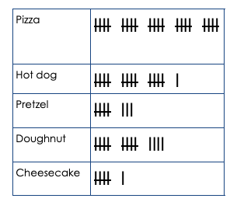
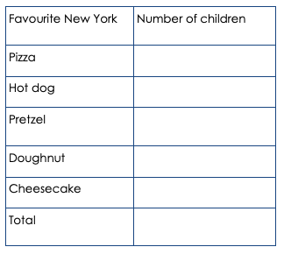
Independent Task
Create your own pictogram! Using the information from the tally chart, complete the frequency table and draw your pictogram

