Slide 1
Rounding to a required degree of accuracy
Mathematics
Mrs Harris

Slide 2
Round the populations to the nearest multiple of 100,000 then plot them on the number line.

Slide 3
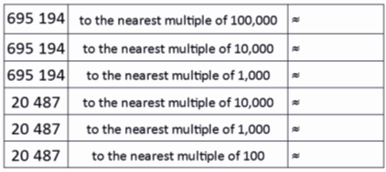
Independent learning
Round each number to the nearest multiple of 1000
765,432
76. 543
7,654
765
234
2,345
23,456
234,567

