Slide 1
Resistance
Physics - Key Stage 3
Lesson 6- Electricity and Magnetism
Miss White

Slide 2
Questions from video

Slide 3
Quick Check
What carries charge through a metal wire?
Define resistance.
State the unit of electrical resistance.
What is Ohm’s Law?

Slide 4
Independent Task 1
p.d. = Current x Resistance
Resistance = p.d. ÷ Current
Current = p.d. ÷ Resistance
1. The current through an ipad is 0.10A and the p.d. of its power supply is 12V.
Calculate the resistance of the ipad.
2. The resistance of a fixed resistor is 34 Ω and the current through it is 0.30 A.
What is the p.d. across the resistor?
3. The p.d. across a 50 Ω resistor is 6.0 V.
What is the current through the resistor?

Slide 5
Harder
kΩ = 1000Ω
mA = 0.001 A
MA = 1,000,000 A
1. The resistance of an iPhone is 3 kΩ and the current through it is 4 mA.
What is p.d. of its power source?
2. The potential difference (p.d.) across a woman when she is struck by lightning is 33 MV and the resistance of a human being is around 100 kΩ.
What current flows through the woman?
Notes:
What quantity does a lower case k represent? Think about kg or kJ, that’s right a 1000 so a k-ohm is 1000 ohms.
What does a lower case m represent? Milli so 1/1000
Capital M = mega ampere = million Amps

Slide 6
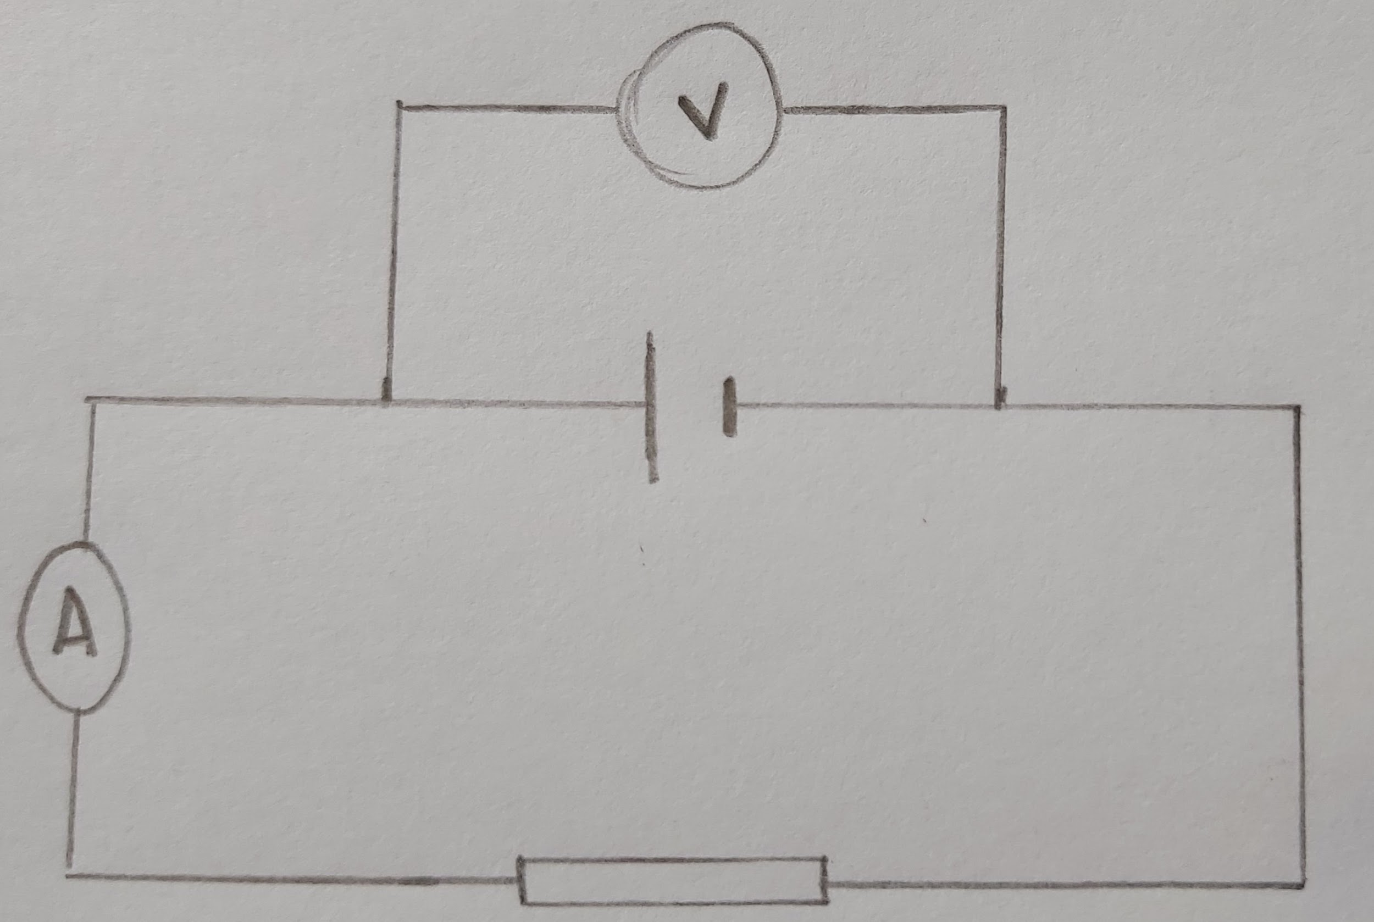
Application - Your go!
Calculate the p.d. across the cell
6 A
20 Ω
Notes:
Pause the lesson and have a go, use the VESRAU scaffold

Slide 7
Independent task 2 - complete the table
 | Current (A) | Potential difference (V) | Resistance (Ω)
a) | 4.0 | 20
b) | 3.0 |  | 15
c) |  | 50 | 200
d) | 0.50 | 12
e) | 0.25 |  | 60
f) |  | 6.0 | 30
Notes:
Find the missing values

Slide 8
Answers

Slide 9
Quick check - Answers
What carries charge through a wire?
Electrons carry charge through wires
Define resistance
Resistance is anything which makes the flow of charge more difficult
What is resistances measured in?
Resistance is measured in Ohms (Ω)
What is Ohm’s Law?
p.d. = Current x Resistance

Slide 10
Independent task 1 - answers
p.d. = Current x Resistance
Resistance = p.d. ÷ Current
Current = p.d. ÷ Resistance
1. The current through an ipad is 0.1A and the p.d. of its power supply is 12V.
Calculate the resistance of the ipad? Resistance = 12 ÷ 0.10 = 120 Ω
2. The resistance of a resistor is 34 Ω and the current through it is 0.3 A.
What is the p.d. across the resistor? p.d. = 0.30 x 34 = 10.2 V
3. The p.d. across a 50 Ω resistor is 6 V.
What is the current through the resistor? Current = 6.0 ÷ 50 = 0.12 A

Slide 11
Harder - answers
1. The resistance of an iPhone is 3 kΩ and the current through it is 4 mA.
What is p.d. of its power source?
I = 4 mA = 0.004 A; R = 3 kΩ = 3 000 Ω
V=IR = 3000 x 0.004 = 12 V
2. The p.d. across a woman when she is struck by lightning is 33 MV and the resistance of a human being is around 100 kΩ.
What current flows through the woman?
V = 33 MV = 33 000 000 V; R = 100 kΩ = 100 000 Ω.
I = V ÷ R = 33 000 000 ÷ 100 000 = 330 A
kΩ = 1000Ω
mA = 0.001 A
MA = 1,000,000 A
Notes:
What quantity does a lower case k represent? Think about kg or kj, that’s right a 1000 so a k-ohm is 1000 ohms.
What does a lower case m represent? Milli so 1/1000
Capital M = mega ampere = million Amps

Slide 12
Application - answers
Values Equation Substitute Rearrange Answer Units
6 A
20 Ω
Current is 6 A Resistance is 20Ω
Potential difference = Resistance x Current
p.d = 6 A x 20 Ω
Potential difference = 120
120 V
V

Slide 13
Independent task 2 - answers
 | Current (A) | Potential difference (V) | Resistance (Ω)
a) | 4.0 | 20 | 5
b) | 3.0 | 45 | 15
c) | 0.25 | 50 | 200
d) | 0.50 | 12 | 24
e) | 0.25 | 15 | 60
f) | 0.2 | 6.0 | 30
Notes:
Find the missing values

