Slide 1
Consolidating and reviewing learning on capacity and volume
Lesson 10 of 10
Mathematics
Miss Jones

Slide 2
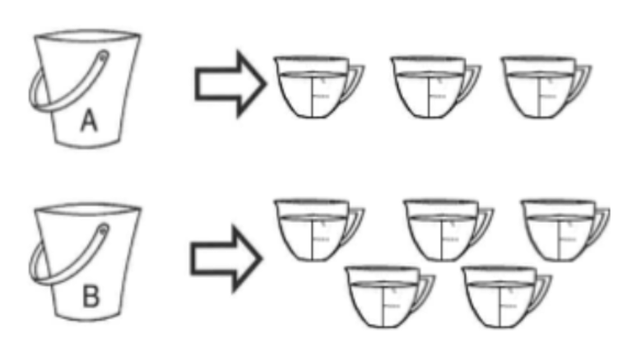
Independent task 1
Each cup holds one litre of water.
Bucket A holds ___ l of water.
Bucket B holds ___ l of water.
Bucket B holds ___ l more than bucket A.

Slide 3
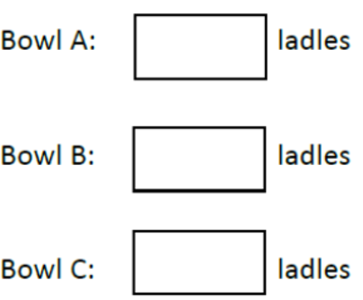
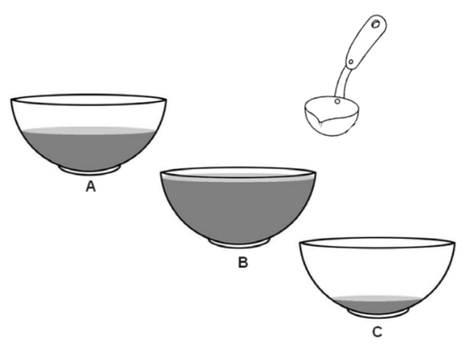
Independent task 2
Remember, the ladles have to total to 10. Can you find more than one answer?
There are 10 ladles of soup in a large pot. The soup is poured into 3 small bowls: A, B and C.
Bowl A has more soup than Bowl C.
Bowl B has more soup than bowl A.
Estimate how many ladles of soup are in each bowl.

