Slide 1
Say what you do on a specific day vs as part of a daily routine (Part 1/2)
Present tense regular -IR verbs
Downloadable Resource
French
Madame Johnson

Slide 2
Say what you do on a specific day vs as part of a daily routine (Part 1/2)
ur understanding of the near future tense.
Phonics focus - [tion]
Introducing new vocabulary
Grammar focus: Present tense regular -IR verbs
Grammar practice: - IR verbs
Reading activity: -IR verbs
Writing activity: translation
Speaking activity
Summarising learning

Slide 3
[ tion ]
attention

Slide 4
[ tion ]
action
international
population

Slide 5
finir | to end/finish
nourrir | to feed
le chat | cat
dimanche | Sunday
l’heure | time/hour
lundi | Monday
mardi | Tuesday
mercredi | Wednesday
jeudi | Thursday
vendredi | Friday

Slide 6
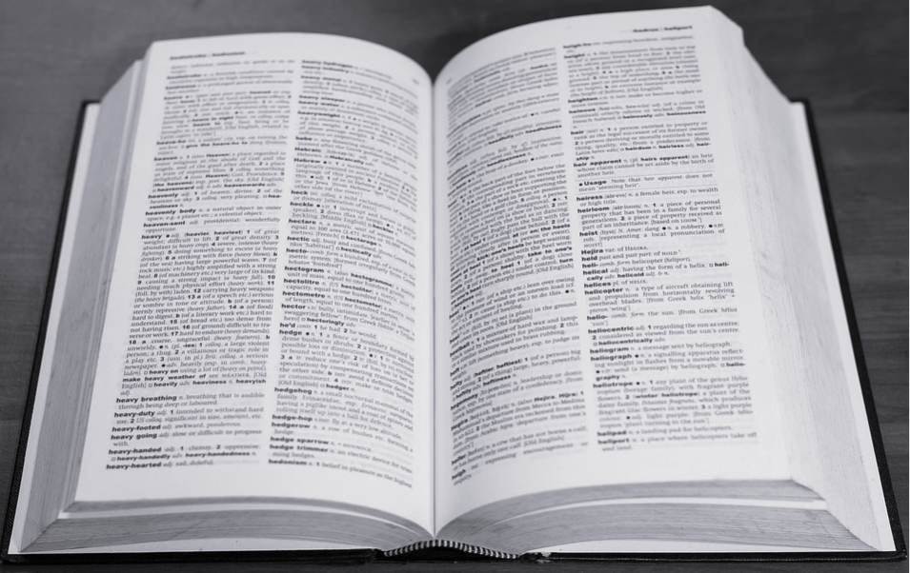
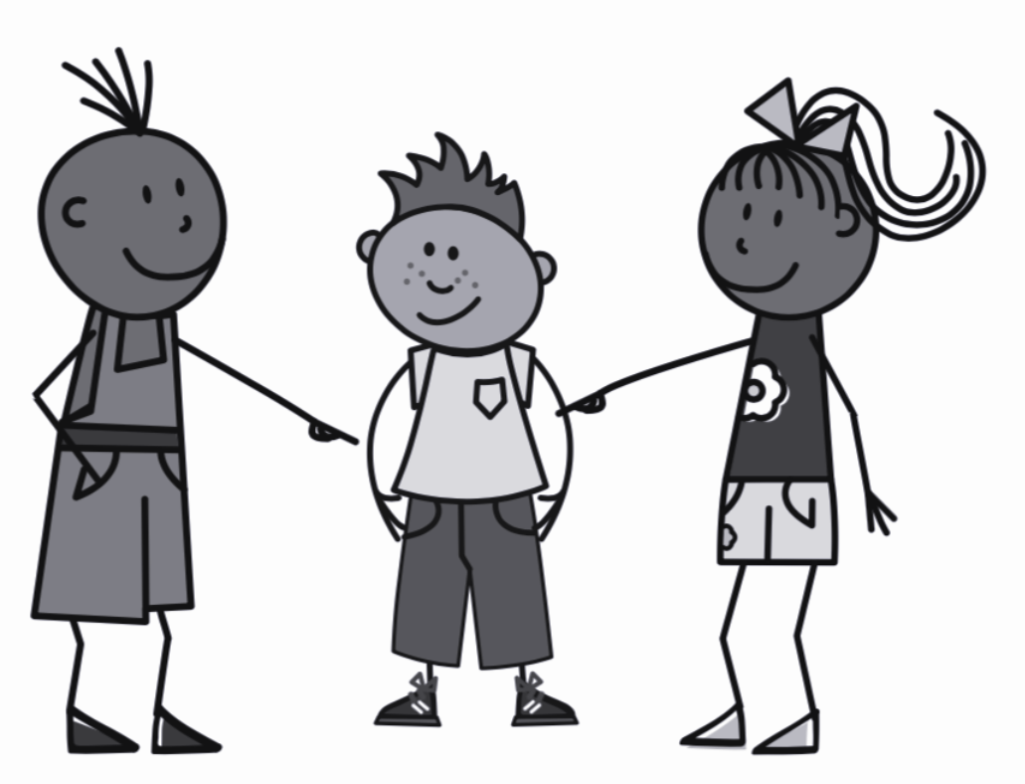
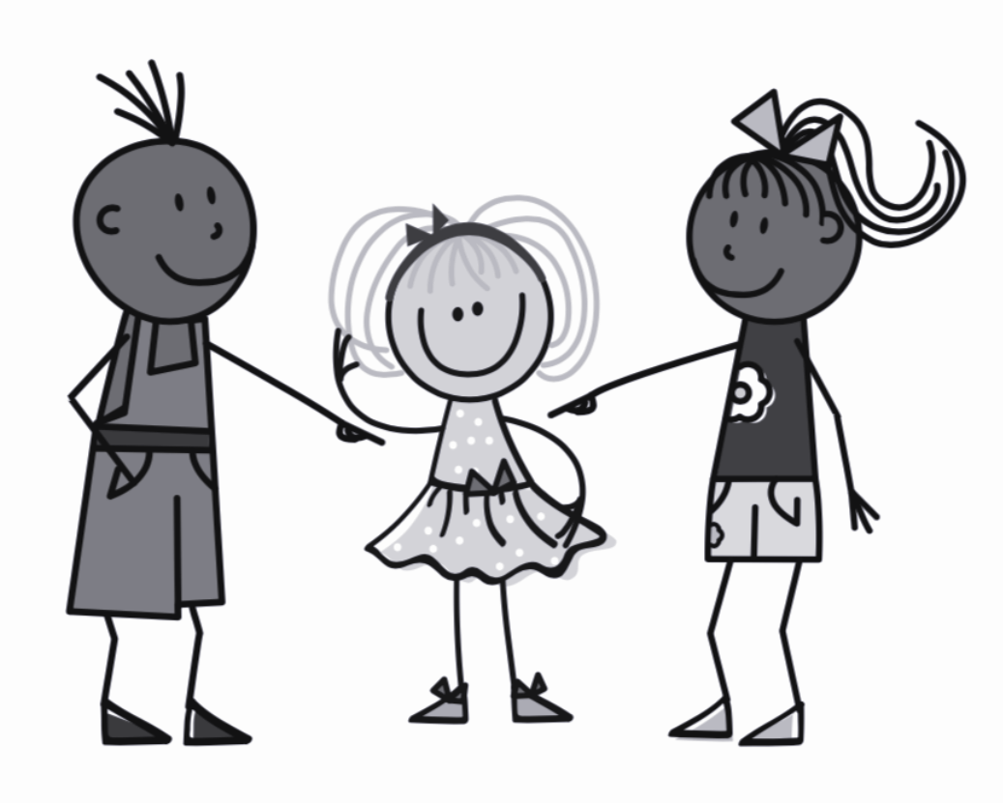
Regular -ir verbs
finir
= to finish
Il finit
Elle finit
= He finishes
= She finishes
The infinitive (to ____, ____ing)
The third person (pronoun + ending)

Slide 7
Regular -ir verbs
finir
= to finish
Ils/Elles finissent
= They finish
The third person plural (pronoun + ending)
The infinitive (to ____, ____ing)

Slide 8
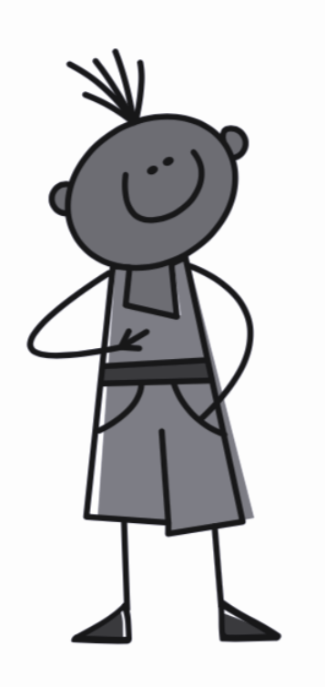
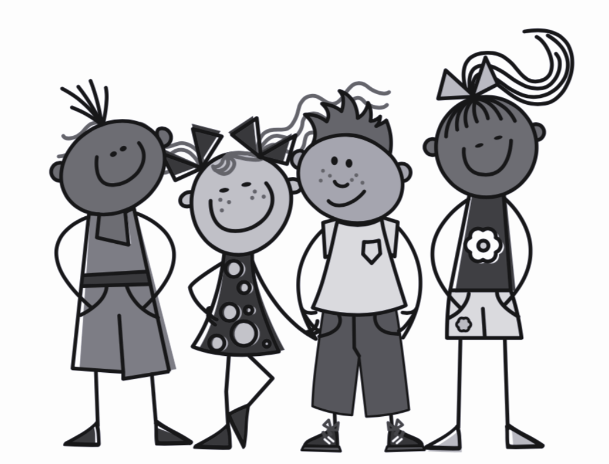
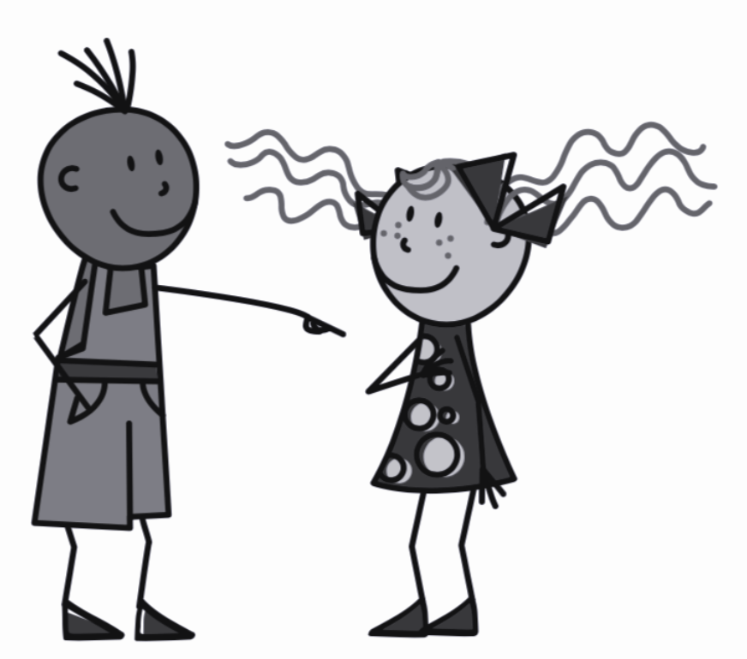
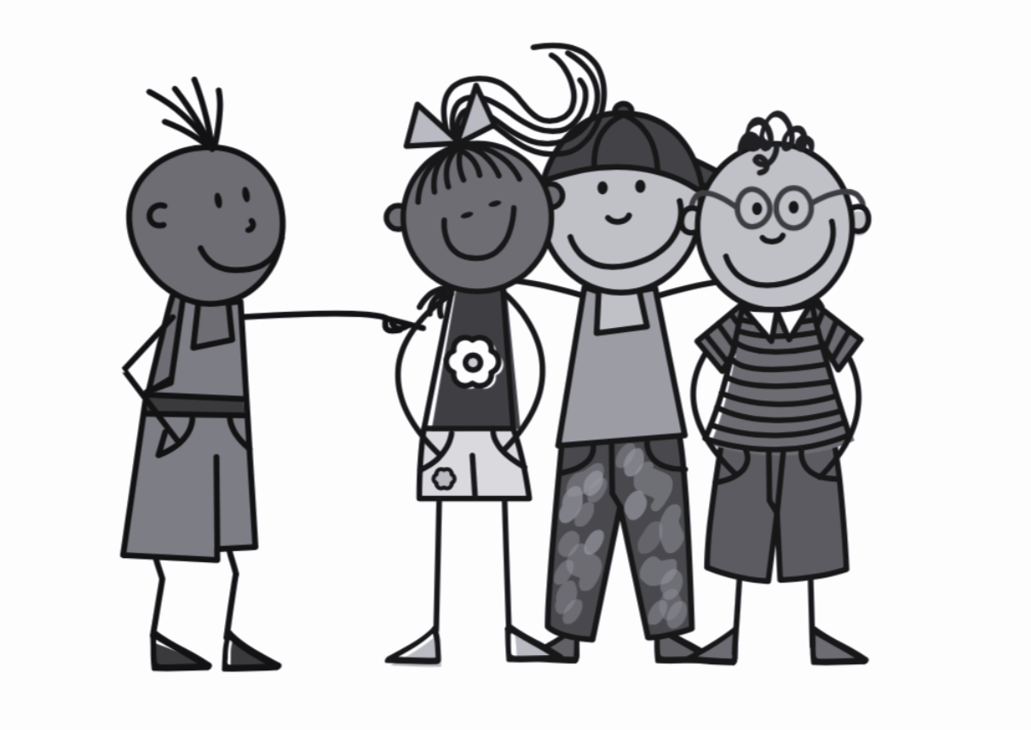
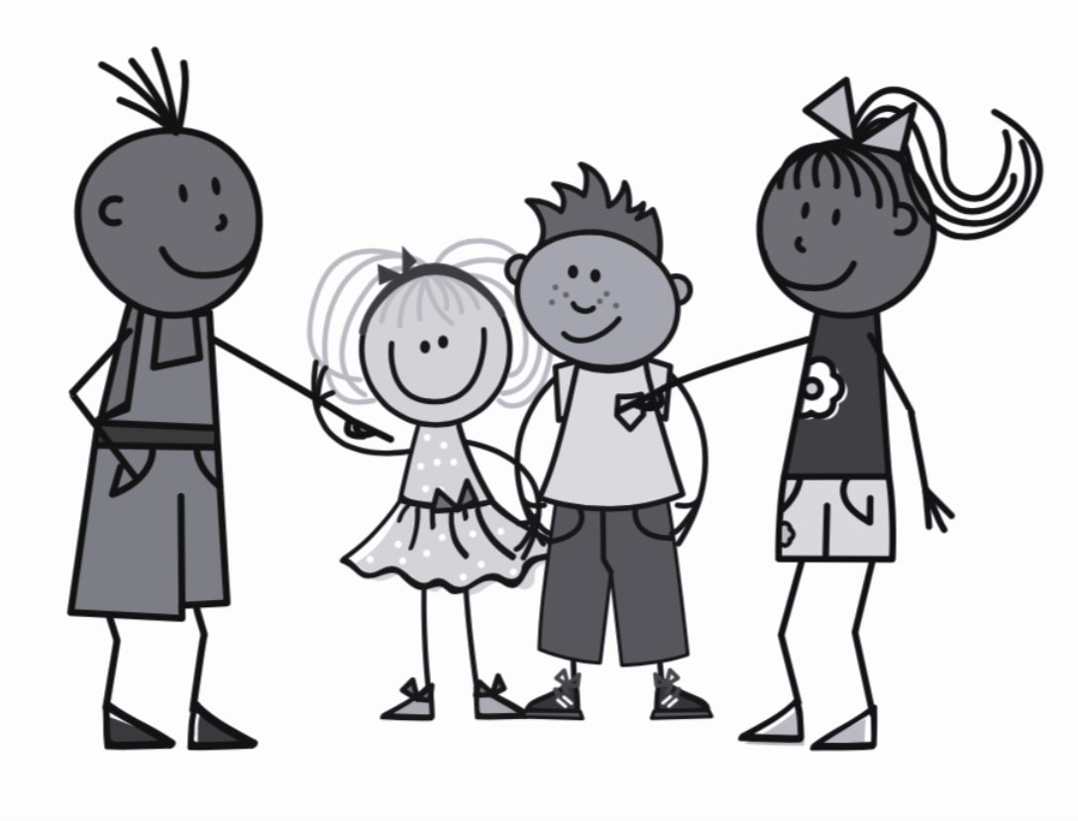
Present Tense - Regular -ir verbs
To form the present tense with a regular IR verb, remove the IR
from the infinitive and add the correct ending.
finir - To finish
Je finis - I finish
Nous finissons - We finish
Tu finis - You finish
Vous finissez - You (pl) finish
Il/Elle finit - He/she finishes
Ils/Elles finissent - They finish

Slide 9
Which ending for fin- | -it | -issent
Il _________ à 8h 30.
2. Elle ______________ les devoirs.
3. Ils ______________ les sandwich.
4. Le prof ______________ le cours.
5. Elles ___________ l’examen.
finit
finit
finissent
finit
finissent

Slide 10
Other regular -IR Verbs include réussir, choisir & nourrir. Let’s take one as an example:
nourrir - To feed
Je nourris - I feed
Nous nourrissons - We feed
Tu nourris - You feed
Vous nourrissez - You (pl) feed
Il/Elle nourrit - He/she feeds
Ils/Elles nourrissent - They feed

Slide 11
Say what you do on a specific day vs as part of a daily routine (Part 1/2)
I finish =
2. He feeds =
3. I feed the cat =
4. They finish =
5. We fill =
Je finis
Il nourrit
Je nourris le chat
Ils / Elles finissent
Nous remplissons

