Slide 1
Physics - Key Stage 3 - Energy
Lesson 4: Efficiency
Mrs Evans

Slide 2
Independent Practice: answer the questions
1. Where is the pendulum moving fastest? and slowest?
2. As the pendulum swings from the left (position 1) to the middle (position 2), which energy store is emptying? which energy store is filling? 3. Will the pendulum swing forever?

Slide 3
Independent Practice:
calculate how efficient the transfer is (to the nearest whole number)?
The candle had 350 J of energy in the chemical store. As it burned, 250 J was transferred by lighting to the surroundings.
Efficiency (%) = | ? J | x 100 (%)
 | ? J
Efficiency (%) = | ? %

Slide 4
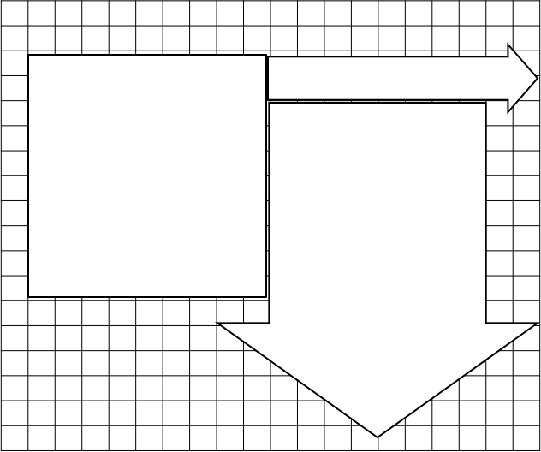
Independent practice: calculate the efficiency
useful
? J
total energy supplied
wasted
10 J
? J
Efficiency (%) = | ? J | x 100 (%)
 | ? J
Efficiency (%) = | ? %

