Slide 1
Discussing Healthy Lifestyles (Part 3/3)
Using three tenses together
Downloadable Resource
Spanish
This lesson contains references to drug and alcohol use.
For some people this will be a sensitive topic. If that
applies to you, you may want to do the rest of this
lesson with a trusted adult nearby who can support you.
Señora Stanley

Slide 2
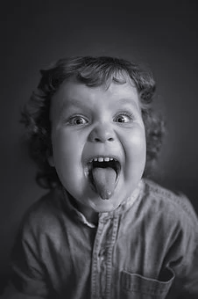
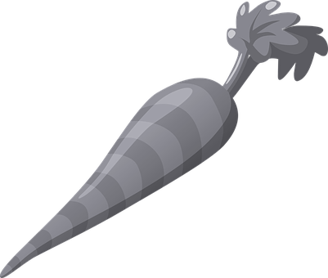
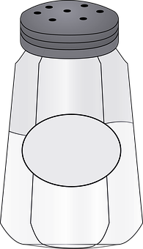
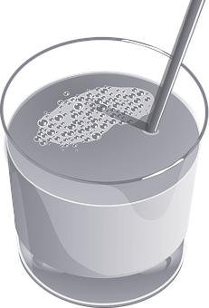
La fonética
[Z]
Durante mi niñez feliz
comía zanahorias
sazonadas con sal
y bebía zumo
de una taza
azul marino

Slide 3
emborracharse | to get drunk
los pulmones | lungs
el corazón | heart
el vicio | vice, bad habit
tomar | to take
perjudicial | damaging
peligroso | dangerous
el fracaso escolar | failure at school
engancharse | to get hooked
darse cuenta de | to realise
tener ganas de | to want to

Slide 4
Combine three tenses together to increase complexity
imperfect
Use __________ for habitual actions in the past.
Antes yo bebía mucho alcohol, pero un día vomité y ahora no bebo tanto.
preterite
Use _________ for completed actions in the past.
Before, I used to drink a lot of alcohol, but one day I vomited and now I don’t drink so much.
present
Use __________ for what you do now.

Slide 5
Combine three tenses together to increase complexity
Un día, cuando hablaba con mi amigo me dijo que ya no tenía ganas de fumar. Lo bueno es que ahora él no fuma nunca.
imperfect
Use __________ for habitual actions in the past.
preterite
Use _________ for completed actions in the past.
One day, when I was talking with my friend, he told me that he didn’t want to smoke any more. The good thing is that now he never smokes.
present
Use __________ for what you do now.

Slide 6
Combine three tenses together to increase complexity
imperfect
Yo comía muchos dulces, sin embargo me he dado cuenta de que es muy malsano y por eso comeré más fruta en el futuro.
Use __________ for habitual actions in the past.
perfect tense
Use _______________ for what has happened.
I used to eat a lot of sweets, however I have realised that it is very unhealthy and therefore I will eat more fruit in the future.
future
Use __________ for what you will do.

Slide 7
Combine three tenses together to increase complexity
preterite
Empecé a fumar hace dos años y me gustaría fumar menos porque estoy enganchado.
Use __________ for completed actions in the past.
conditional
Use _____________ to say what would happen.
I started to smoke two years ago and I would like to smoke less because I am hooked.
present
Use __________ for what happens now.

Slide 8
Jigsaw translation
Hace un año conocí a una chica que se llama Carolina y yo empecé a emborracharme con ella. Todos los fines de semana íbamos al centro donde bebíamos cerveza y comíamos comida rápida. La verdad es que tenía miedo de engancharme. Un día decidí llevar una vida más sana y por eso dejé de salir con ella. Ahora no suelo emborracharme e intento comer bien. He empezado a hacer footing y en unos meses participaré en una carrera.
A year ago I met a girl who is called Carolina and I began to get drunk with her. Every weekend we used to go to the town centre, where we drank beer and ate fast food. The truth is that I was frightened of getting hooked. On day I decided to have a healthier life and therefore I stopped going out with her. Now I don’t tend to get drunk and I try to eat well. I have started to go jogging and in a few months I will take part in a race.

Slide 9
Summary
1 If you use the phrases todos los días or antes to refer to the past, the verb should be in the _________________.
2 If you use the phrases un día or hace una semana the verb should be in the ________________.
3 To say what you have done, use the ____________ tense.
4 En seis meses means _______________
5 El fracaso escolar means _______________

