Slide 1
Independent Living Daily Living Skills
Lesson 3 - Recycling
Oak Specialist
Building Understanding

Slide 2
Unit 3- Daily Living Skills
Lesson 1- Creating a visual schedule
Lesson 2- Getting dressed
How to make and follow a visual schedule for daily activities.
Breaking down the steps of the sequence and creating opportunities for independence.
Lesson 4- Using equipment in the kitchen
Lesson 3- Recycling
Sorting recycling items into different categories.
Labelling kitchen equipment and learning what food to use them with.
Lesson 5- Following a simple recipe
Lesson 6- Daily meals
Following simple steps to make a cheese sandwich.
Choosing food items and matching them to a meal time.

Slide 3
Teacher notes- Recycling
-Learning Intention- To sort items for recycling
What is recycling? Why is it important?
How can we sort items for recycling? What are the common materials?
Recycling sorting game- sorting real items into different bins or boxes.
What else can we recycle? Can you reuse your items?
Resources: recyclable items e.g. magazine, pizza box, drinks can, milk bottle and recycling boxes or bins.
Notes:
This is the equivalent to a loose lesson plan/overview for teachers before starting the lesson.

Slide 4
Lesson Activity Stages
What is recycling?
Materials we can recycle
Sorting items to recycle
Other ways to recycle

Slide 5
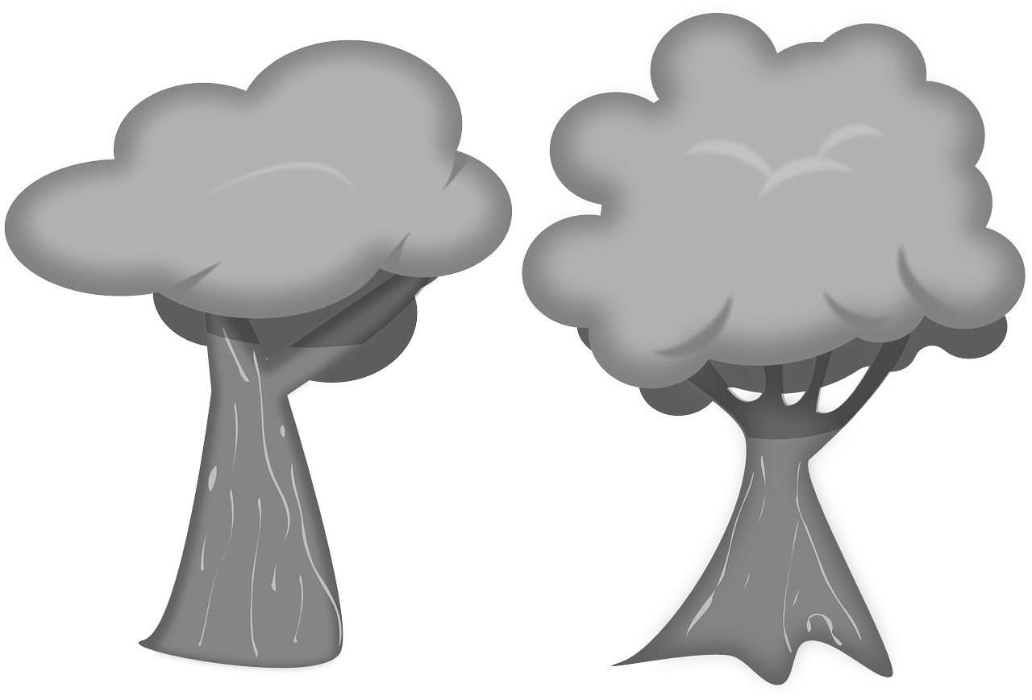
What is recycling?
Recycling means converting waste materials into new materials and objects.
Recycling is important for the environment and our planet.
Notes:
Recycling means converting waste materials into new materials and objects. Do you recognise this sign? Discuss how recycling is important for the environment and our planet. What happens if we don’t recycle? Talk about how rubbish can be left in big rubbish piles and they never disappear. If we recycle and use things again, we can reduce the need to keep making and buying new things.

Slide 6
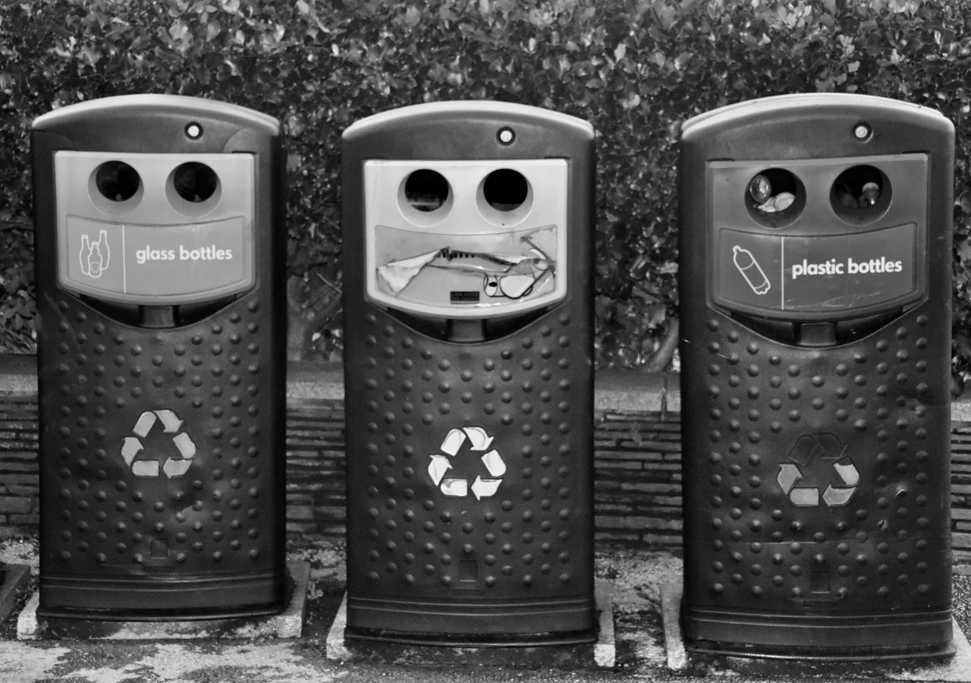
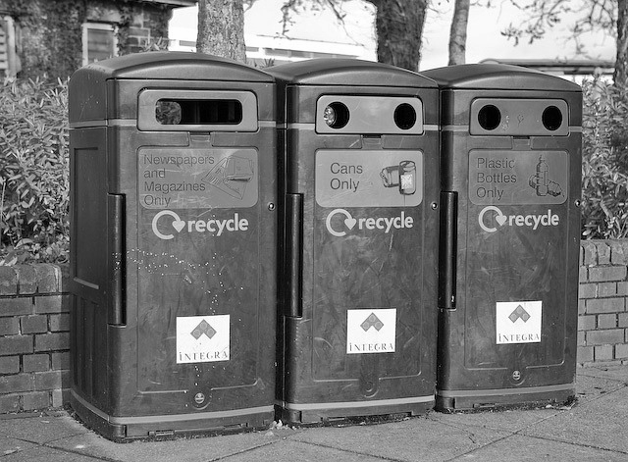
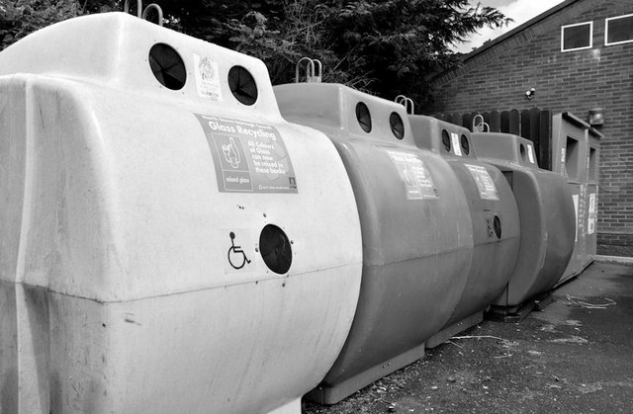
Recycling bins
You may have seen recycling bins in your house, school or community.
Notes:
Have you seen bins like this before? Do you have some at home or school? These bins are used to help us recycle our items. On the front there are symbols and words to help us know which bin to put our items in. Sometimes they are different colours to help us.

Slide 7
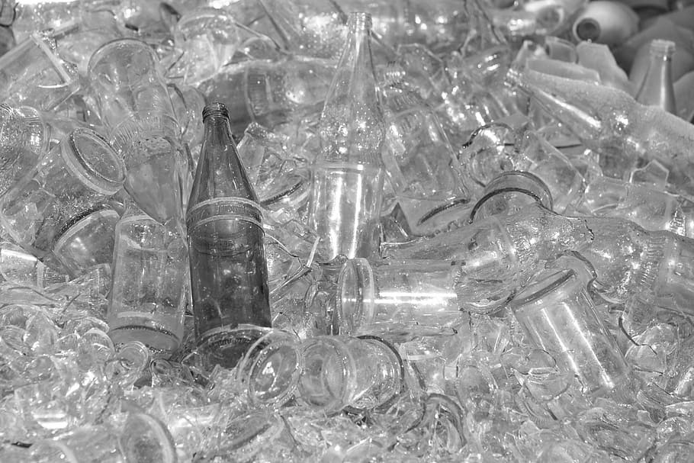
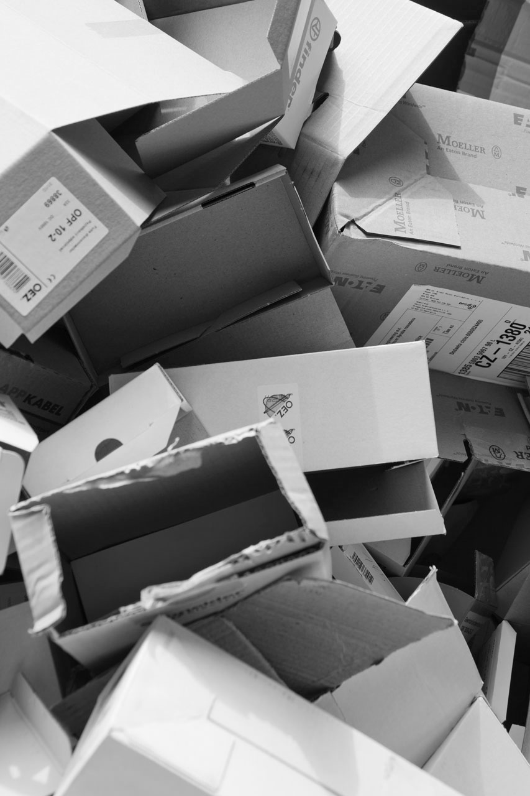
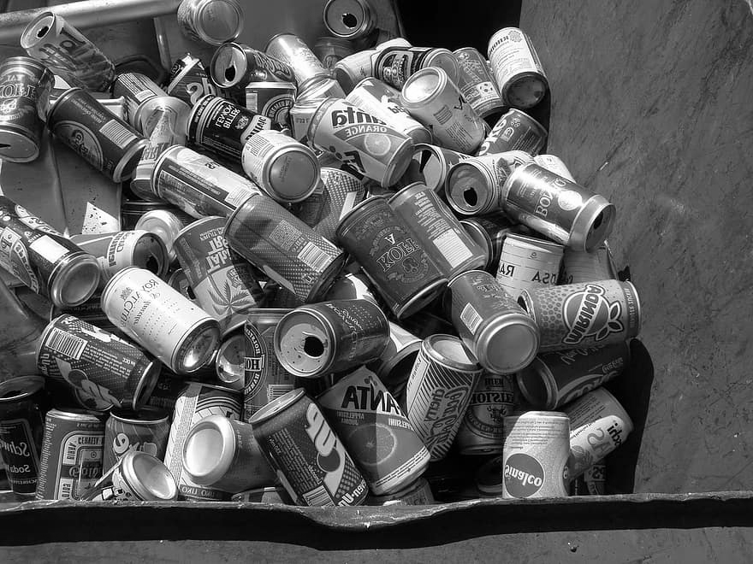
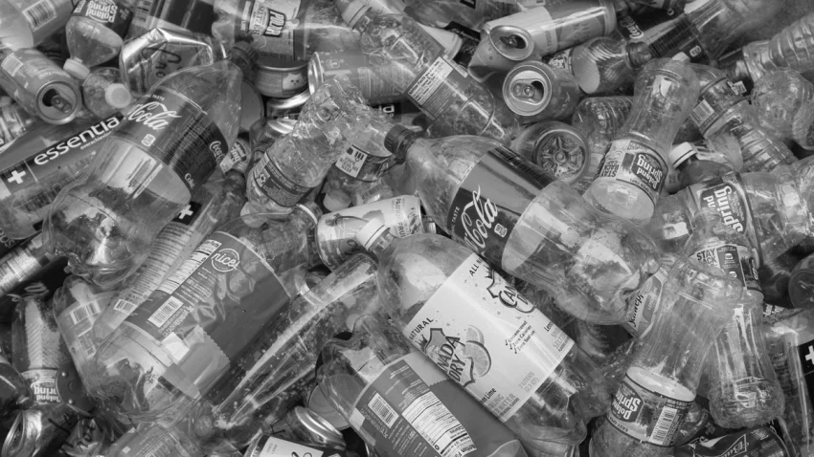
Recycling materials
It is important to sort our waste to recycle. Can you name these materials?
glass
cardboard
cans
plastic
Notes:
There are different materials that we can sort our recycling by. Can you name the materials? What items do you see? There are more materials that we can recycle but we’re going to learn about these four in this lesson.

Slide 8
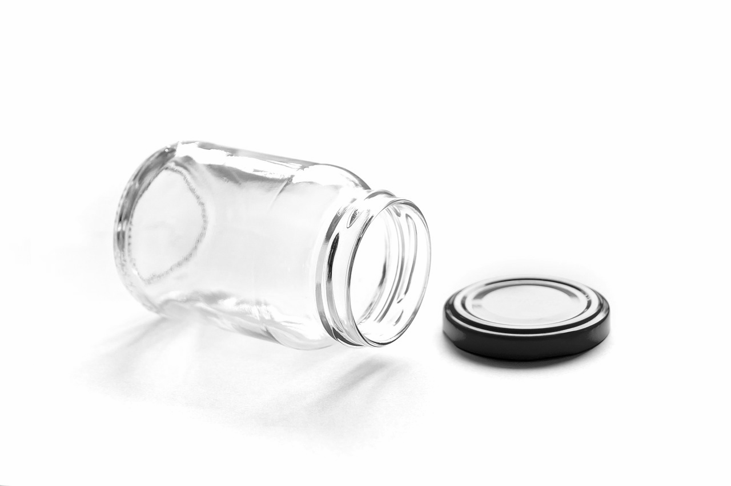
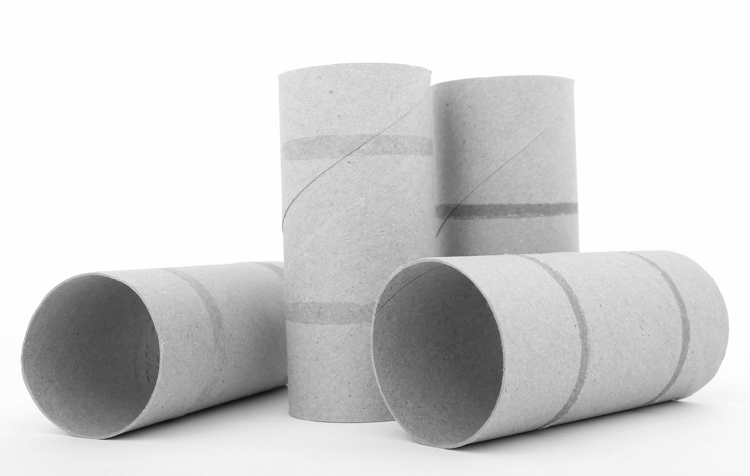
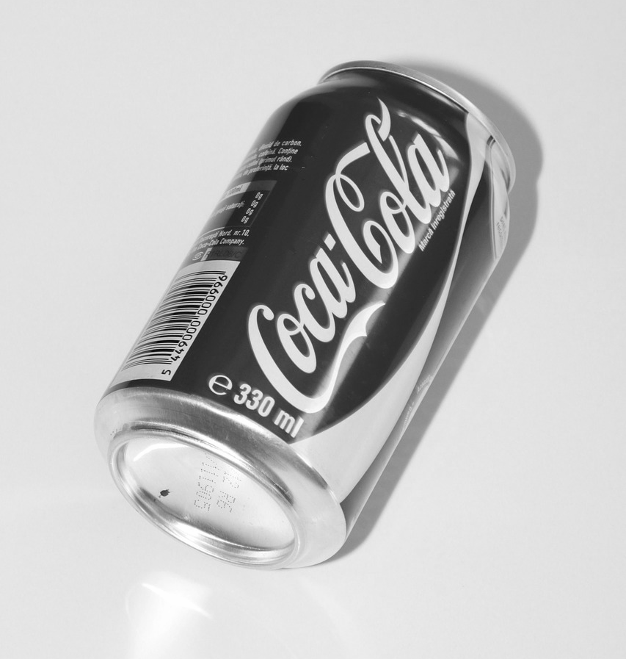
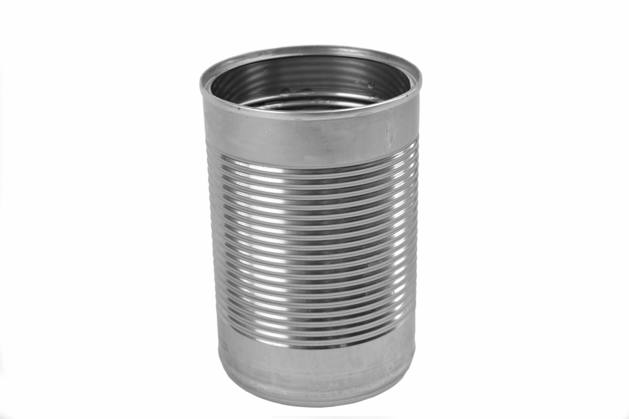
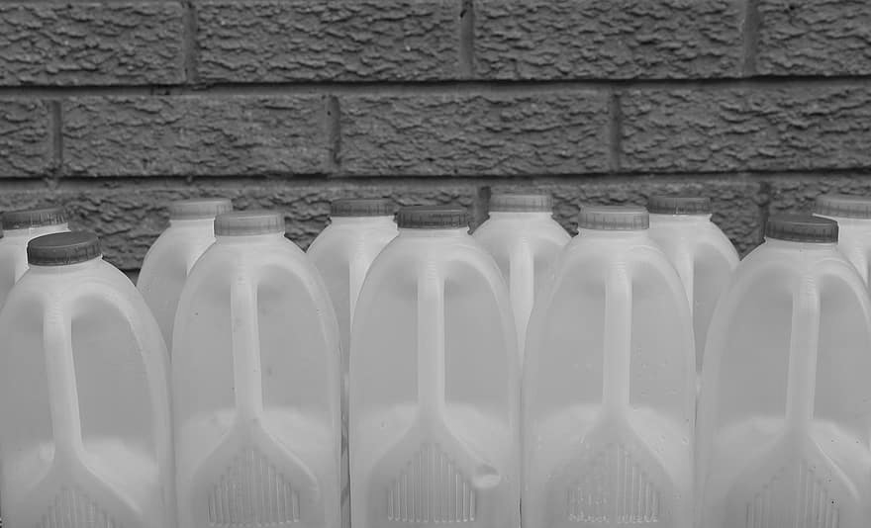
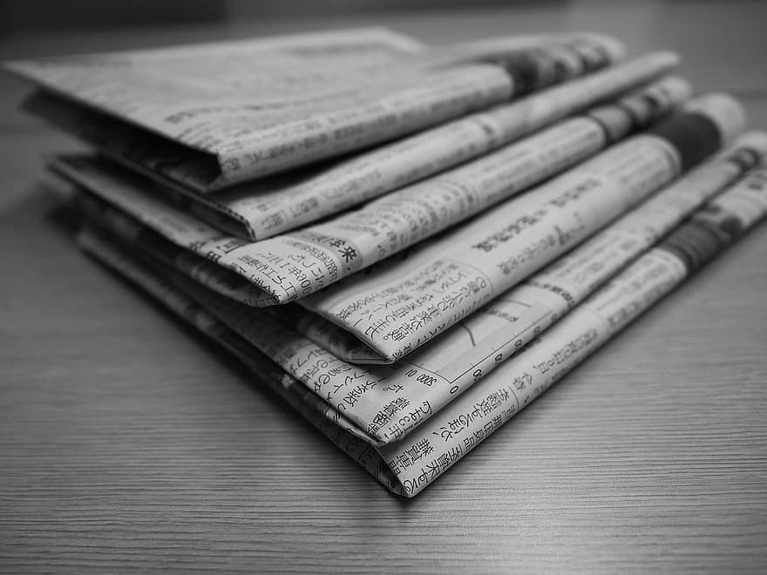
Items to recycle
These are some household items that we can recycle. What can you see?
Notes:
We cannot recycle everything but here are some household items we can recycle. What items can you see? Do you have any items like this in your house?

Slide 9
Sorting the recycling
Can you sort the items into the correct recycling bin?
glass
cans
plastic
cardboard
Notes:
We know we can sort into four categories- glass, cans, plastic and cardboard. Can you sort the items for recycling into the correct bins? Have a look on the side of the bin to help you know which bin is for what material. Point to each item, label it and then choose which bin you think it should go in.

Slide 10
Slides
Great recycling!
glass
cans
plastic
cardboard
Notes:
Did you sort the items correctly? You could talk about that tins and cans are made from aluminium and that is why they are grouped together.

Slide 11
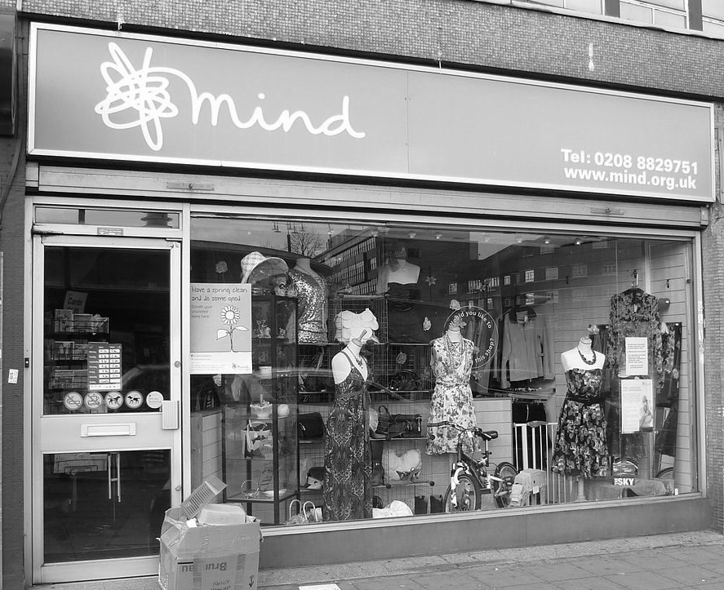
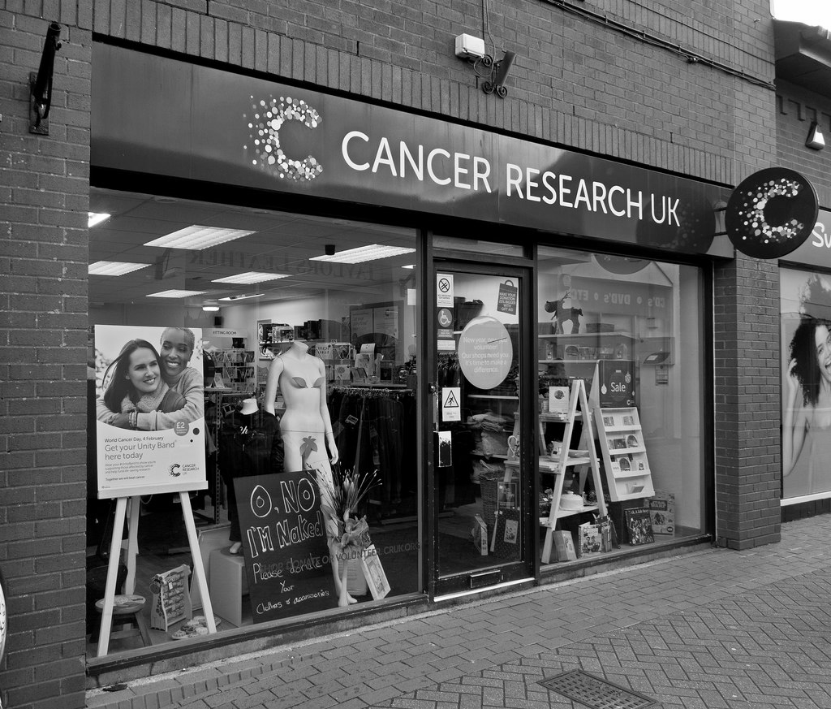
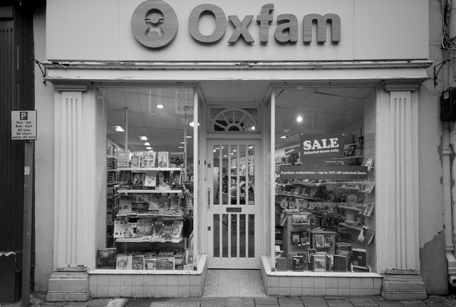
Re-use
To help the environment and our planet, we can also re-use our items.
We can take our old toys and clothes to charity shops for others to buy and use.
Do you recognise any of these shops?
Notes:
Have you been to a charity shop before? You can take your old items and buy items that have been used by others usually for less money. This helps to reduce waste and also helps charities raise money.

Slide 12
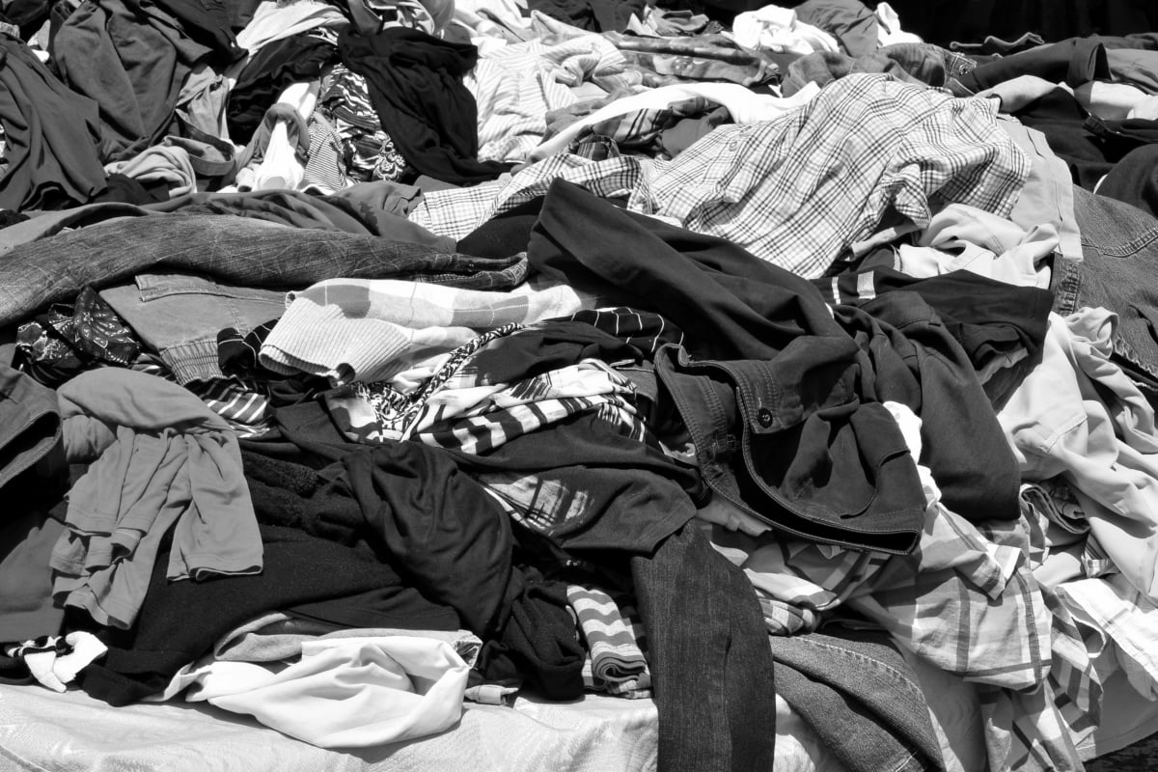
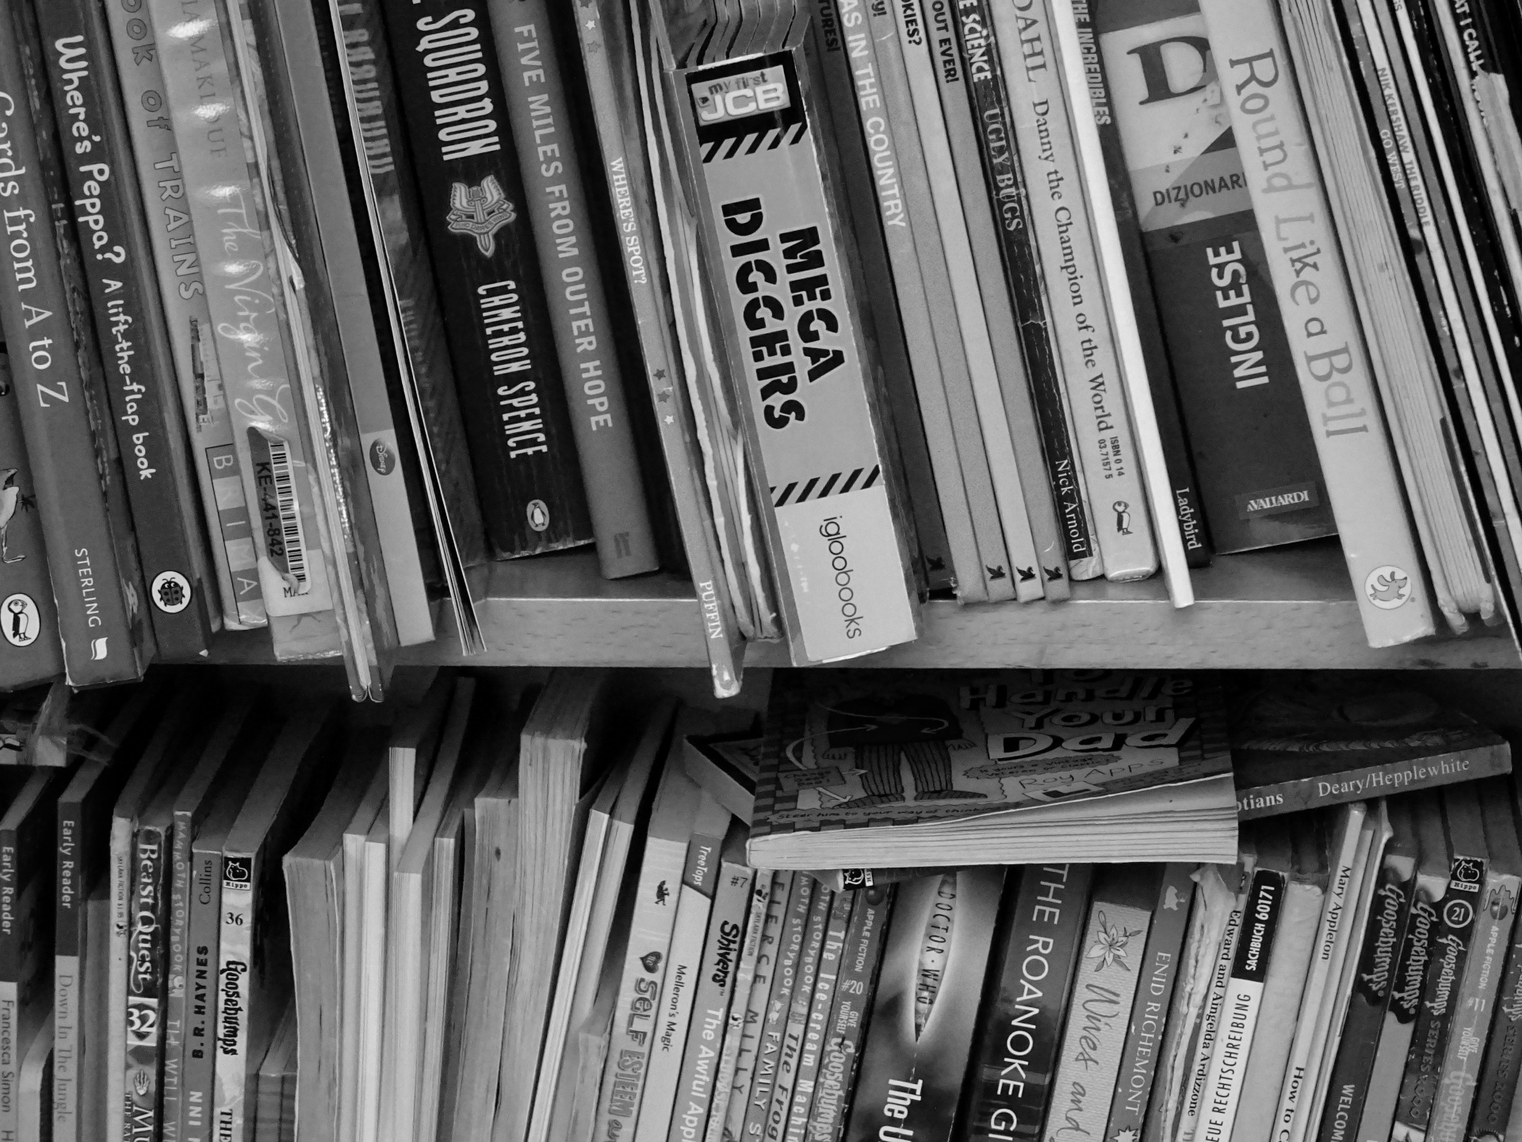
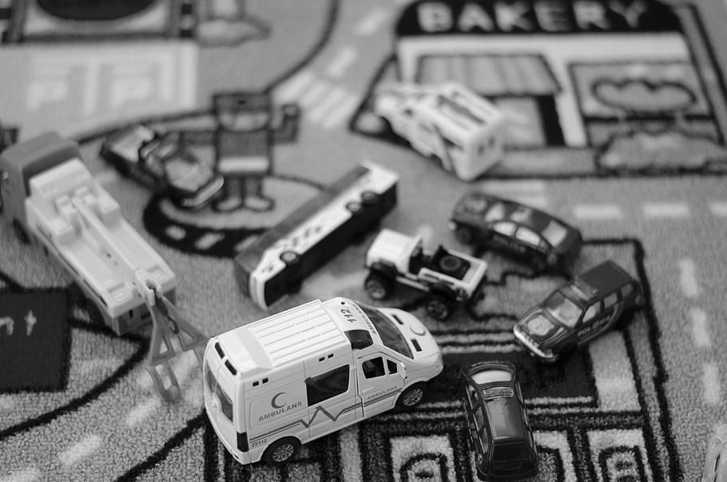
Activity
Collect items in your home and sort them into the correct boxes for recycling.
Look at your books, toys and clothes. If you have finished with them, choose a charity shop to take them to instead of throwing them in the bin.
Notes:
Collect items in your home and use your bins to recycle the items. Each local authority will have different coloured bins for different materials. Research what other materials you can recycle. Can you re-use some old toys, books or clothes by taking them to the charity shop?

Slide 13
Independent Living
Daily Living Skills
Recycling: Suggest adaptations for teachers/parents/carers.
Make it easier
Make it harder
More ideas
With a parent/carer watch videos online or television programmes related to the environment and sorting materials.
Just use two bins to sort with.
Research other materials that you can recycle. What is a landfill site?
Research alternatives to buying plastic.
What can you make with your items for recycling? Search online with parent/carer for recycled art projects.
Visit your local recycling centre to see what other waste we can dispose of safely.
Notes:
Final slide of the lesson. Suggest adaptations for teachers/parents.

Slide 14
Further Learning with Oak National
Independent Living:
Applying Learning- Recycling (Unit 3)
Communication and Language
Building Understanding/Applying Learning- Our World (Unit 5)
Numeracy:
Building Understanding/ Applying Learning- Shape and sorting (Unit 2)
Notes:
Insert info for subject/lesson name/stage (if appropriate)

Slide 15
References
Slide 8- Northern_Punkie, Pixabay / Recycling bins, Albert Bridge, Geograph / Colour-coded recycling bins, GeographBot, Wikimedia Commons
Slide 9- Glass Bottle, Pxfuel / Empty cardboard boxes, Publicdomainpictures / Recycling, Pikist / Bottles and cans, NBC New York
Slide 10- Glass Jar, Devonath, Pixabay / Coke Can, Byrev, Pixabay / Toilet Roll, Shutterbug75, Pixabay / Plastic Milk Bottle, Pikist / Newspaper, Pikist / Envelope, Pxhere / Empty tin can, Sun Ladder, Wikimedia Commons
Slide 11- Recycling Box, OpenClipart-Vectors, Pixabay / Plastic Bottle, Clker-Free-Vector-Images, Pixabay / Cardboard Box, OpenClipart-Vectors, Pixabay, Cans, Clker-Free-Vector-Images, Pixabay / Recycling box, OpenClipart-Vectors, Pixabay
Slide 13- Cancer Research charity shop, Roger A Smith, Geograph / Mind charity shop, Philafrenzy, Wikimedia Commons / Oxfam Charity Shop, Roger A Smith, Geograph
Slide 14- Toy ambulance, Pxfuel / Books on a shelf, Video Girl , Publicdomainpictures / Clothes, istock, Pixnio
Notes:
Insert info for subject/lesson name/stage (if appropriate)

