Slide 1
Talking about extra-curricular activities (Part 2/2)
Using the present and imperfect tenses together
Revisiting negatives
Downloadable Resource
French
Madame Williams

Slide 2
[ e ]
[ ai ]
je
j’ai

Slide 3
avoir du temps libre | to have free time
avoir beaucoup d’amis | to have lots of friends
avoir trop de devoirs | to have too much homework
faire partie d'un club de musique | to be part of a music club
chanter dans une chorale | to sing in a choir
être délégué(e) de classe | to be the class representative
être membre de l’équipe de netball | to be a member of the netball team
jouer à cache-cache | to play hide and seek
jouer dans l’orchestre | to play in the orchestra
participer au spectacle de l’école | to take part in the school show
The infinitive can also be translated by the gerund.
Jouer à cache-cache - to play hide and seek AND playing hide and seek.

Slide 4
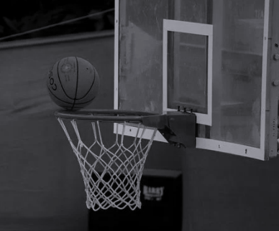
Using the present tense
J’ai trop de devoirs
Je suis membre de l’équipe de basket
Je fais partie d’un club d’échecs
I have too much homework
I am a member of the basketball team
I’m part of a chess club

Slide 5
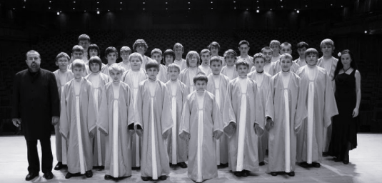
Using the imperfect tense to say what I used to do
Je faisais partie d’un club d’échecs
J’avais trop de devoirs
I used to have too much homework
I used to be part of a chess club
Je chantais dans une chorale
J’étais membre de l’équipe de basket
I used to sing in a choir
I used to be a member of the basketball team

Slide 6
Improving listening skills
Don’t rely on the time indicator to tell you when the action happens.
Listen for [ai] to indicate the imperfect tense.
2. Beware of exceptions.
Je fais = I do Je faisais = I used to do
J’ai = I have
J’avais = I had / I used to have
Je chantais dans une chorale
I used to sing in a choir

Slide 7
Using negatives
Place ne or n’ before a verb and pas after a verb to make a sentence negative.
The word pas can be replaced by jamais, plus or rien to alter the meaning of the sentence.
Ne and jamais - never
Ne and plus - no longer / anymore
Ne and rien - anything

Slide 8
Extra-curricular activities. Part 2
I used to be in a chess club
2. I used to be a member of the football team
3. I no longer sing in a choir
4. I do not do anything
5. because I have too much homework
Je faisais partie d’un club d’échecs
J’étais membre de l’équipe de foot.
Je ne chante plus dans une chorale
Je ne fais rien
car j’ai trop de devoirs

