Slide 1
Discussing Healthy Lifestyles (Part 1/3)
Reflexive and non-reflexive use of verbs in the present tense
Downloadable Resource
Spanish
Señora Stanley

Slide 2
[Z]
zona

Slide 3
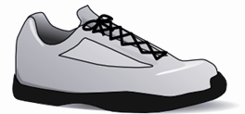
La fonética
[Z]
diez
voz
cabeza
zona
zapato

Slide 4
emborracharse | to get drunk
los pulmones | lungs
el corazón | heart
el vicio | vice
tomar | to take
perjudicial | damaging
peligroso | dangerous
el fracaso escolar | failure at school
engancharse | to get hooked
darse cuenta de | to realise
tener ganas de | to want to

Slide 5
Using verbs reflexively
When you use a verb reflexively, the infinitive ends in “se” e.g. llevarse.
A verb is reflexive when the subject and the object are the same.
Ejemplo: Me lavo. I wash myself.
Words like ‘myself’ or ‘himself’ are called reflexive pronouns.
When you use the infinitive of a reflexive verb, the pronoun has to agree with the subject:
Quiero lavarme. I want to wash myself.

Slide 6
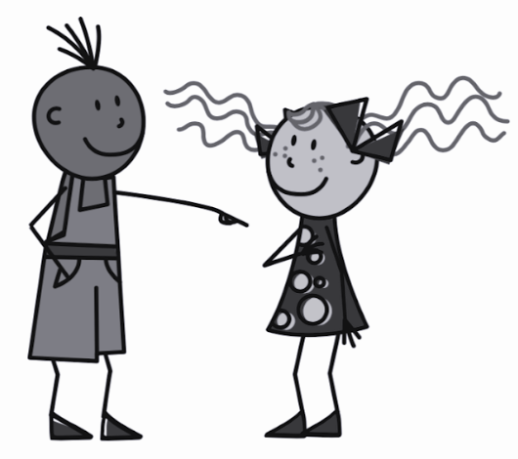
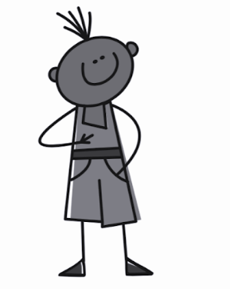
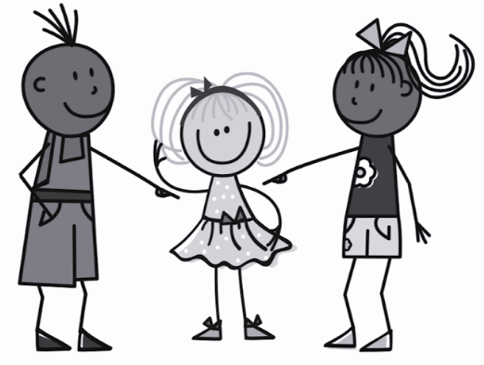
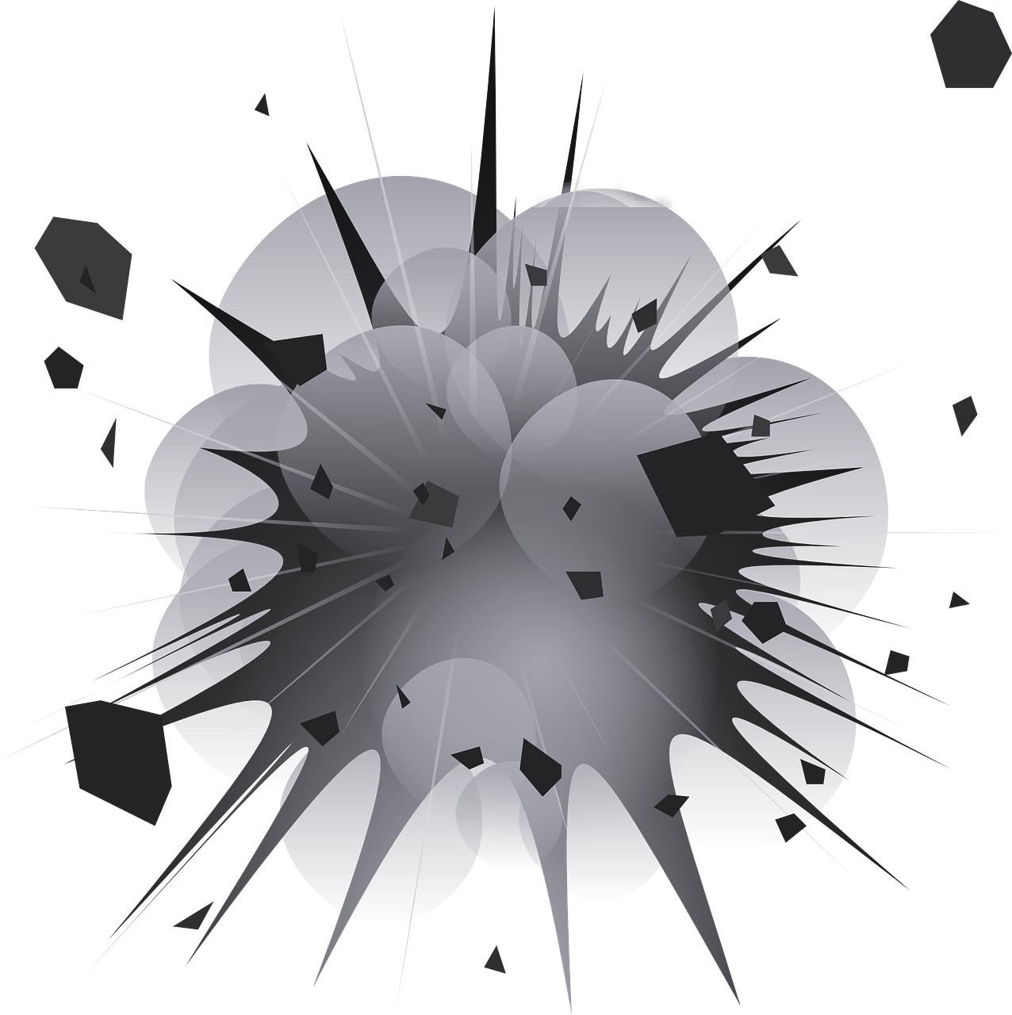
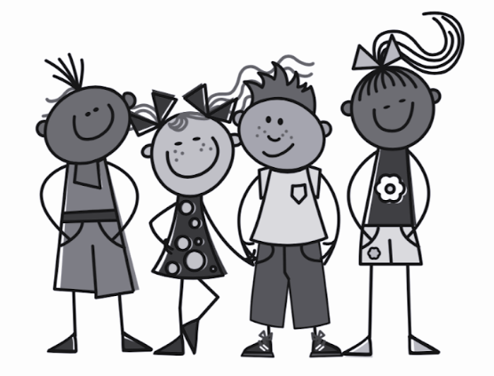
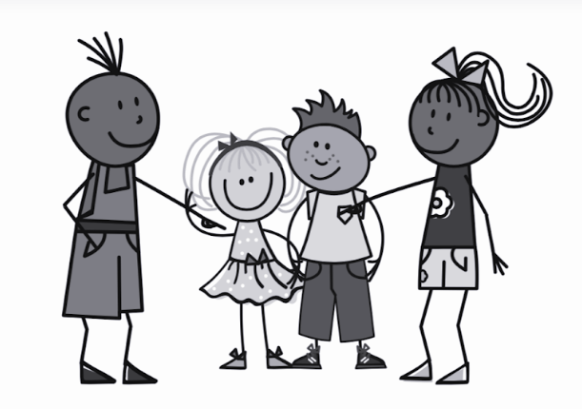
Reflexive pronouns
you
myself | me
yourself | te
him/herself | se
ourselves | nos
themselves | se
te enganchas
me engancho
I
s/he, it
se engancha
Engancharse - to get hooked
we
nos enganchamos
They
se enganchan

Slide 7
Almost any verb can be ‘reflexive’.
comprar - to buy
Compro una bicicleta.
I buy a bicycle.
Me compro una bicicleta.
I buy myself a bicycle.
Some verbs change in meaning when they are reflexive.
dar - to give
darse cuenta de (que) - to realise (that)
Doy un regalo a mi amigo.
Me doy cuenta de que el alcohol es perjudicial.
I give / I’m giving a present to my friend
I realise / I am realising that alcohol is harmful.

Slide 8
Reflexive verb or not?
 |  | English
1 | Mi amiga María nunca se emborracha. | My friend Maria never gets drunk.
2 | Tú te das cuenta de que los cigarrillos son peligrosos. | You realise that cigarettes are dangerous?
3 | Ellos no se enganchan a las drogas. | They don’t get hooked on drugs.
4 | Mi amigo y yo no nos emborrachamos. | My friend and I do not get drunk.
5 | Yo le doy una hamburguesa a Juan. | I give a hamburger to Juan.
6 | Pienso que mis amigos no toman drogas. | I think that my friends don’t take drugs.

Slide 9
‘Me’ does not always mean that the verb is reflexive
Remember that if a verb is reflexive the subject and object
are the same.
Me relaja it relaxes me
Me ayuda it helps me
The subject (it) and object (me) are not the same, so the verb is not being used reflexively.
The word order is different in Spanish

Slide 10
Is the verb being used reflexively or not?
 |  | Reflexive | Not reflexive | Translation
1. | El alcohol no me ayuda a descansar. |  |  | Alcohol doesn’t help me to rest.
2. | Me emborracho a veces. |  |  | Sometimes I get (myself) drunk.
3. | No quiero engancharme a las drogas. |  |  | I don’t want to get (myself) hooked on drugs.
4. | Beber café me relaja. |  |  | Drinking coffee relaxes me.
5. | Me compro una hamburguesa. |  |  | I buy (myself) a hamburger.

Slide 11
Lee y pon las palabras en el orden correcto.
Yo tengo muchos vicios y creo que es peligroso para el corazón y los pulmones. Por ejemplo, fumar es perjudicial pero yo estoy enganchado. Me doy cuenta de que tomar alcohol es malo, sin embargo me emborracho a menudo. Tengo ganas de dejar porque el fracaso escolar me da miedo.
peligroso
A
B
C
D
tomar
E
F
G
H
emborracho
doy
vicios
ganas
pulmones
fracaso

Slide 12
If a verb is ‘ ____________’ , the subject and object are the same.
The reflexive pronoun ‘me’ means _________.
‘Me relaja’ is not reflexive because the ________ and object of the verb are different.
When a reflexive verb is written in the infinitive, the reflexive pronoun has to agree with the ______________ of the verb.
Emborracharse means _____________________.

