Slide 1
Lesson 2- Reaction rate graphs
Chemistry- Key Stage 3
Energetics
Miss Charlton

Slide 2
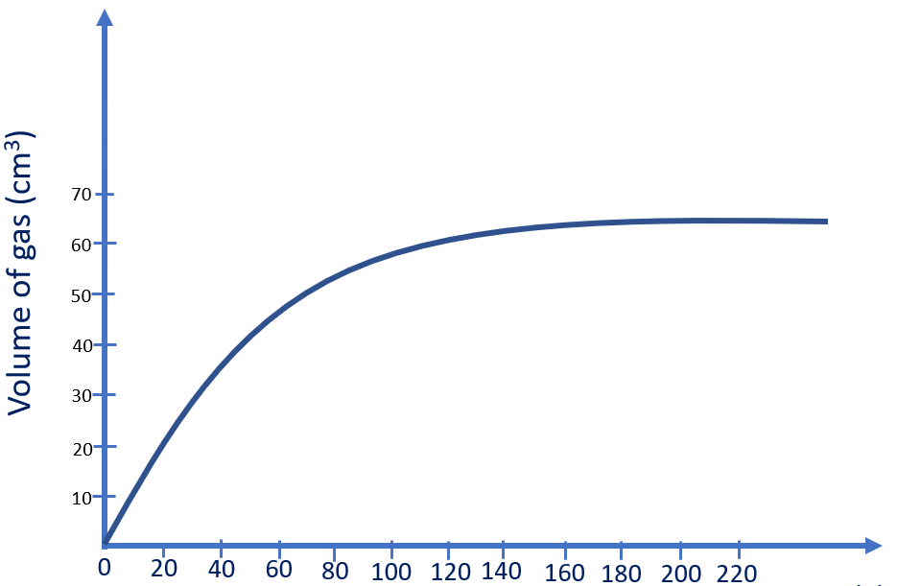
Questions
Using the graph:
Describe the trend in the graph.
Calculate the volume of gas produced in 40 seconds.
Calculate the volume of gas produced between 20 seconds and 40 seconds.
Time (s)

Slide 3
Rate of reaction
Question 1
Describe what happens to the rate of the reaction throughout a chemical reaction.
Question 2
Explain why the rate of reaction is fastest at the start of a reaction.

Slide 4
Questions
Time (s) | Volume of carbon dioxide produced (cm³)
 | Test 1 | Test 2 | Test 3 | Mean
0 | 0 | 0 | 0 | 0
20 | 22 | 21 | 35 | 22
40 | 44 | 45 | 45
60 | 60 | 47 | 61
80 | 71 | 68 | 70
100 | 80 | 72 | 75
Calculate the mean. The first 2 have been done for you.
Identify anomalies
Exclude anomalies from mean calculation
Round to correct number of decimal places (this must be the same as data in the table).

Slide 5
Answers

Slide 6
Answers
Using the graph:
Describe the trend in the graph.
As time increases, the volume of gas produced also increases. After 160 seconds the volume of gas does not increase any further suggesting the reaction is finished.
Calculate the volume of gas produced in 40 seconds.
30 cm³
Calculate the volume of gas produced between 20 seconds and 40 seconds.
20 seconds = 20cm³ 40 seconds = 30cm³
30 - 20 = 10 cm³

Slide 7
Rate of reaction
Question 1
Describe what happens to the rate of the reaction throughout a chemical reaction.
At the start of a chemical reaction the rate of reaction is the fastest as there is a higher concentration of reactants which collide more frequently. As more product is made the rate of reactions begins to slow down as the reactants collide less frequently, until there are no reactants left to react together and the reaction stops.

Slide 8
Rate of reaction
Question 2
Explain why the rate of reaction is fastest at the start of a reaction.
At the start of the reaction we have a high concentration of reacting particles, this makes the rate of reaction faster as the reacting particles will collide more frequently.

Slide 9
Answers
Time (s) | Volume of carbon dioxide produced (cm³)
 | Test 1 | Test 2 | Test 3 | Mean
0 | 0 | 0 | 0 | 0
20 | 22 | 21 | 35 | 22
40 | 44 | 45 | 45 | 45
60 | 60 | 47 | 61 | 61
80 | 71 | 68 | 70 | 70
100 | 80 | 72 | 75 | 74
Calculate the mean. The first 2 have been done for you.
Identify anomalies
Exclude anomalies from mean calculation
Round to correct number of decimal places (this must be the same as data in the table).

