Slide 1
Distinguish between parts and wholes [1 / 2]
Verb acheter
Partitive articles
French
Madame Sooden

Slide 2
[ oi ]
trois
droite
Pourquoi ?
[why?]

Slide 3
[ u ]
amusant
utiliser
[to use]
sur
[on]

Slide 4
[ ê / è ]
fête
collège
frère

Slide 5
Vocabulary list for this lesson:
En français
En anglais
la glace | ice-cream
le poisson | fish
le pain | bread
l’agneau | lamb
5
4
3
2
1

Slide 6
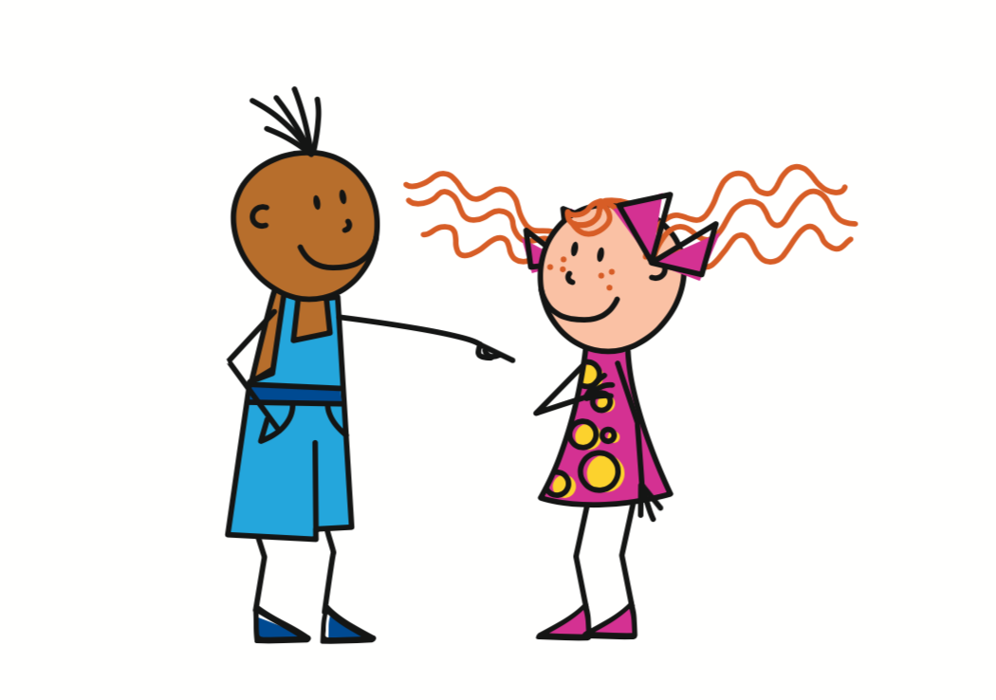
Acheter
- to buy
J’achète
= I buy
Tu achètes
= You buy
1st person singular (pronoun + verb)
2nd person singular (pronoun + verb)

Slide 7
Acheter
- to buy
Il achète
= He buys
Elle achète
= She buys
3rd person singular (pronoun + verb)
3rd person singular (pronoun + verb)

Slide 8
Partitive articles - To say 'some' in French/refer to part of a noun.
Before a masculine noun:
some
de | le
du
du pain
Before a feminine noun:
some
de | la
de la
de la glace
Before a noun with a vowel / h:
some
de | l’
de l’
de l’agneau

Slide 9
Distinguish between parts and wholes
1 | Conjugate acheter : il ______.
2 | Conjugate acheter : tu ______.
3 | Identify the partitive article : une / du
4 | Translate ‘un poisson’ into English.
5 | Translate ‘du poisson’ into English.
6 | Translate ‘I buy some bread’ into French.
achète
achètes
du
a fish
some fish
j’achète du pain

