Slide 1
Solve problems involving the calculation of percentages of amounts
Mathematics
Miss Parsons

Slide 2
Question 1
Calculate the discounted prices for these objects.

Slide 3
Question 2
Hassan scored 75% on a grammar test. There were 96 marks.
Lawind sat a different test with 80 marks. He got 4/5 correct.
Who got more correct answers? Convince me.

Slide 4
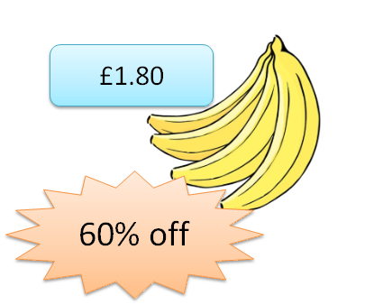
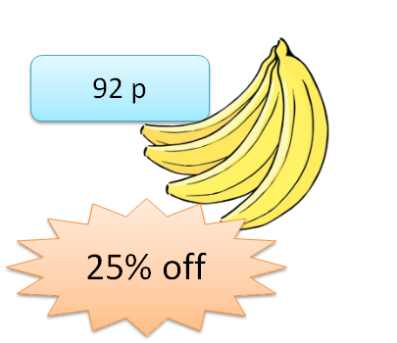
Question 3
Two supermarkets have offers on identical bunches of bananas. Youcef decides the offer at supermarket A is cheaper because they offer a greater percentage decrease. Is Youcef right?
Supermarket A
Supermarket B

Slide 5
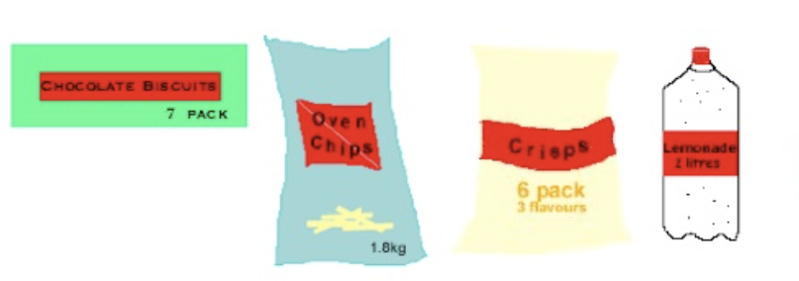
Question 4
Here is your shopping list:
2 bottles of lemonade
1 six pack of crisps
4 packets of biscuits
1 bag of chips
How much would you pay in total?
Biscuits
were 54p
now 50% off!
Oven Chips
were £1.60
now 25% off!
Crisps
were £1.20
now 35% off!
Lemonade
was 55p
now 20% off!
Credit: NRICH

