Slide 1
Combined Science - Chemistry - Key Stage 4
Atomic Structure & the Periodic Table
Group 7 displacement reactions
Dr Patel

Slide 2
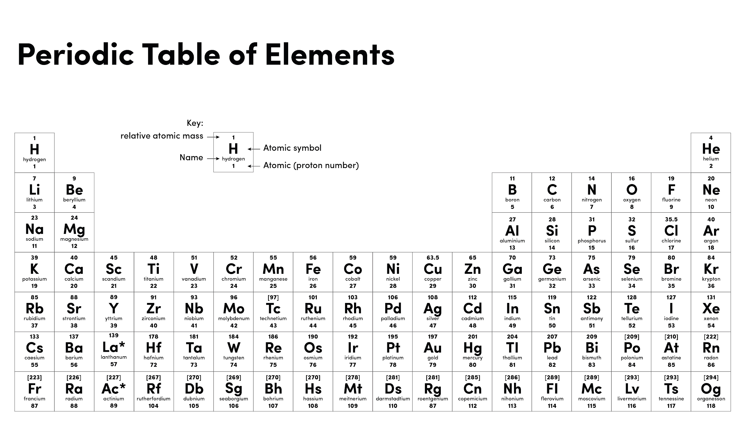

Slide 3
Warm up
What name is given to group 7 elements?
How many electrons do group 7 elements have in their outer shell?
Do group 7 elements lose or gain electrons when they react?

Slide 4
Independent practice
A student has obtained the results below.
Which halogen is the most reactive, and explain why using the student’s results?
Which halide was bromine able to displace?
 | Fluorine | Chlorine | Bromine | Iodine
Potassium fluoride
Potassium chloride
Potassium bromide
Potassium iodide

Slide 5
Independent practice
For each reaction below complete the equation, and state the colour change that would be observed. If there is no reaction, state there is no reaction.
Sodium iodide + chlorine
Sodium bromide + chlorine
Sodium chloride + iodine
Challenge:
Have a go at writing a balanced symbol equation for any reactions that occur
➝
➝
➝

