Slide 1
Talking about local actions
3rd person singular/plural of present subjunctive
Downloadable Resource
Spanish
Señora Stanley

Slide 2
Talking about local actions
your understanding of the near future tense.
Phonics - n / ñ
Vocabulary
Grammar - present subjunctive (focus on s/he and they)
Listening
Reading - gap fill
Speaking
Writing

Slide 3
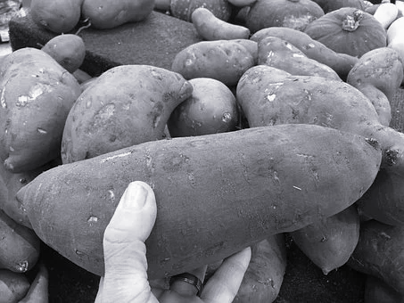
[n]
[ñ]
Ñoño Yáñez no come ñame en las mañanas con el niño porque nunca necesita desayunar.

Slide 4
la basura | rubbish
el calentamiento global | global warming
la contaminación | pollution
el árbol | tree
la naturaleza | nature
el aparato eléctrico | electrical appliance
el río | river
la sequía | drought
ahorrar | to save
malgastar | to waste

Slide 5
Present subjunctive - s/he
The present subjunctive is used when expressing points of view after es + adjective + que to insist or advocate that something happens.
For s/he (third person singular) add swapped present endings to the stem:
These endings are also used for the I form of the subjunctive
-ar verbs add -er ending
(for example usar)
-er/ir verbs add -ar ending (for example vivir)
use
viva
Es importante que use menos agua
Es esencial que viva en una casa ecológica

Slide 6
Present subjunctive - they
Add swapped present tense endings to the stem:
-ar verbs, for example reciclar
Add present tense -er verb ending
-er/-ir verbs, for example comer
Add present tense -ar verb ending
reciclen
coman
Es necesario que reciclen el papel.
Es recomendable que coman fruta.

Slide 7
Present subjunctive (they)
Where verbs have irregular 1st person forms, these are used to form the present subjunctive:
These verbs use the same swapped present tense endings:
- ar verbs use -er verb endings
-er/-ir verbs use -ar verb endings.
tener - tengo tengan
hacer - hago hagan
These verbs are irregular:
ir - vayan
ser - sean

Slide 8
Indicative or subjunctive?
 | indicative | subjunctive | English
1. |  |  | It is important that they save water.
2. |  |  | It is essential that they clean the rivers.
3. |  |  | My grandparents always turn off the electrical appliances.
4. |  |  | It is necessary that they recycle the rubbish.
5. |  |  | In the school the children plant lots of trees.

Slide 9
Present subjunctive - spelling change
Verbs ending in -gar
For example, apagar - to switch off
Stem: apag + ending
In order to keep the hard “g” sound, add u before the ending:
apague - I / s/he
apaguen - they

Slide 10
Lee y escribe el verbo en la forma correcta
1 Mis padres siempre __________ (apagar) los aparatos eléctricos.
2 Es esencial que ellos _______ (apagar) las luces también.
3 Es importante que mi hermano _______ (usar) menos agua a causa de la sequía.
4 Digo a mis amigos que es preferible que ________ (reciclar) la basura.
5 Para combatir el calentamiento global mis amigos nunca ________ (malgastar) agua.
apagan
apaguen
use
reciclen
malgastan

Slide 11
Present subjunctive
The present subjunctive endings for “they” are ______ (ar verbs) and _____ (er/ir verbs)
Verbs ending in -gar need to have an extra letter
___ added to keep the hard ‘g’ sound.
The present subjunctive I and s/he form of the verb tener is _______
The Spanish word for drought is _________
El calentamiento global is _____________

