Slide 1
Counting on and back from a given number within 10
Mathematics
Independent Task
Miss Robson

Slide 2
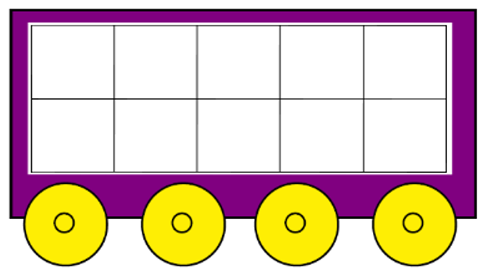
Activity

