Slide 1
Decimals and measures
Use, read and write standard units of length, mass and volume
Independent Task
Mathematics

Slide 2
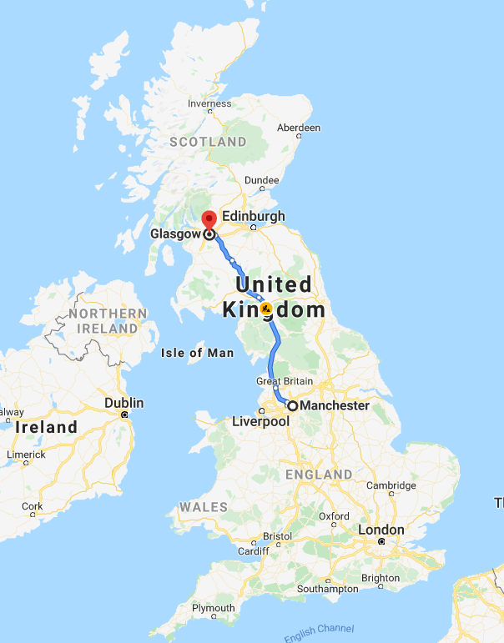
Question 1
Match the object to its approximate mass, capacity or length.
The capacity of a mug.
The distance from Manchester to Glasgow.
The height of a male giraffe.
The mass of a blue whale.
6 m
350 ml
350 km
180,000 kg

Slide 3
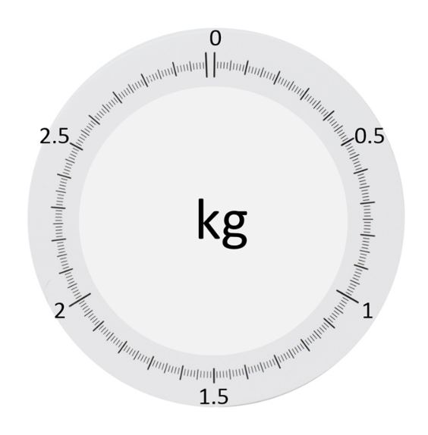
a
Question 2
What value does each arrow represent on this scale?
b
c

Slide 4
Question 3
What value does the arrow indicate if the container has a capacity of:
1 litre
5 litres
20 ml
Half a litre

Slide 5
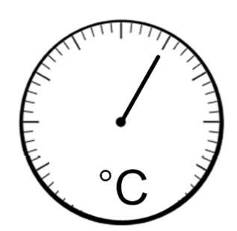
Question 4
What temperature is shown if:
a = 0°C and b = 16°C
a = -13°C and b = -5°C
a = -5°C and b = 35°C
a = -8°C and b = 72°C?
a
b

Slide 6
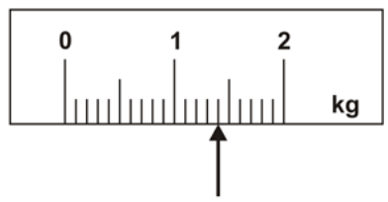
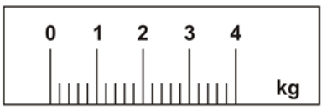
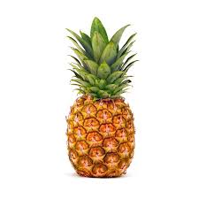
Question 5
On this scale, the arrow shows the weight of the pineapple.
What is the mass of the pineapple?
b) Here is a different scale. Mark with an arrow the mass of the same pineapple.
‘Contains material developed by the Standards and Testing Agency
for 2001 national curriculum assessments and licensed under Open
Government Licence v3.0’
View the Open Government Licence here:
http://www.nationalarchives.gov.uk/doc/open-government-
licence/version/3/

