Slide 1
Lines of Best Fit
Mathematics
Mr Millar

Slide 2
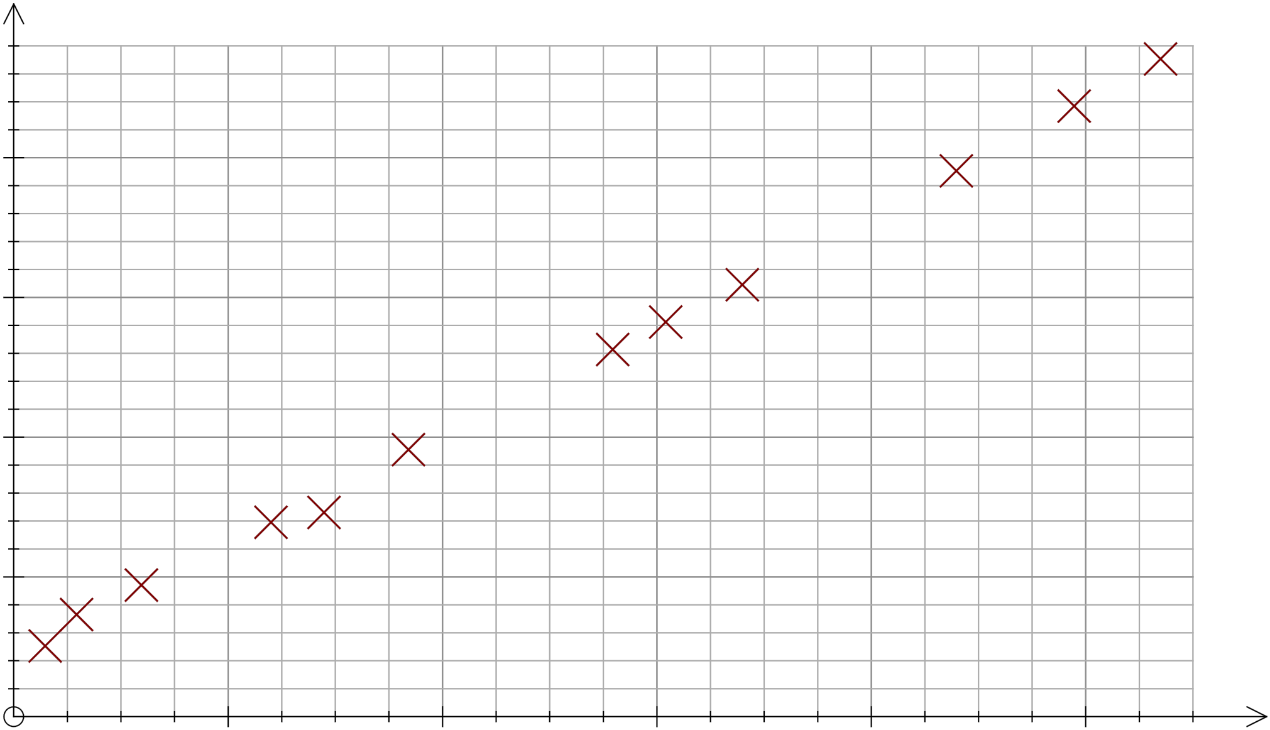
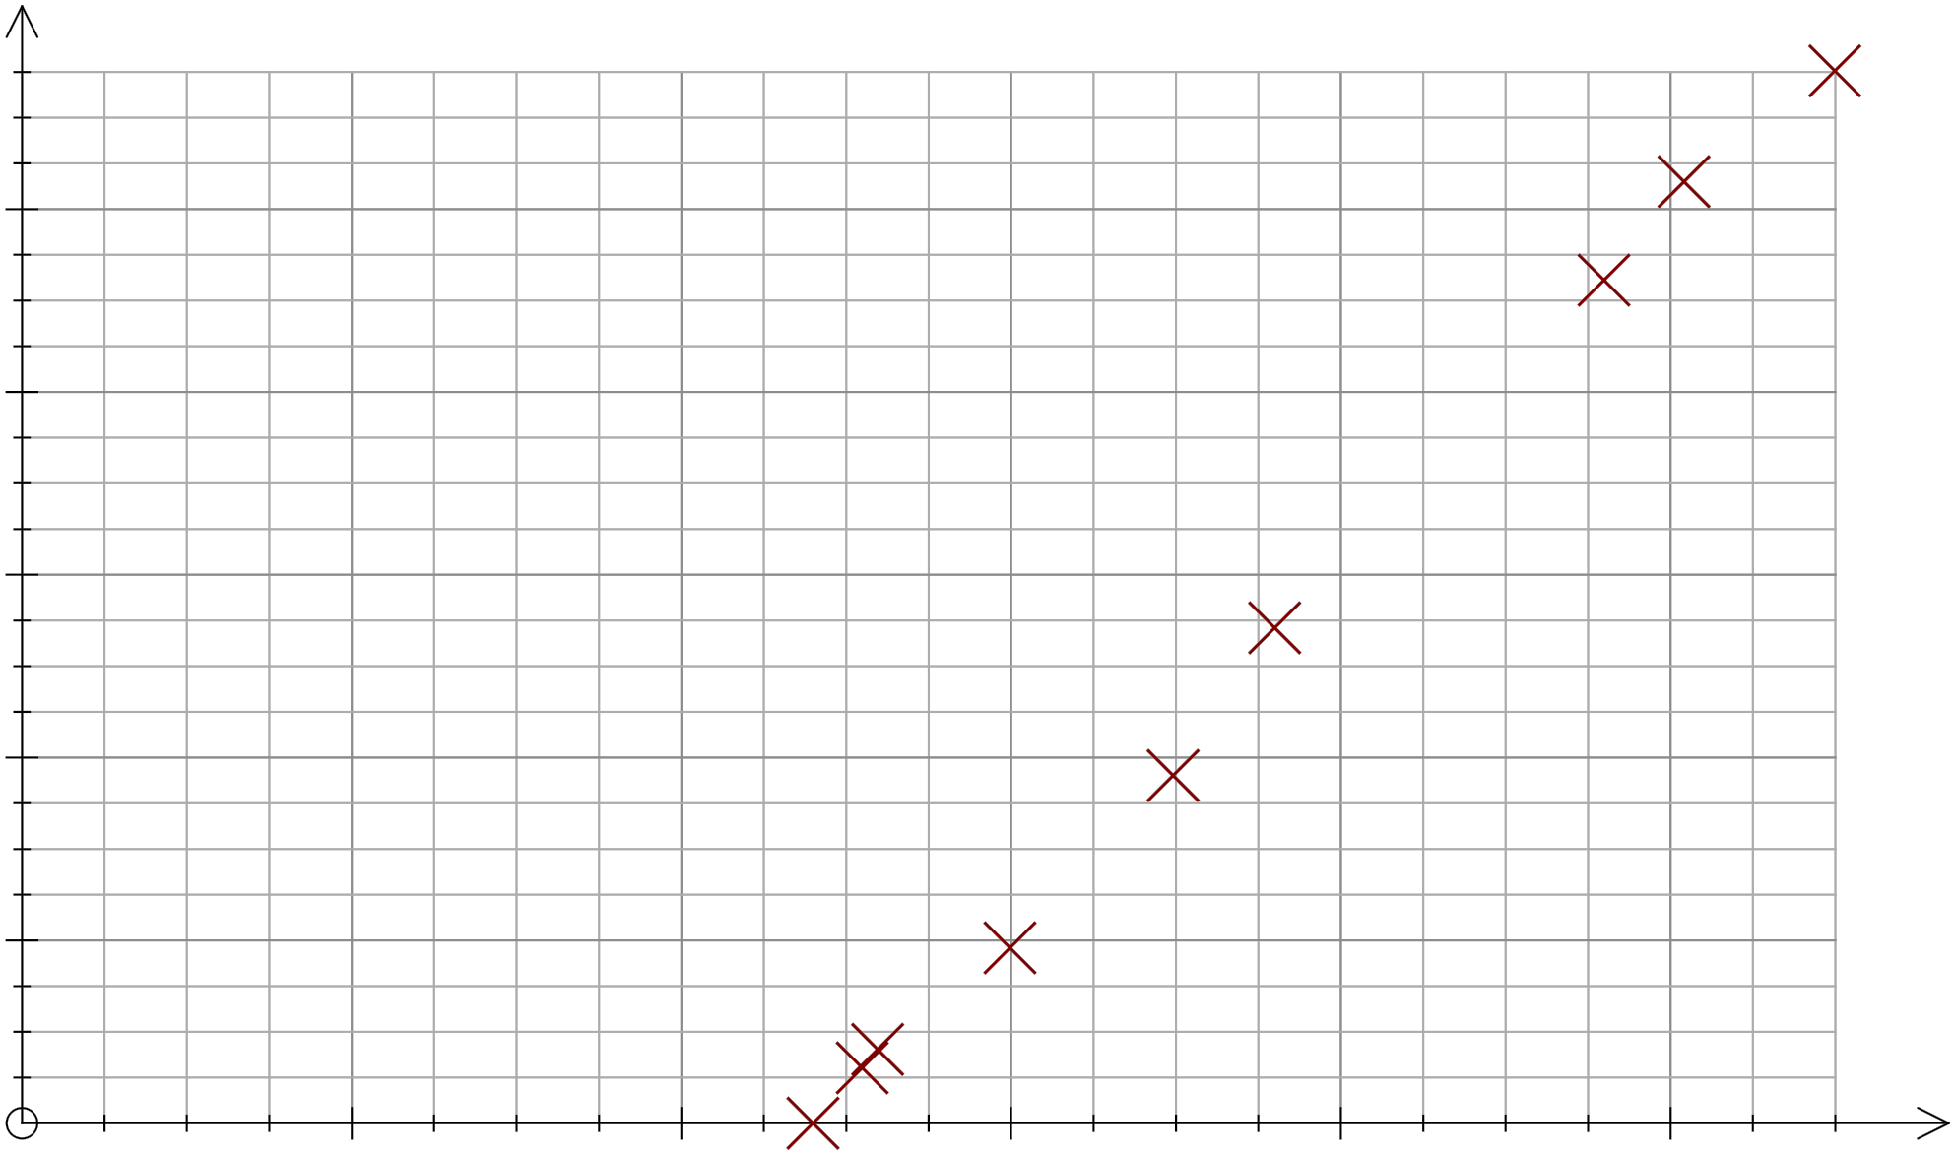
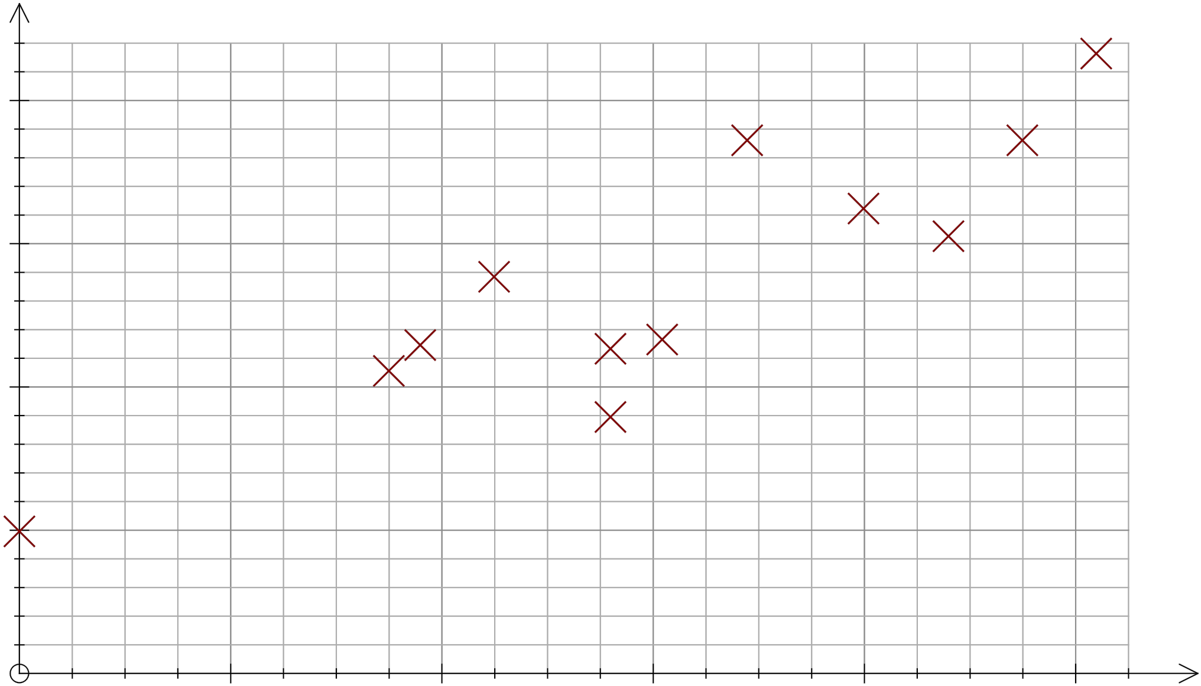
What’s the same and what’s different?
Can you come up with some examples of pairs of variables that fit these graphs?
Notes:
E.g. notice ‘gaps’ in trends, axes intercepts, etc

Slide 3
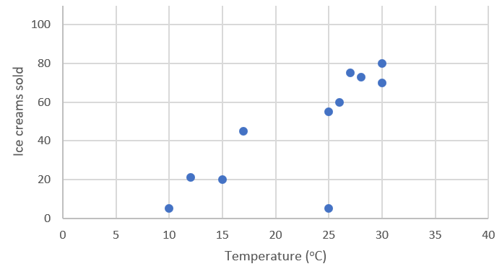
Lines of best fit can help us:
More easily see what the correlation is / how strong it is
Identify outliers
Work out an expected relationship
I would expect that if it was 20⁰C, _____ ice creams would be sold.
I can see an outlier!

Slide 4
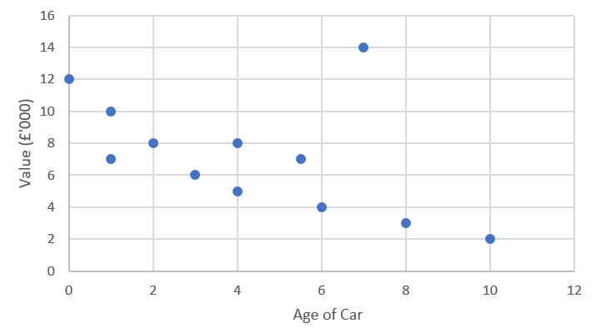
Which of these lines of fit is the most appropriate to use?
Use your line of best fit to predict the value of a car which is 7 years old.
State which car is an outlier.

Slide 5
Zaki collects data about the height and shoe sizes of some of his class.
What do you think of his statements?
Draw a scatter graph and line of best fit to help you decide.
Pupil | A | B | C | D | E | F | G | H | I | J | K | L | M | N | O
Shoe size | 6 | 7 | 5 | 7 | 8 | 4 | 5.5 | 7 | 8 | 7.5 | 8.5 | 4 | 9 | 6 | 4.5
Height (cm) | 155 | 160 | 155 | 162 | 165 | 153 | 154 | 159 | 162 | 159 | 168 | 151 | 171 | 154 | 150
I would expect someone 157cm tall to have size 7 shoes.
I would expect someone 135cm tall to have size 0 shoes.

Slide 6
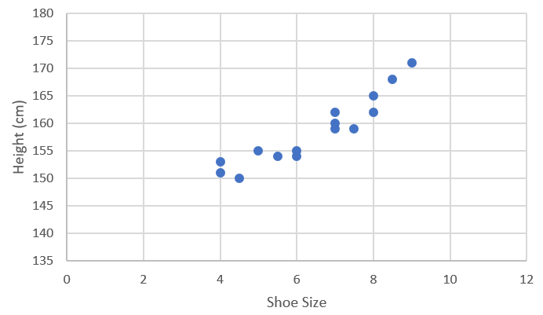
Zaki collects data about the height and shoe sizes of some of his class.
What do you think of his statements?
I would expect someone 157cm tall to have size 7 shoes.
I would expect someone 135cm tall to have size 0 shoes.

Slide 7
Answers

Slide 8
What’s the same and what’s different?
Can you come up with some examples of pairs of variables that fit these graphs?
All show positive correlation, but the lower right graph has a weaker correlation.
If you were to plot “lines of best fit”, each would intercept the x or y axis at different places
Notes:
E.g. notice ‘gaps’ in trends, axes intercepts, etc

Slide 9
Lines of best fit can help us:
More easily see what the correlation is / how strong it is
Identify outliers
Work out an expected relationship
I would expect that if it was 20⁰C, 40 ice creams would be sold.
I can see an outlier!

Slide 10
Which of these lines of fit is the most appropriate to use?
Use your line of best fit to predict the value of a car which is 7 years old.
State which car is an outlier.
The graph on the right
£4,000

Slide 11
Zaki collects data about the height and shoe sizes of some of his class.
What do you think of his statements?
I would expect someone 157cm tall to have size 7 shoes.
Yes – 157cm is within the range of data so it is reasonable to use a line of best fit
I would expect someone 135cm tall to have size 0 shoes.
No – 135cm is NOT within the range of data so it is not reasonable to use a line of best fit

