Slide 1
Rate of Reaction using Graphs and Tangents (Higher Tier)
Worksheet
Combined Science – Chemistry – Key Stage 4
The Rate and Extent of Chemical Change
Dr Deng

Slide 2
Example 1
A student investigated the rate of reaction between calcium carbonate (marble chips) and hydrochloric acid.
The student had collected 34 cm³ of gas produced after 20 seconds. Calculate the mean rate of reaction from 0 to 20 seconds.

Slide 3
Example 2
A student investigated the rate of reaction between magnesium and hydrochloric acid.
The student had recorded an initial reactant mass of 23 g. The mass of the product recorded was 19.4 g after 30 seconds.
Calculate the mean rate of reaction from 0 to 30 seconds.

Slide 4
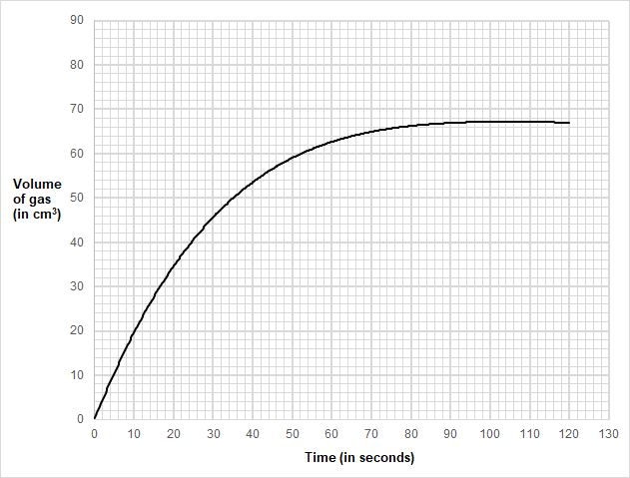
Example 3
Determine the mean rate of reaction in the first 18 seconds

Slide 5
Question 1: Information
A student investigated how temperature affects the rate of reaction between magnesium carbonate and dilute hydrochloric acid. The table below shows the student’s results for hydrochloric acid at 30 °C.

Slide 6
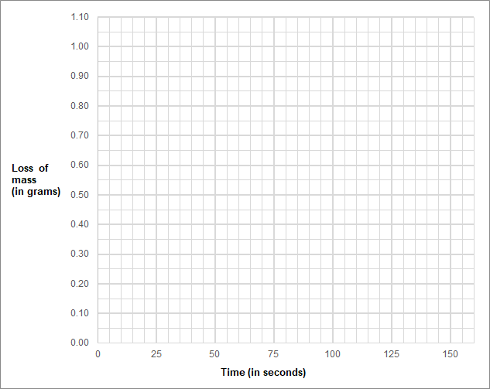
Question 1
Task: Plot the data from the table and draw a line of best fit.

Slide 7
Question 2
(a) Determine the rate of reaction at 10 seconds when:
Concentration of acid used is 1.0M
Concentration of acid used is 1.5M
(b) From question (a), determine which reaction was faster at 10 seconds.

Slide 8
Example 1 answer
A student investigated the rate of reaction between calcium carbonate (marble chips) and hydrochloric acid.
The student had collected 34 cm³ of gas produced after 20 seconds. Calculate the mean rate of reaction from 0 to 20 seconds.
Mean rate of reaction = quantity of product formed
time taken
= 34 cm³
20 s
= 1.7 cm³/s

Slide 9
Example 2 answer
A student investigated the rate of reaction between magnesium and hydrochloric acid.
The student had recorded an initial reactant mass of 23 g. The mass of the product recorded was 19.4 g after 30 seconds.
Calculate the mean rate of reaction from 0 to 30 seconds.
Mean rate of reaction = quantity of reactant used
time taken
= 23 – 19.4 g
30 s
= 0.12 g/s

Slide 10
Example 3 answer
Mean rate of reaction in the first 18 seconds
= Δy
Δx
Δx = 18 - 0
= 32
18
= 1.777…
Δy = 32 - 0
= 1.78 cm³/s

Slide 11
Question 1 answer
Plot the data from the table and draw a line of best fit.

Slide 12
Question 2 answer
(a) Determine the rate of reaction at 10 seconds when:
i) Concentration of acid used is 1.0M
Rate = Δy
Δx
= 26 – 6 cm³
15 – 4 s
= 20 cm³
11 s
= 1.81 cm³/s
Δx = 15-4
Δy = 26-6

Slide 13
Question 2 answer
(a) Determine the rate of reaction at 10 seconds when:
ii) Concentration of acid used is 1.5M
Rate = Δy
Δx
= 50-16 cm³
16-3 s
= 34 cm³
13 s
= 2.62 cm³/s
Δy = 50-16
Δx = 16-3

Slide 14
Question 2 answer
(a) The rate of reaction at 10 seconds when:
Concentration of acid used is 1.0M - 1.81 cm³/s
Concentration of acid used is 1.5M - 2.62 cm³/s
(b) Reaction with the higher concentration of acid used (1.5 M) was faster at 10 seconds.

