Slide 1
Problem solving Lesson 6 of 6
Computing
Ben Garside

Slide 2
Moves like Jim

Slide 3
Moves like Jim: Introduction
Open the Moves like Jim Scratch program (oaknat.uk/comp-moveJim) and complete the tasks below.
You are to work through the tasks independently, but use your problem-solving skills to help you if you are struggling:
Carefully read over the instructions again. Stop and think through the problem.
Read the support tips and look at your work from previous lessons/tasks
Talk through your problem with someone else (they don’t need to be an expert)

Slide 4
Task 1
Complete the subroutine ‘move1’ so that you tell Jim what dance move to do if the user presses the correct key in time.
Support: Look at the available costumes to pick a dance move.
Your solution (take a screenshot of the block of code you have created or modified)
Source: Scratch

Slide 5
Task 2
The ‘move2’ subroutine needs to be completed. Most (but not all) of the blocks to make this subroutine have been provided for you.
‘Move2’ requires both the q and w keys to be pressed for a successful move
You must decide upon what the successful move is
You must switch to costume ‘Jim-c’ if the user fails to press q and w in time
The costume should be switched to ‘Jim-b’ at the end of the subroutine
Support: Look at the structure of the ‘move1’ subroutine to help you.
Add your screenshot on the next page

Slide 6
Task 2 evidence
Your solution (take a screenshot of the block of code you have created or modified)

Slide 7
Task 3
The subroutine gives a five second countdown before saying “dance” and the game starts.
Modify this subroutine to include count-controlled iteration.
Your solution (take a screenshot of the block of code you have created or modified)
Support: ‘Counting cat’ or ‘Ten green bottles’ from lesson five.
Source: Scratch

Slide 8
Task 4
The ‘move3’ subroutine needs to be built by you. It must meet the following criteria:
Keys 1 or 9 must be pressed for a successful dance move to be executed
This time, a successful dance move will be Jim switching between costumes ‘Jim-d’ and ‘Jim-e’ five times, waiting 0.3 seconds before swapping costumes
You must switch to costume ‘Jim-c’ if the user fails to press 1 or 9 in time
The costume should be switched to ‘Jim-b’ at the end of the subroutine
Add your screenshot on the next page

Slide 9
Task 4 evidence
Your solution (take a screenshot of the block of code you have created or modified)

Slide 10
Moves like Jim optional explorer tasks

Slide 11
Task 5
Use the score variable to add 1 to the score if the user has successfully completed each subroutine.
Take a screenshot of where you have increased the score for the ‘move3’ subroutine.
Your solution (take a screenshot of the block of code you have created or modified)

Slide 12
Task 6
Complete the ‘feedback’ subroutine. It must meet the following criteria:
If the score is greater than two, a well done message should be displayed for two seconds
If the score isn’t greater than two, the following message should be displayed for two seconds: “Better luck next time”
You can pick a costume to change, depending on the message
You should make sure that the subroutine is called after all the ‘move’ subroutines.
Add your screenshot on the next page

Slide 13
Level up

Slide 14
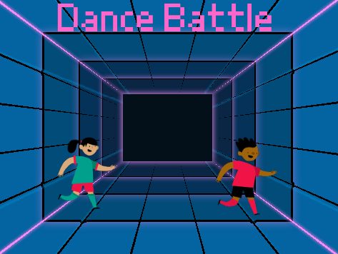
Task 7: Level up introduction
A games development company has seen your ‘Moves like Jim’ game, and want to hire you to create a new game called ‘Dance battle’.
The company wants to help you develop your skills by giving you more training. Complete the table below to help them gain an understanding of your current programming skills.
Source: Scratch

Slide 15
Task 7 part 1: Your skills
Write “Yes” in the boxes that apply to you
Programming skills/concept | I don’t know what this is or how to use it | I know what this is, but would need support being able to use it | I am confident I know how to use this in a program
Place blocks in a sequence
Use variables
True or false conditions
Selection (If statements)
Operators (logic and comparison)
Count-controlled iteration (loops)

Slide 16
Task 7 part 2: Achievements and next steps
What do you think is your biggest achievement with the programs that you have made? What skills have you learnt throughout the programming unit that you have just completed at school?
Before you start working for us, what skills or programming concepts do you think you need to spend the most amount of time on?

