Slide 1
Lesson 3: Creating Digital Video
Media Studies
Bethany Davies
Materials from the Teach Computing Curriculum created by the National Centre for Computing Education

Slide 2
Task 1 - Digital Video
Our client, Fab Gadget Ltd., has asked us to create a video for them to advertise their upcoming robotic lawnmower. You have been provided with the video, audio, and image files required to make the video. You have also been provided with a copy of the storyboard to assist you with creating the video. Our client has insisted that their logo is displayed in the bottom left-hand corner of the screen for the entirety of the video. The storyboard for the video is detailed in the follow slides.
Follow these steps to create the short video and learn about the video editing software. You will make use of the OpenShot application to create the video.

Slide 3
Task 1 - Creating a website
Assets that are needed to complete this task can be obtained here: oaknat.uk/comp-digital-video

Slide 4
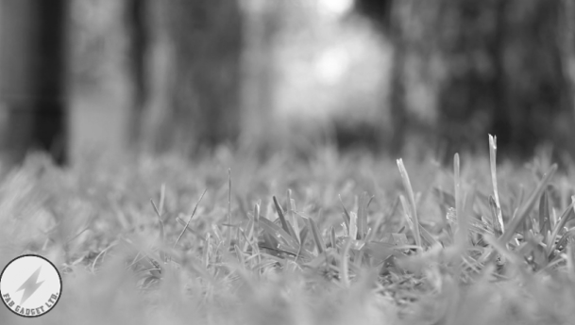
Task 1 - Digital Video
Project | Robot Mower | Scene | N/A |  | Pages | 3
Shot | Close-up of grass in wind |  |  | Fade in from black
 |  |  |  | Garden sounds in background

Slide 5
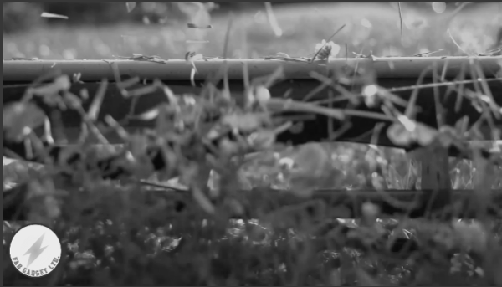
Task 1 - Digital Video
Shot | Close-up of mower |  | Fade from previous
 |  |  | Sound of manual mower
 |  |  | Garden sounds in background
 |  |  | Voiceover: “You could spend…”

Slide 6
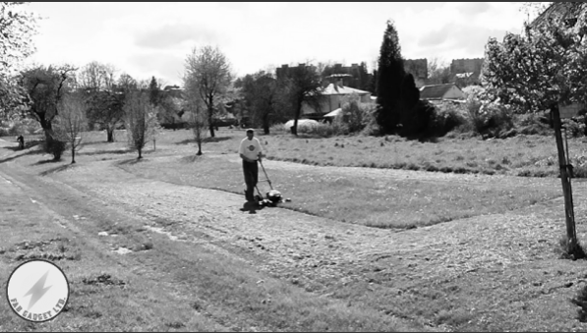
Task 1 - Digital Video
Shot | Man mowing grass |  | Fade from previous
 |  |  | Sound of manual mower
 |  |  | Garden sounds in background
 |  |  | Voiceover continued

Slide 7
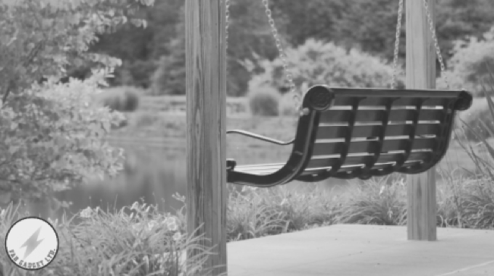
Task 1 - Digital Video
Shot | Swinging chair |  | Fade from previous
 |  |  | Garden sounds in background
 |  |  | Voiceover: “But wouldn’t you rather...”

Slide 8
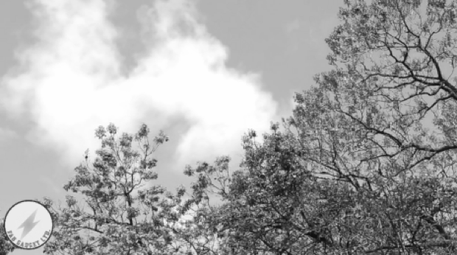
Task 1 - Digital Video
Shot | Trees and clouds |  | Fade from previous
 |  |  | Garden sounds in background
 |  |  | Voiceover: “Just sitting back…”

Slide 9
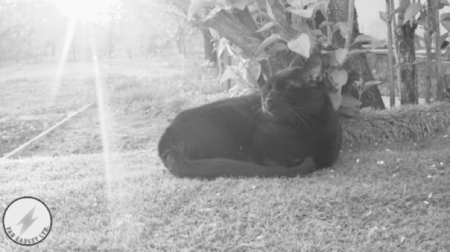
Task 1 - Digital Video
Shot | Cat in the sun |  | Fade from previous
 |  |  | Garden sounds in background
 |  |  | Voiceover: “Basking in the…”

Slide 10
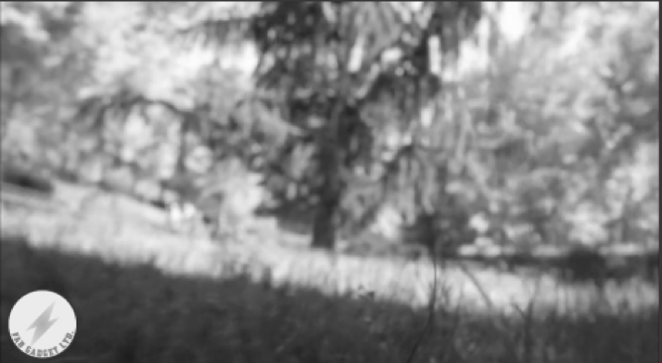
Task 1 - Digital Video
Shot | Mower’s eye view |  | Fade from previous
 |  |  | Garden sounds in background
 |  |  | Voiceover: “Well, now you can.”

Slide 11
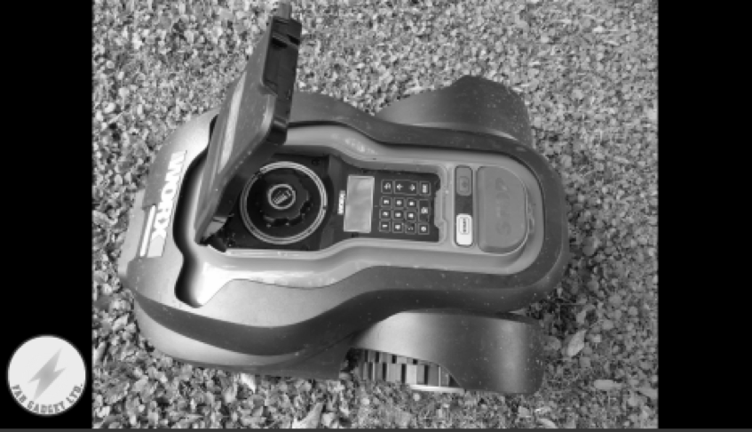
Task 1 - Digital Video
Shot | Robot image montage |  | Fade from previous
 |  |  | Three images
 |  |  | Fade between each image
 |  |  | Garden sounds in background
 |  |  | Voiceover: “The new robot…”
 |  |  | Fade to black

Slide 12
Task 1 - Digital Video
Create the video by completing the steps below
Step 1
Open OpenShot on your computer.

Slide 13
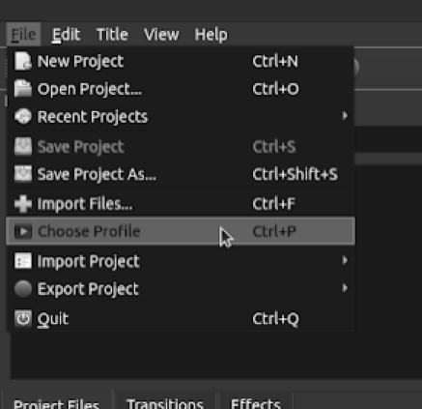
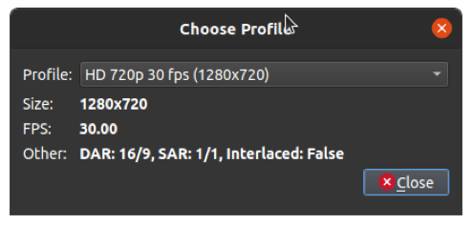
Task 1 - Digital Video
Create the video by completing the steps below
Step 2
Select the HD 720p Profile.
Go to File > Choose Profile from the main menu, or press the keyboard shortcut of Ctrl + P.
From the Profile drop-down menu, select HD 720p 30fps (1280×720) and then click on Close.

Slide 14
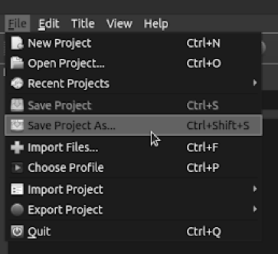
Task 1 - Digital Video
Create the video by completing the steps below
Step 3
Save your project.
Go to File > Save Project As... from the main menu, or press the keyboard shortcut of Ctrl + Shift + S.

Slide 15
Task 1 - Digital Video
Create the video by completing the steps below
Step 3 - Continued
Save your project with a sensible name so that you will know what it is when you come to find it later!
Notice that it saves with a .osp file extension; this is the OpenShot file format. OpenShot will also create a folder which will contain the project assets. If you were to back up your project, you would need the file and the folder.

Slide 16
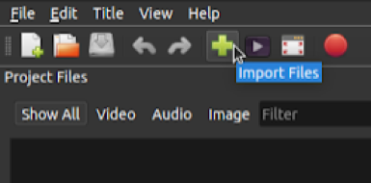
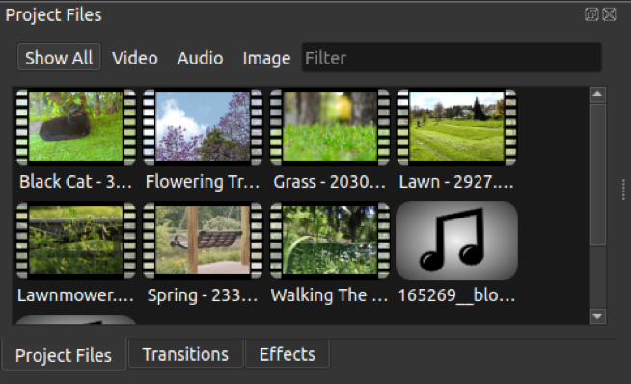
Task 1 - Digital Video
Create the video by completing the steps below
Step 4
Import your project files.
Click on the green plus icon to open the Import File… window.
Browse to the media objects for this lesson and select all the files and click on Open to import them into your project.
You should now have seven video clips, three image files, and three audio clips visible in your Project Files.

Slide 17
Task 1 - Digital Video
Create the video by completing the steps below
Step 5
Import your logo.
Click on the green plus icon again to import the Fab Gadget logo that you created last lesson. Be sure to import the PNG version.

Slide 18
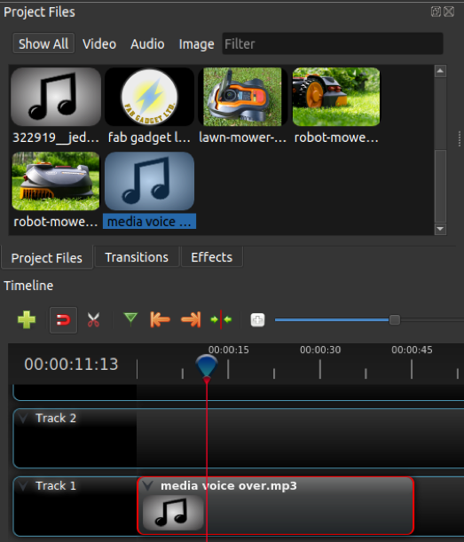
Task 1 - Digital Video
Create the video by completing the steps below
Step 6
Cut the voiceover clip.
The voiceover has been provided as one single file. You need to cut it into six sections.
Drag the media voiceover.mp3 file from your Project Files onto Track 1.

Slide 19
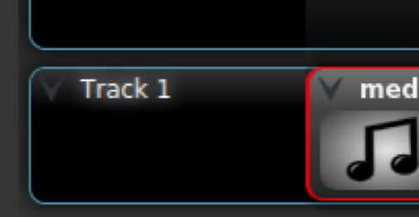
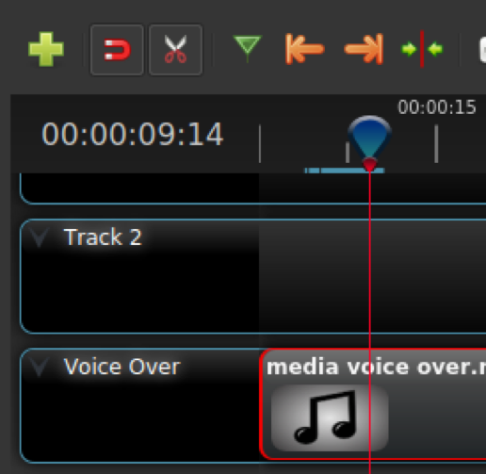
Task 1 - Digital Video
Create the video by completing the steps below
Step 6 - Continued
Rename the track to Voiceover by clicking the down arrow next to the track title and selecting Rename Track.
Press the space bar to start playing the track, and when you get to the first break, press the space bar again to pause.
Select the Razor Tool and click on the track at the point where the red playback line is. You should now have two clips on the same track.

Slide 20
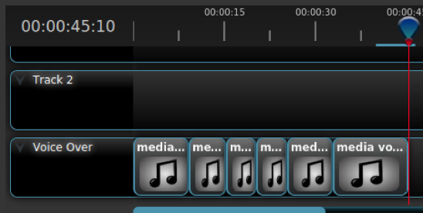
Task 1 - Digital Video
Create the video by completing the steps below
Step 6 - Continued
Repeat Steps 4 and 5 to split the voiceover into the six separate clips.

Slide 21
Task 1 - Digital Video
Create the video by completing the steps below
Step 7
Add the background soundtrack and mower soundtrack.
Deselect the Razor Tool.
Click the down arrow next to your Voiceover track and select Add Track Below. Now, rename this new track Mower Sound.
Repeat step 2 to add a track below Mower Sound called Background Sound.

Slide 22
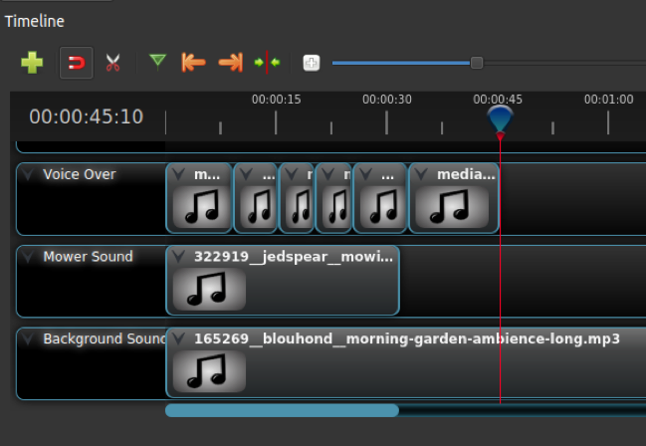
Task 1 - Digital Video
Create the video by completing the steps below
Step 7 - Continued
Drag the 165269_… file onto the Background Sound track and the 322919_… file onto the Mower Sound track.
Your timeline should now look like the image on this slide.
Save your project by pressing Ctrl + S.

Slide 23
Task 1 - Digital Video
Create the video by completing the steps below
Step 8
Add the Close-up of grass in wind clip.
Rename the track above Voiceover to Video 1.
Drag the Grass - 20306.mp4 clip onto the Video 1 track.
Select all of the voiceover clips, by either left-clicking and dragging a box over the clips, or holding Ctrl and left-clicking on each individual track.
With all the voiceover clips selected, move them across to the right of the timeline.

Slide 24
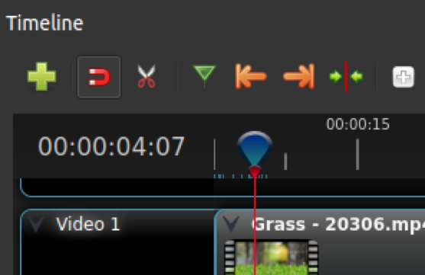
Task 1 - Digital Video
Create the video by completing the steps below
Step 8 - Continued
Drag the blue playhead back to the start of the timeline.
Use the cursor keys to adjust the playhead to about 4 seconds, and then use the Razor Tool to cut the Grass… clip at the position of the playhead.
Deselect the Razor Tool and left-click to select the section of the Grass… clip to the right of the playhead. Press the Delete key to remove this section of clip from the timeline.

Slide 25
Task 1 - Digital Video
Create the video by completing the steps below
Step 9
Add the Close-up of mower clip
Rename the track above Video 1 to Video 2.
Drag the Lawnmower.mp4 clip onto the Video 2 track.
Zoom in as far as you can, by clicking on the Plus icon in the timeline tools.

Slide 26
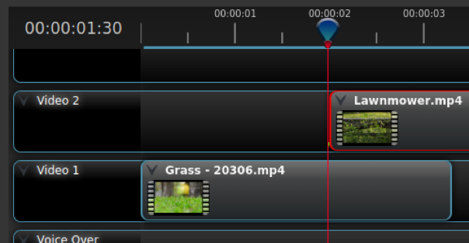
Task 1 - Digital Video
Create the video by completing the steps below
Step 9 - Continued
Drag the Lawnmower.mp4 clip so that it overlaps the track below and starts at the two-second mark.
If you drag the playhead back to the start and press the space bar to preview your edit, you should see that your mower clip appears just as the sound of the mower begins.

Slide 27
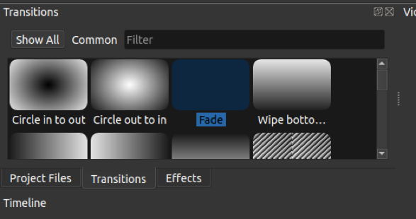
Task 1 - Digital Video
Create the video by completing the steps below
Step 10
Add Fade between two video tracks.
The change between our two video clips is known as a hard cut, as it just jumps from one clip to the other, without any transition.
You are going to add a fade so that it blends between the two clips.
Select the Transitions tab, and then select the Fade transition.

Slide 28
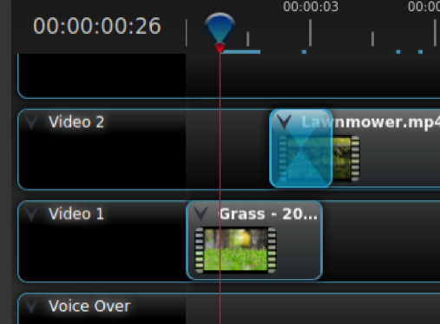
Task 1 - Digital Video
Create the video by completing the steps below
Step 10 - Continued
Drag the Fade onto the Lawnmower.mp4 clip so that it sits at the start of the clip.
Click on the Minus symbol to zoom out a little on your timeline and then click and drag the right-hand end of the Fade to line up with the end of the Grass - … track.
Drag the playhead back to the start and press the space bar to preview your fade. The mower clip should now ease in from the previous clip.

Slide 29
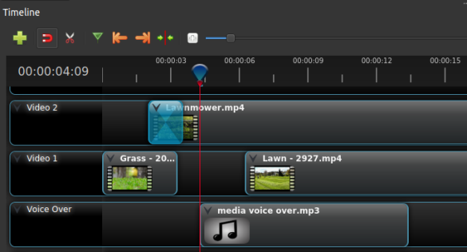
Task 1 - Digital Video
Create the video by completing the steps below
Step 11
Add the Man mowing grass clip.
Drag the Lawn - 2927… clip onto the Video 1 track, leaving a gap between it and the Grass - 20… clip.
Drag the first section of the media voiceover clip back so that it starts just after the fade to the Lawnmower.mp4 clip ends. Your timeline should look something like this:

Slide 30
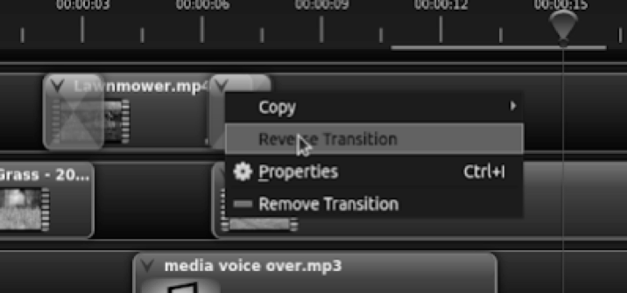
Task 1 - Digital Video
Create the video by completing the steps below
Step 11 - Continued
Cut the Lawnmower.mp4 clip after the start of the Lawn - 2927… clip, leaving enough room for a fade.
Delete the second part of the Lawnmower.mp4 clip from the timeline.
Drag the Fade onto the end of the Lawnmower.mp4 clip in the same way as you did in step 10.
Click the down arrow on the end Fade and select Reverse Transition.

Slide 31
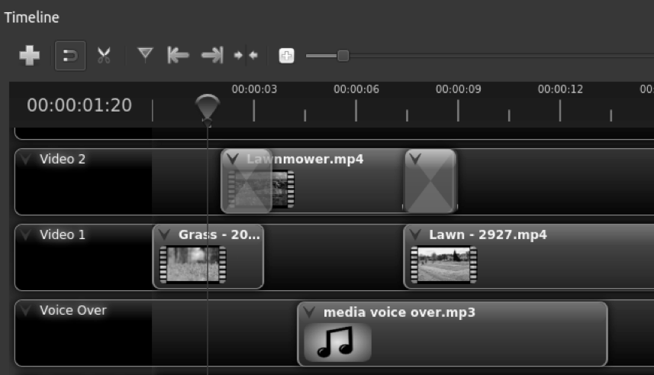
Task 1 - Digital Video
Create the video by completing the steps below
Step 11 - Continued
Your timeline should now look like this:

Slide 32
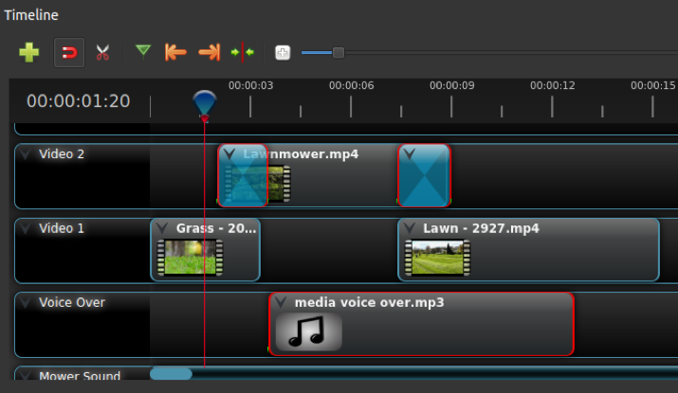
Task 1 - Digital Video
Create the video by completing the steps below
Step 11 - Continued
Select the Razor Tool again and cut the Lawn - 2927.mp4 clip so that it ends about two seconds after the first media voiceover.mp3 clip finishes. Now, remove the right-hand section of the Lawn - 2927.mp4 clip.
Drag the playhead back to the start of your timeline and press the space bar to preview your edit so far.

Slide 33
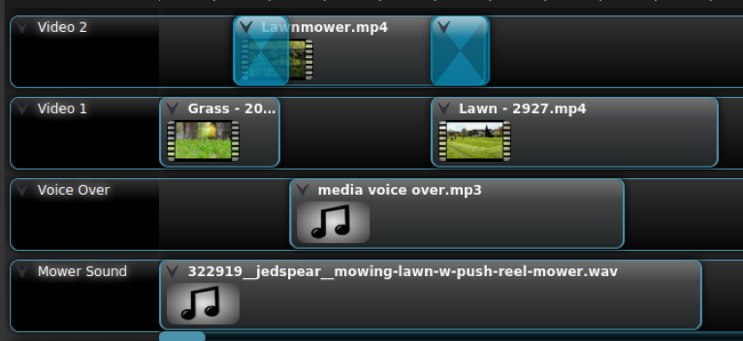
Task 1 - Digital Video
Create the video by completing the steps below
Step 12
Trim the Mower Sound track.
Align your playhead with the end of the Lawn - 2927.mp4 track.
Select the Razor Tool and cut the Mower Sound track just before the position of the playhead.
Deselect the Razor Tool and right-click on the right-hand piece of the Mower Sound clip and choose Remove Clip.

Slide 34
Task 1 - Digital Video
Create the video by completing the steps below
Step 13
Add the Swinging Chair clip.
Drag the Spring - 23353.mp4 clip onto the Video 2 track so that the start of it overlaps the end of the Lawn - 2927.mp4clip.
Click the down arrow on the first Fade and choose Copy > Transition.
Press Ctrl + V to paste the transition into the Video 2 track.
Drag the transition to the start of the Spring… clip and make sure that it extends past the end of the Lawn… clip.

Slide 35
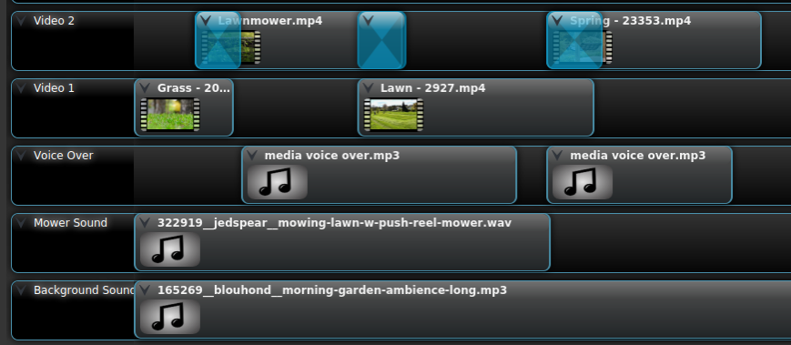
Task 1 - Digital Video
Create the video by completing the steps below
Step 13 - Continued
Drag the second section of the media voiceover clip back so that it lines up with the start of the Spring… clip.
Select the Razor Tool and cut the Spring… clip about a second after the end of the media voiceover.mp3 clip.
Deselect the Razor Tool, right-click on the right-hand side of the Spring... clip, and choose Remove Clip.

Slide 36
Task 1 - Digital Video
Create the video by completing the steps below
Step 14
Add the Trees and Clouds clip.
In the same way as you did for the swinging chair clip, drag the Flowering Trees… clip onto the Video 1 track, lining it up with the end of the media voiceover clip.
Copy the second Fade and paste it onto the end of the Spring… clip, adjusting its size if necessary.
Drag the third section of the media voiceover.mp3 clip back to align with the end of the Fade that you just pasted.

Slide 37
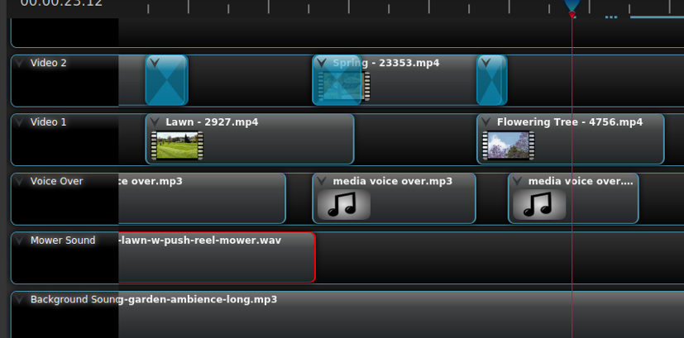
Task 1 - Digital Video
Create the video by completing the steps below
Step 14 - Continued
Use the Razor Tool to cut the Flowering Trees… track about a second after the third media voiceover clip ends, and then remove the excess clip in the same way as before.

Slide 38
Task 1 - Digital Video
Create the video by completing the steps below
Step 15
Add the Cat in the sun clip.
Drag the Black Cat… clip onto the Video 2 track, lining it up with the end of the media voiceover clip.
Copy the first Fade and paste it on the start of the Black Cat… clip, adjusting its length if necessary.
Drag the fourth section of the media voiceover clip back to line up with the end of the Fade that you just pasted.

Slide 39
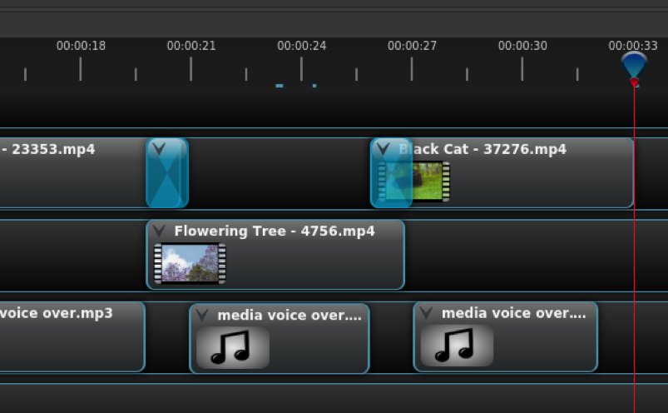
Task 1 - Digital Video
Create the video by completing the steps below
Step 15 - Continued
Use the Razor Tool to cut the Black Cat… clip a second after the media voiceover clip ends, then delete the excess of the Black Cat… clip.

Slide 40
Task 1 - Digital Video
Create the video by completing the steps below
Step 16
Add the Mower’s Eye View clip.
Drag the Walking The… clip onto the Video 1 track, lining it up with the end of the fourth section of the media voiceover.
Copy the second Fade and paste it onto the end of the Black Cat... clip, adjusting its size if necessary.
Drag the fifth section of the media voiceover clip back to align with the end of the Fade that you just added.

Slide 41
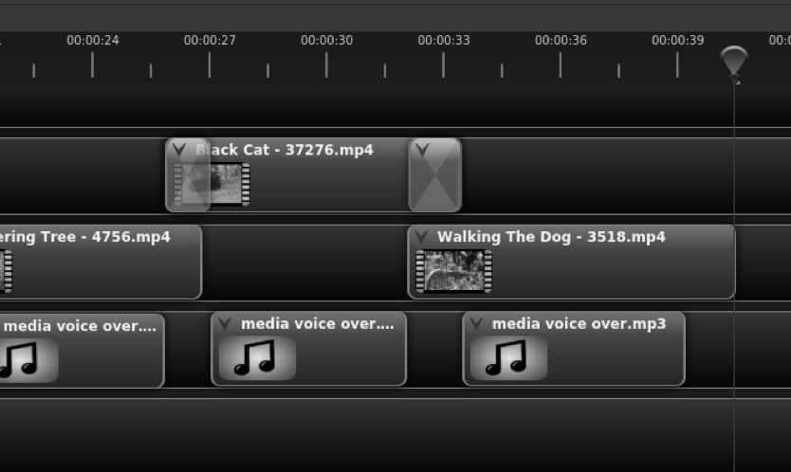
Task 1 - Digital Video
Create the video by completing the steps below
Step 16 - Continued
Use the Razor Tool to cut the Walking The... clip a second after the media voiceover clip ends, then delete the excess of the Walking The... clip.

Slide 42
Task 1 - Digital Video
Create the video by completing the steps below
Step 17
Add the Robot Image Montage section.
Drag the lawn-mower… image onto Video 2, lining it up with the end of the fifth section of the media voiceover clip.
Drag the sixth section of the media voiceover clip to line up with the end of the Walking The… clip.
Drag the first robot-mower image onto the Video 1 track and the second robot-mower image onto the end of the Video 2 track.

Slide 43
Task 1 - Digital Video
Create the video by completing the steps below
Step 17 - Continued
Cut all three images on the tracks so that they are each about the same length, overlap each other by about the same amount, and are slightly longer than the sixth section of the media voiceover clip.
Add Fades to the starts and ends of the pictures on the Video 2 track so that the images fade into each other.

Slide 44
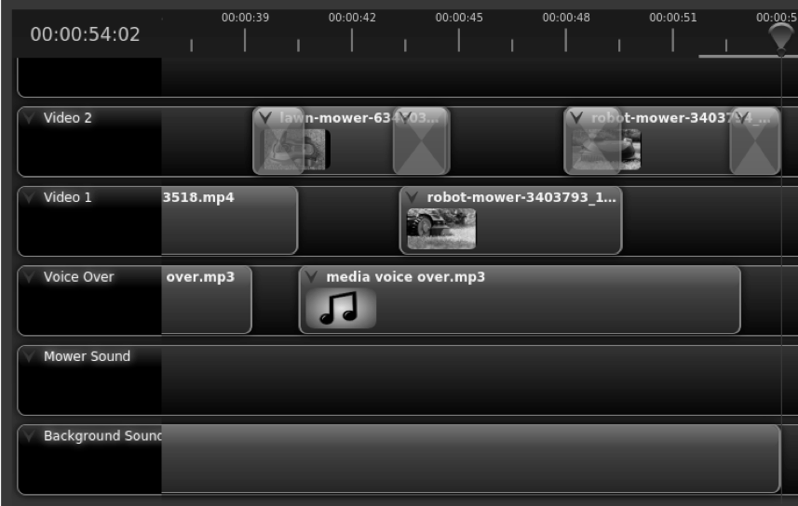
Task 1 - Digital Video
Create the video by completing the steps below
Step 17 - Continued
Position the playhead at the end of the third image and cut the Background Sound clip at this point, discarding the excess part of the clip.

Slide 45
Task 1 - Digital Video
Create the video by completing the steps below
Step 18
Add the logo.
Scroll to the track above Video 2 and rename it Logo.
Click the Minus button at the right-hand end of the timeline to zoom out until you can see all of your project on screen.
Drag your PNG logo file from the Project Files onto the start of the Logo track.
Hold your mouse pointer over the right-hand side of the logo clip until your mouse pointer changes to an arrow pointing left and right.

Slide 46
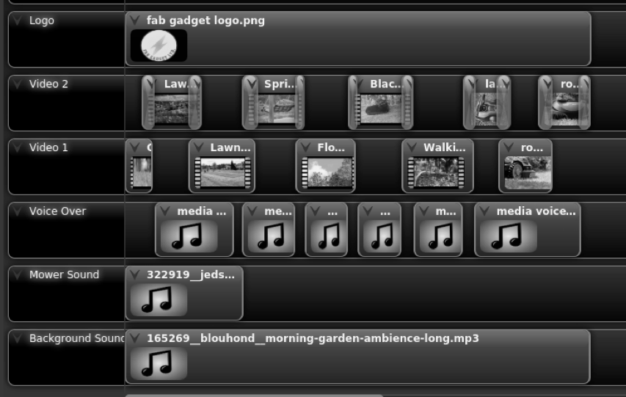
Task 1 - Digital Video
Create the video by completing the steps below
Step 18 - Continued
Click and drag the logo clip to the right until it covers the entire length of the video timeline.
Right-click on the logo clip and select Transform. You will see eight blue dots appear around the image in your preview window.

Slide 47
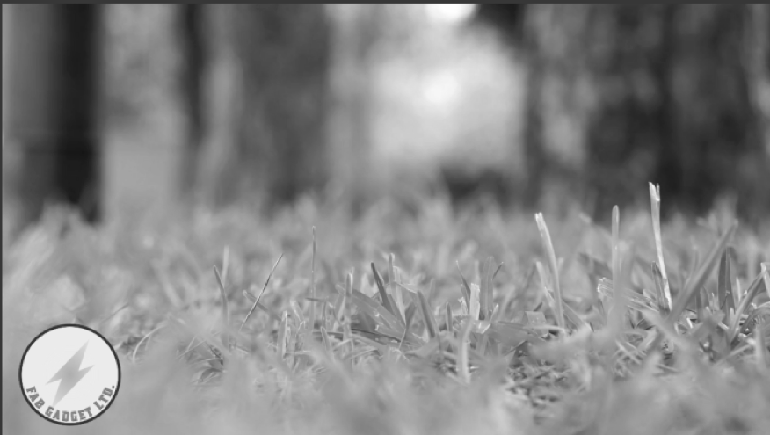
Task 1 - Digital Video
Create the video by completing the steps below
Step 18 - Continued
Use these blue dots to resize and reposition the logo so that it sits neatly in the bottom left-hand corner of the screen. If you hold down Ctrl while resizing the image, it will retain its proportions.
Add a Fade to the end of the logo clip.

Slide 48
Task 1 - Digital Video
Create the video by completing the steps below
Step 19
Adjust audio track levels.
When previewing your video, you might find that some audio clips are too loud.
Right-click on the clip that you want to adjust and select Volume > Entire Clip > Level 20%.
Preview your video again and adjust the volume again if it is still not right.

Slide 49
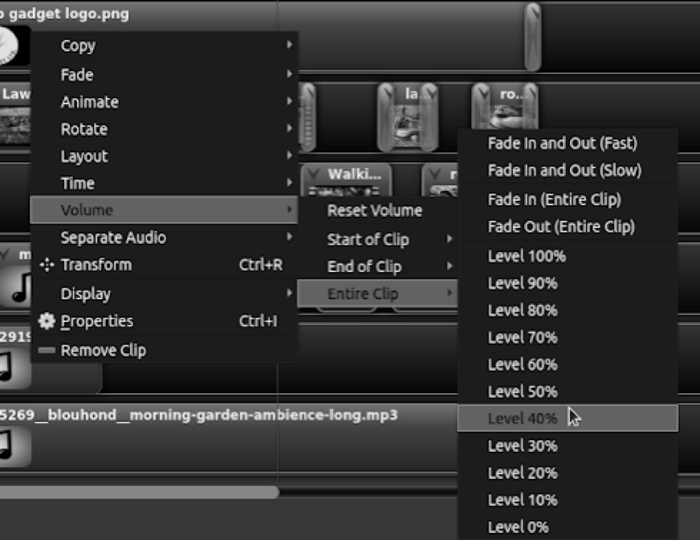
Task 1 - Digital Video
Create the video by completing the steps below
Step 19 - Continued
You could also apply a fade in and out to the background track in this menu.

Slide 50
Task 1 - Digital Video
Create the video by completing the steps below
Step 20
Export your completed video.
Press Ctrl + S to save your project.
Select File > Export Project > Export Video from the main menu.

Slide 51
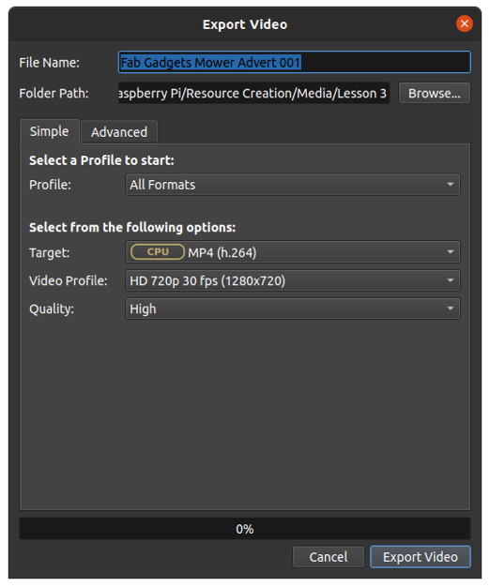
Task 1 - Digital Video
Create the video by completing the steps below
Step 20 - Continued
Ensure that you have the HD 720p 30 fps (1280×720) video profile selected, you have a sensible name for the file, and the folder path is where it should be.

Slide 52
Task 1 - Digital Video
Create the video by completing the steps below
Step 20 - Continued
Click on Export Video to begin the process. Depending on the power of your computer, this might take some time.
When the process reaches 100%, click on Done and then locate the exported MP4 file and play it back with your computer’s default video application, eg Windows Media Player, VLC media player, QuickTime.

Slide 53
Task 2 - Missing Words
Complete each sentence in the following slides by filling in the missing word. These are all new terms or key vocabulary that has been introduced in today’s lesson. Write down your answers to compare to the correct answers at the end! There are Eleven questions in total.
There are a number of standard _______ _______ that are used in video production.
A _______ shot is one where the subject is tightly framed and takes up most of the
screen.
A _______ _______ is sometimes known as a ‘wide shot’.
A _______ _______ shot can be used to make the subject look weak or vulnerable.

Slide 54
Task 2 - Missing Words
5. To perform a _______ _______ well, you will need to use a camera tripod.
6. The human eye can process, on average, 12 _______ _______ _______ .
7. ____________ is always a trade-off between file size and video quality.
8. The encoding information for video or audio data is known as the _______.
9. Separating a video clip into smaller sections is known as _______.
10. The type of transition that you used in your video project is called a _______.
11. The process of saving your video edit to a playable video file is known as ________.

Slide 55
Task 2 - Missing Words - Answers
1.Camera angles
2.Close-up
3.Long shot
4.High-angle
5.Pan shot
6.Frames per second
7.Compression
8.Codec
9.Cutting/Cut
10.Fade
11.Exporting

