Slide 1
Linking subtraction equations to problem solving contexts
Mathematics Independent Task
Miss Robson

Slide 2
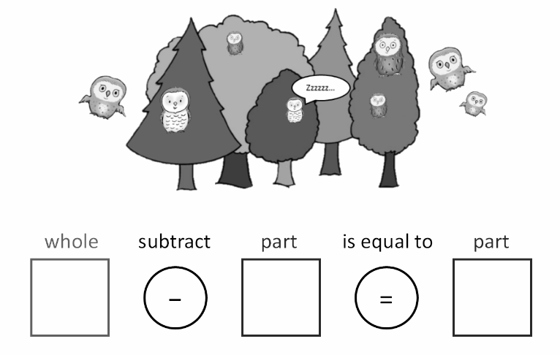
Activity
How many different stories can you come up with? Record the equations for your stories.

