Slide 1
Growth and Decay. Downloadable Resource - Percentage change.
Mathematics
Mr. Thomas

Slide 2
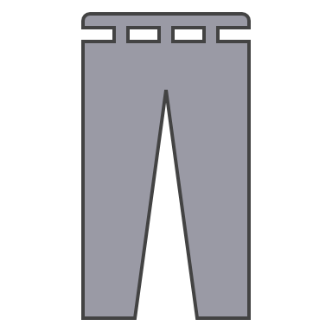
Try this
Cost for the shop | £4.10 | £3.10 | £14 | £7.25 | £8.20
Cost for the customer | £6 | £4 | £20 | £8 | £10
Attach each of these labels to the clothes so that:
The shop owner makes a profit on every item.
The shop owner makes the most profit if someone buys 1 of everything.
25% off
30% off
15% off
5% off
20% off
Notes:
Again, knowing that a 20% decrease is n - (0.2 x n), or more importantly 0.8n

Slide 3
Connect
Let’s explore decimal multipliers further for percentage increase and decrease…

Slide 4
Connect
Increase £100 by 30%
Decrease £93.20 by 21%
Increase £54.23 by 53.9%
Decrease £107.20 by 92.9%

Slide 5
Independent Task
Increase £1,600 by 40%
Increase £1,235 by 95.2%
Increase £345.67 by 31.65%
Decrease £12.30 by 10%
Decrease £89.54 by 23.5%
Decrease £849.99 by 95.12%
Try increasing £100 by 10% and then decreasing it by 10%. What do you notice has happened, relative to the initial £100?

Slide 6
Explore
Increasing ______ by 40%
Decreasing ______ by 40%
is the same as
How many ways can you fill these to make a true statement?
Organise your answers and compare them. What do you notice?

Slide 7
Explore – SUPPORT
Increasing ______ by 40%
Decreasing ______ by 40%
is the same as
How many ways can you fill these to make a true statement?
Organise your answers and compare them. What do you notice?
Notes:
The first one will always be 3 sevenths of the second

