Slide 1
Find the Radius and Diameter when given the Area
Maths
Mr Lund

Slide 2
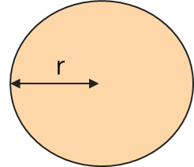
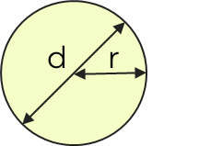
Find the Radius and Diameter when given the Area
3.The area of the circle is 201 cm².
Calculate the
diameter to 3
significant figures.
4. The area of the circle is 804 cm².
Calculate the radius
and the diameter,
to 3 significant figures.
‹#›

Slide 3
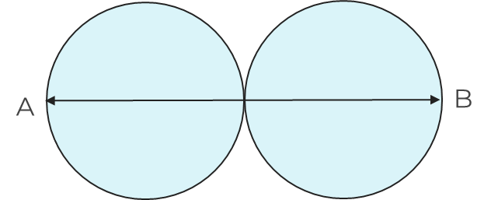
Find the Radius and Diameter when given the Area
5. The area of the circle is 16 m².
a) To 3 significant figures, what is the area of the square?
b) What percentage of the square is the circle?
6. The total area of these identical circles is 60m².
The line AB passes through the centres
of both circles.
What is the distance of the line AB to 3 significant figures?
d
‹#›

Slide 4
Answers

Slide 5
Find the Radius and Diameter when given the Area
3.The area of the circle is 201 cm².
Calculate the
diameter to 3
significant figures.
4. The area of the circle is 804 cm².
Calculate the radius
and the diameter,
to 3 significant figures.
Diameter = 8.0 x 2 = 16 cm
‹#›

Slide 6
Find the Radius and Diameter when given the Area
5. The area of the circle is 16 m².
a) To 3 significant figures, what is the area of the square?
b) What percentage of the square is the circle?
6. The total area of these identical circles is 60m².
The line AB passes through the centres
of both circles.
What is the distance of the line AB to 3 significant figures?
d
20.3 m²
‹#›

