Slide 1
Lesson 2: Selecting Outcomes
Selection in Quizzes
Computing
Josh Crossman
Materials from the Teach Computing Curriculum created by the National Centre for Computing Education

Slide 2
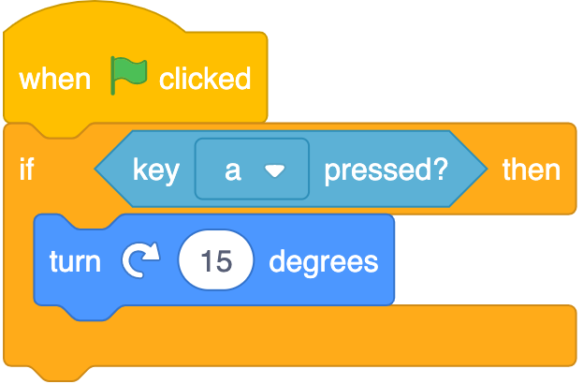
Task 1 - Using repetition with selection
Open oaknat.uk/comp-p5b2-1
Run the program - what happens?
Credit: Scratch

Slide 3
Task 2 - Using repetition with selection
Add a forever loop to the code and run the program - what happens?
Credit: Scratch

Slide 4
Task 3 - Different outcomes
Create a program for the dog sprite using the algorithm.
Some of the blocks have been provided for you.
if key a is pressed then
move 10 steps
else
turn clockwise

Slide 5
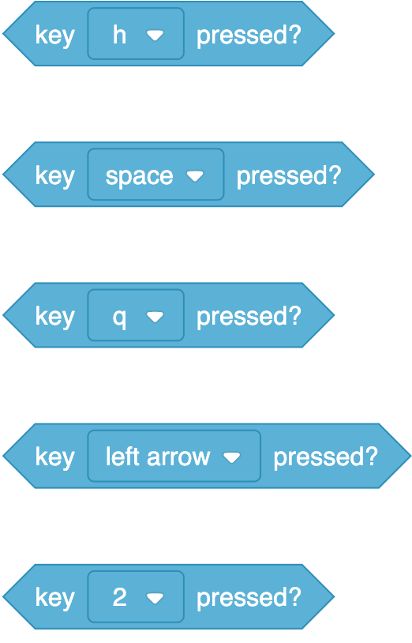
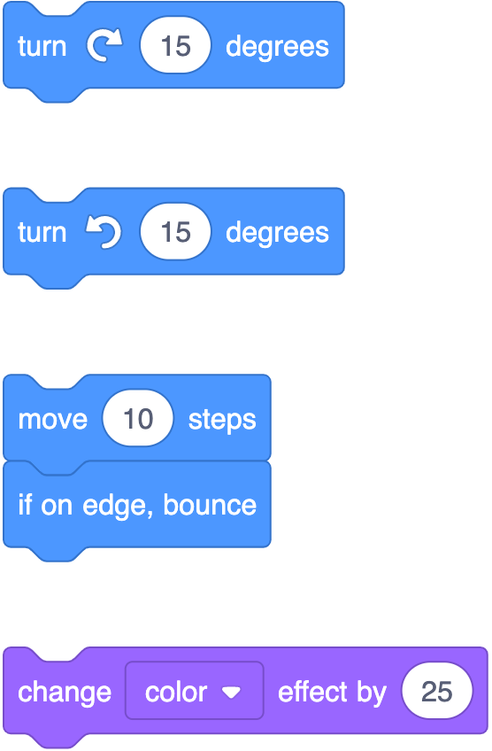
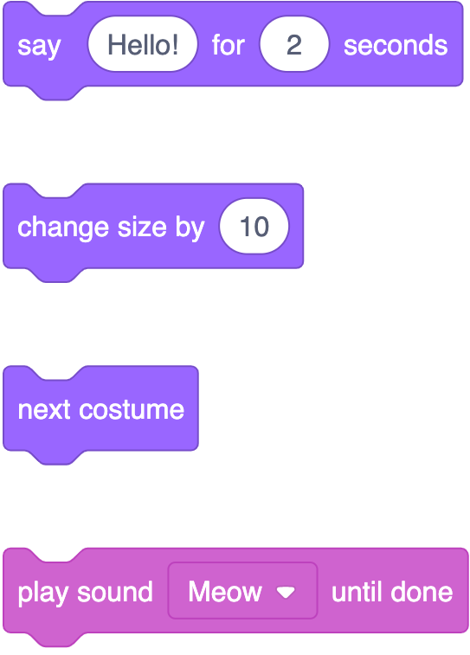
Task 4 - Programming two outcomes
Pick a condition, a true outcome and a false outcome. Construct a program.
Condition | Outcome if true | Outcome if false
Credit: Scratch

Slide 6
Task 4 - Programming two outcomes
Use the template below to support you.
if then
else
Condition (must be true or false)
Outcome if the condition is true
Outcome if the condition is false (else)

