Slide 1
Writing & Performing:
A simple colour poem
Communication and Language: Seasons - Building Understanding
Alison

Slide 2
For this lesson you will need
Recommended, but not required:
Relevant symbols & signs
Some chosen items from your fridge and/or fruit bowl
A pen and paper
A camera to video or photograph the performance

Slide 3
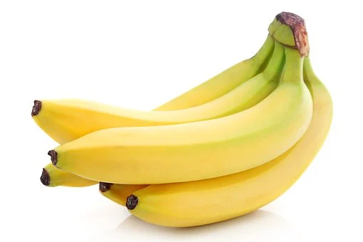
Step 1: Choose the items
Have a look for different coloured objects from around the home.
When describing the items, use simple language combining colour and object.
For example: yellow banana

Slide 4
Time to complete your task
Find your objects
Look around the home for small different coloured objects that can be moved easily.
You might want to stick to a category such as fruit & vegetables or clothing.
Check what words your child knows.

Slide 5
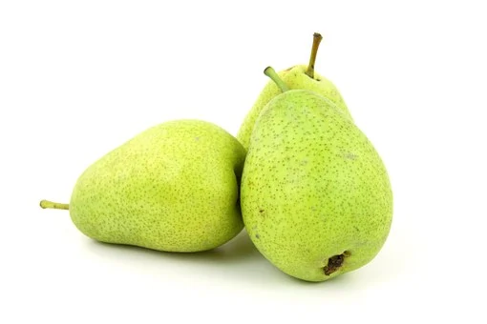
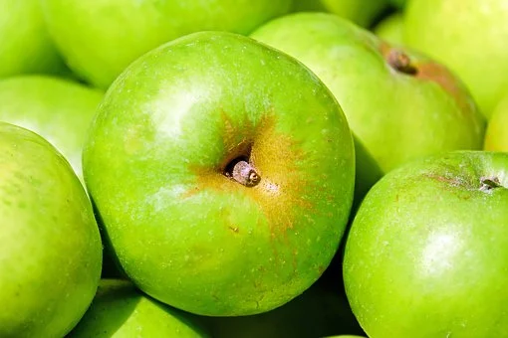
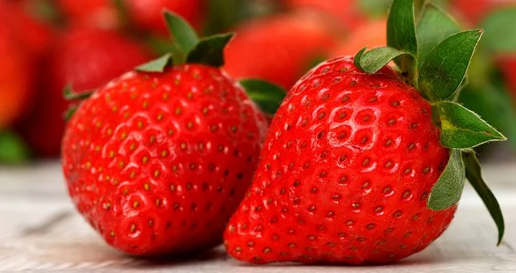
Step 2: The Sequence
Line the objects up. This can be in any order and will become the sequence for your poem.
Remember poems don’t have to rhyme.
Images Pixabay

Slide 6
Step 3: Extending the sentence
Each object becomes one word in each line of the poem. We are now going to extend the sentence by adding in the colour of each object. To do this, have the symbol for each colour or different coloured pieces of paper and ask your child to match these to the objects.

Slide 7
Time to complete your task
Matching the colour to the object
Lay out the symbols for the colours of the objects chosen. See if your child can match each colour to the object.
Model the language, for example ‘yellow banana, green apple, red strawberry, green pear’.

Slide 8
Step 4 - read your poem!
Together, or just your child, move along the line of things and name them. You can use signs, symbols, eye pointing or speech to do this.
Keep practising. If you want to change the order you can do.
Notes:
Recording of lesson to go here. Full screen on slides.

Slide 9
Time to complete your task
Perform your poem
Now it’s your turn.
Support your child to read their poem out loud.
You can ask family to be an audience or you could record the performance on a video.

Slide 10
Make it easier
Make it harder
More ideas
After you child has ordered the objects, you can read the poem to them.
Keep it simple and only use 2 or 3 objects.
Reduce the prompts given.
Increase the number of objects used.
Use the symbols to write down your poem and then read what you’ve written.
Make a book of colour poems using different items from around the home.
You could order your poems in categories:
Clothing
Food
Drink
Animals

