Slide 1
Money
Applying number sense within the context of money
Mathematics Independent Task
Mrs Khaira

Slide 2
Activity 1
1 | 2 | 3 | 4 | 5 | 6 | 7 | 8 | 9 | 10 | 11 | 12 | 13 | 14 | 15 | 16 | 17 | 18 | 19 | 20
21 | 22 | 23 | 24 | 25 | 26 | 27 | 28 | 29 | 30 | 31 | 32 | 33 | 34 | 35 | 36 | 37 | 38 | 39 | 40
41 | 42 | 43 | 44 | 45 | 46 | 47 | 48 | 49 | 50
Source: Amisha Khaira images

Slide 3
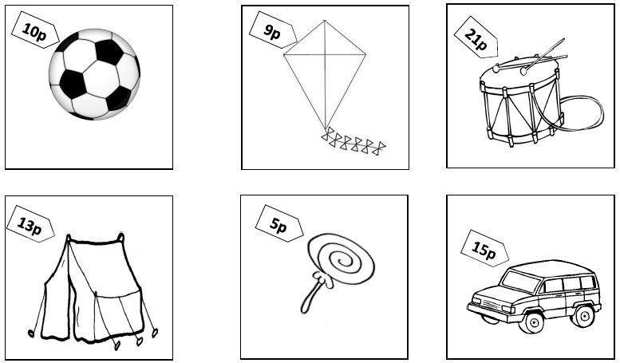
Activity 2

Slide 4
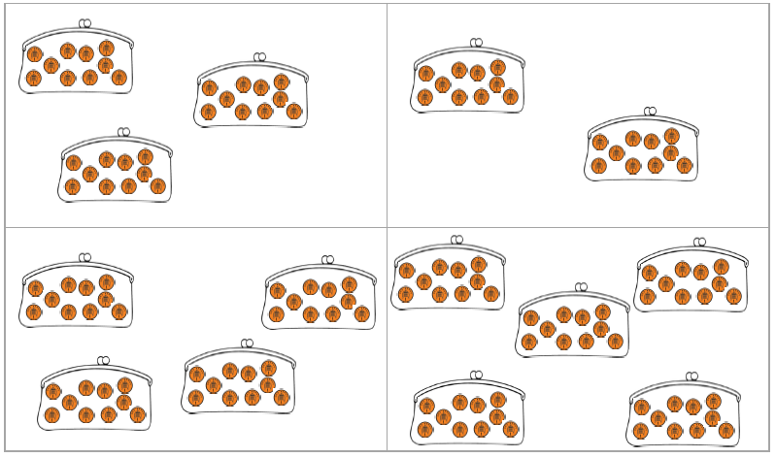
Activity 3

