Slide 1
Angles in Polygons
Downloadable Resource – Generalising angles in polygons (Part II)
Mathematics
Mr. Thomas

Slide 2
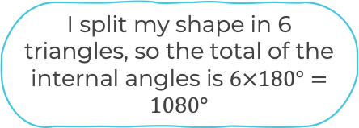
Try this
What is Antoni’s error?
What would you have done differently?
Can you calculate the sum of the internal angles of this hexagon?

Slide 3
Connect
Let's continue this idea further…

Slide 4
Independent Task
Split these shapes and state what the sum of their interior angles will be.

Slide 5
Explore
If I draw a triangle from the centre to each side, it’s 180 multiplied by the number of sides, then subtract 360 degrees in the centre.
In relation to what we have learnt, who is right?
(n-2) x 180
There will be 2 less triangles than the number of sides, so multiply that by 180.
180 x n – 360

