Slide 1
Gradient 1
Downloadable Resource
Mathematics
Mr Maseko

Slide 2
Fill in the missing ordinates.
What’s the same and what’s different?
Name each of the students’ graphs
( | 0 | , |  | )
( | 0 | , |  | )
( | 0 | , |  | )
( | 1 | , |  | )
( | 1 | , |  | )
( | 1 | , |  | )
( | 2 | , |  | )
( | 2 | , |  | )
( | 2 | , |  | )
( | 3 | , |  | )
( | 3 | , |  | )
( | 3 | , |  | )
( | 4 | , |  | )
( | 4 | , |  | )
( | 4 | , |  | )
( | 5 | , |  | )
( | 5 | , |  | )
( | 5 | , |  | )
In my graph, the y-ordinate is double the x-ordinate
In my graph, the y-ordinate is triple the x-ordinate
In my graph, the y-ordinate is 5 times the x-ordinate

Slide 3
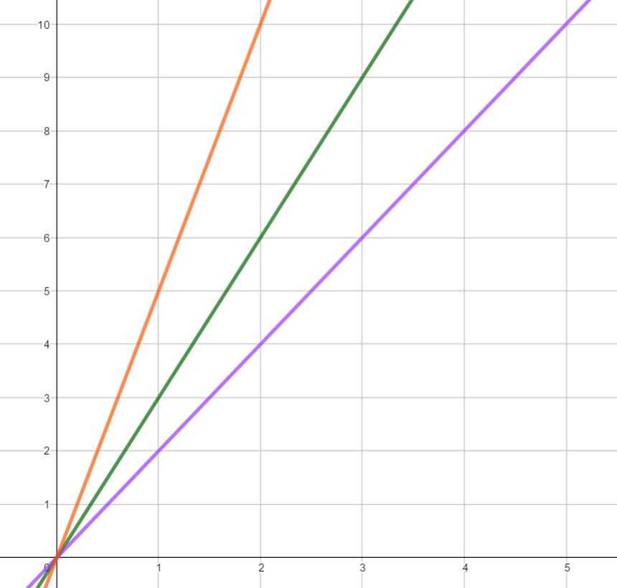
On the orange graph, everytime we move up 1 in the x-direction we move up ___ in the y-direction. So this graph has a gradient of ____.
In my graph, y = 2x
In my graph, y = 3x
On the green graph, everytime we move up 1 in the x-direction we move up ___ in the y-direction. So this graph has a gradient of ____.
In linear graphs, the coefficient of x determines how steep it is. This is referred to as the gradient.
In my graph, y = 5x

Slide 4
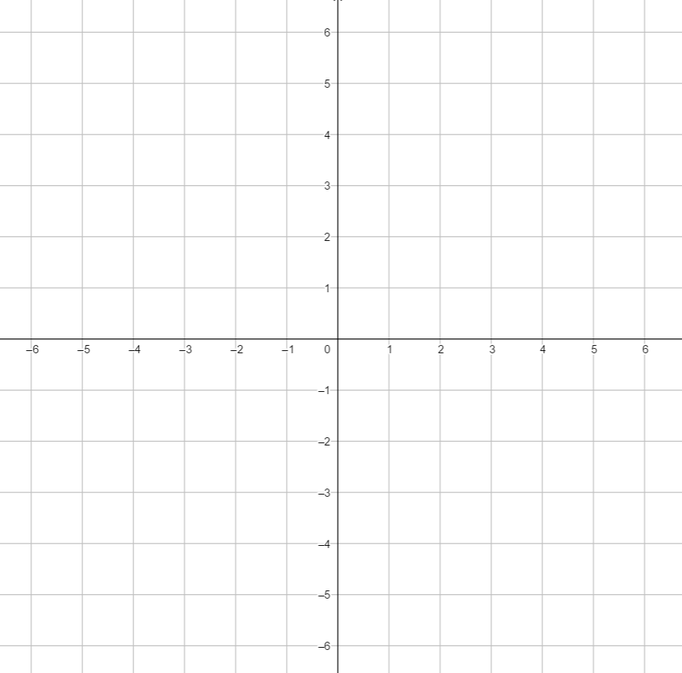
What would happen if every time we move up 1 in the x-direction we move down 2 in the y-direction?
In linear graphs, the coefficient of x determines how steep it is. This is referred to as the gradient.

Slide 5
1) Plot the following lines on the coordinate grid and state the gradient of each line
Line 1: has the coordinates, (-3,-3), (1,1), (1,4),
Line 2 has the coordinates, (-1-4), (0,-1), (2,5)
Line 3 has the coordinates, (-2,5), (0,1), (2,-3)
2) A linear graph has a gradient of 3 and goes through (3,7) and (4,y). Find y.

Slide 6
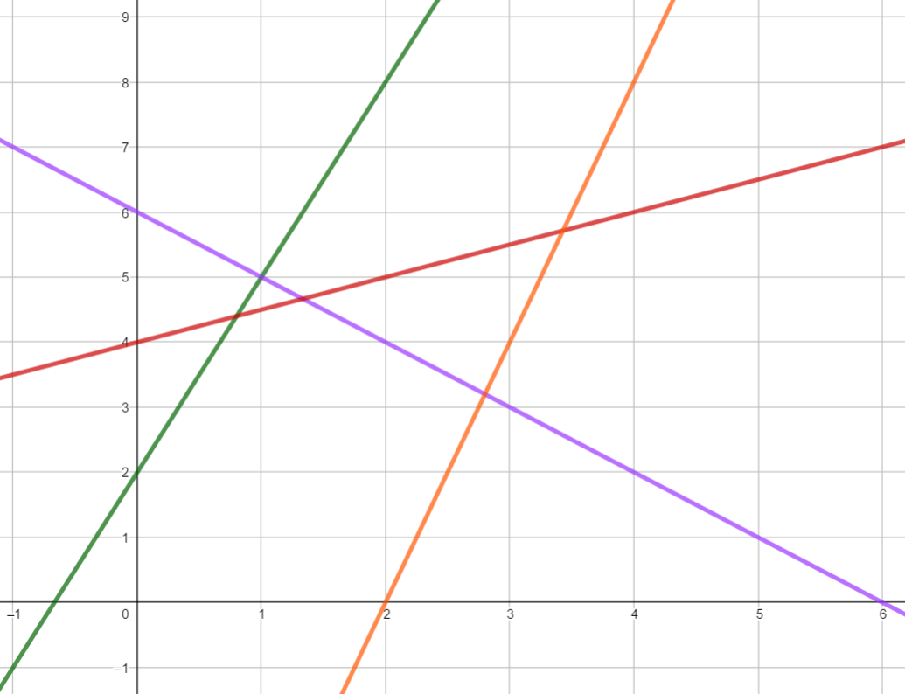
1
Find the gradient of each of these lines
2
List some linear graphs that would have the same gradient one of these graphs

