Slide 1
Find the median from a histogram
Maths
Miss Parnham

Slide 2
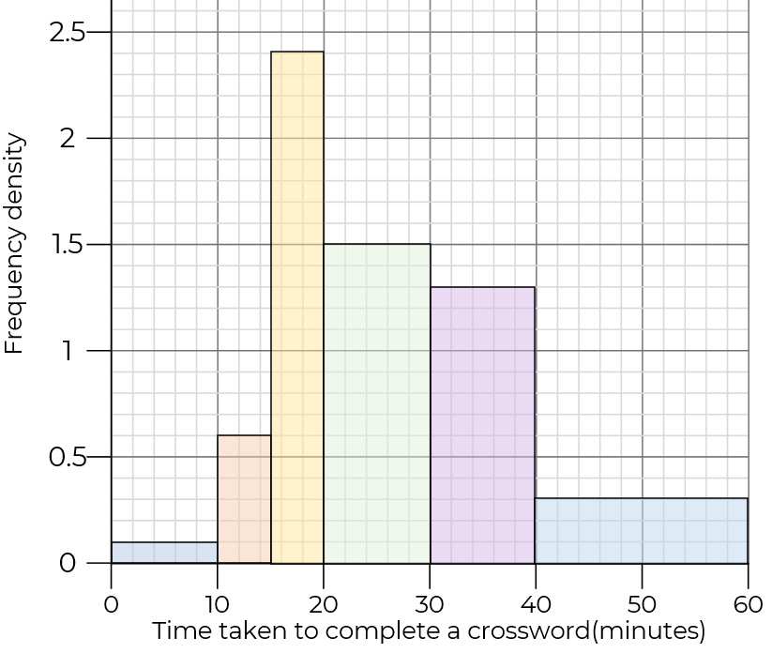
Find the median from a histogram
1. The histogram shows the time taken to complete a crossword.
a) Find the total frequency.
b) Which class interval contains the median?
c) Estimate the median time.

Slide 3
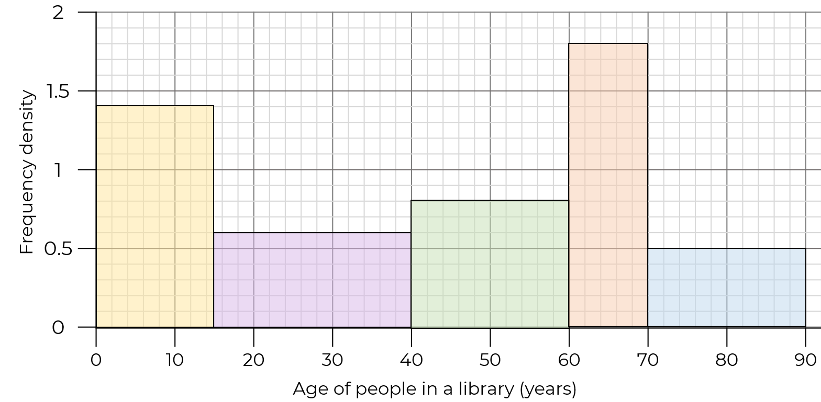
Find the median from a histogram
2. The histogram shows the age of people in a library.
a) Estimate the median age of people in the library.
b) Estimate how many people in the library are over 50

Slide 4
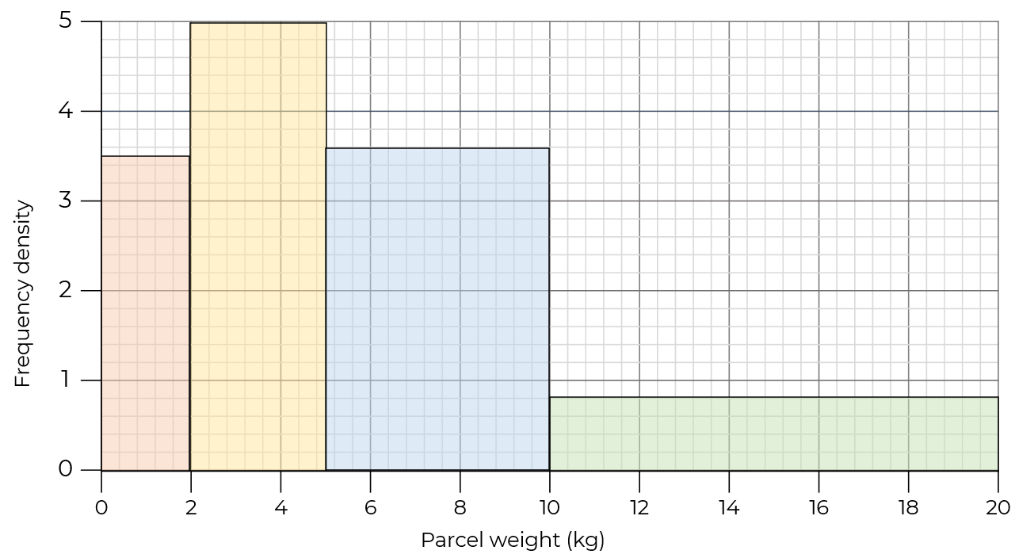
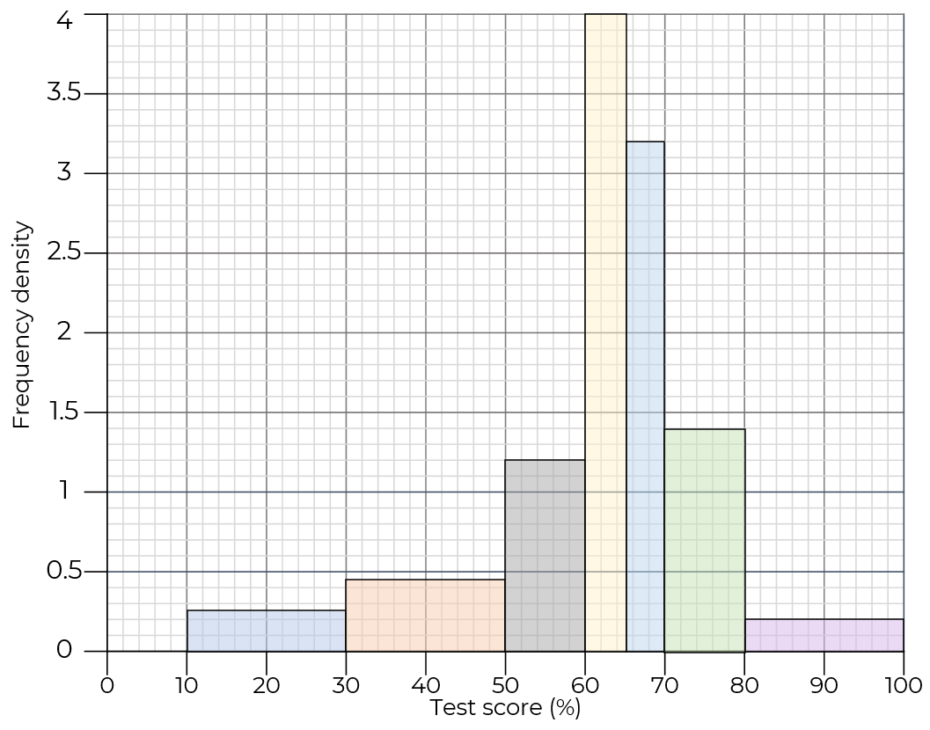
Find the median from a histogram
3. The histogram shows the weight of some parcels.
a) Estimate the median weight.
b) Find the lower quartile
4. Use the histogram to estimate the median and interquartile range.

Slide 5
Answers

Slide 6
Find the median from a histogram
1. The histogram shows the time taken to complete a crossword.
a) Find the total frequency.
b) Which class interval contains the median?
c) Estimate the median time.
50
12
20 < t ≤ 30
15
13
26 minutes
3
6
1

Slide 7
Find the median from a histogram
2. The histogram shows the age of people in a library.
a) Estimate the median age of people in the library.
b) Estimate how many people in the library are over 50
45 years old
18
21
36 people
16
15
10

Slide 8
Find the median from a histogram
3. The histogram shows the weight of some parcels.
a) Estimate the median weight.
b) Find the lower quartile
4. Use the histogram to estimate the median and interquartile range.
15
20
Interquartile range 69.4 - 55 = 14.4% (3sf)
7
18
16
Median score 63.5%
8
14
12
9
5.56 kg(3sf)
5
4
3 kg

