Slide 1
LO: To step and speak a persuasive piece
Lesson 3 of 10
English
Miss Doherty

Slide 2
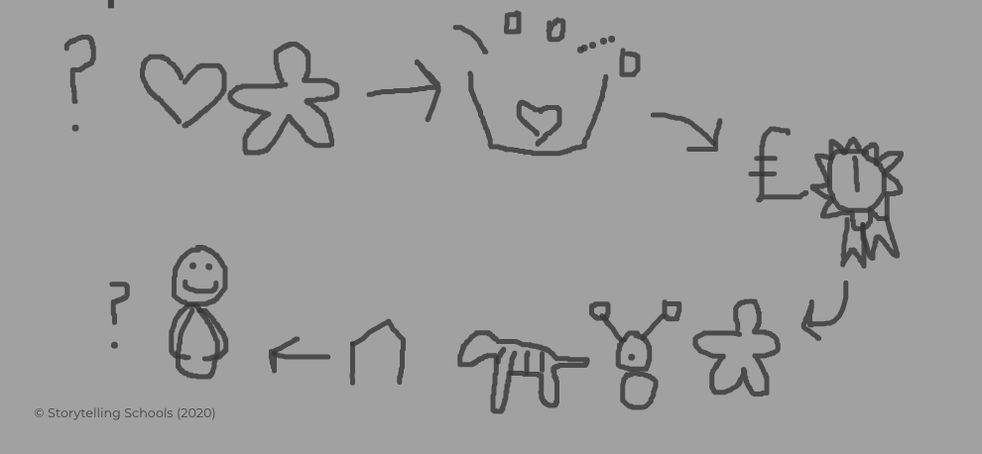
© Storytelling Schools (2014) 147 Traditional Stories for Primary Children to Retell, by Chris Smith, courtesy of Hawthorn Press
© Storytelling Schools (2020) The Storytelling Schools Method. A Handbook for Teachers, Twinberrow Press

