Slide 1
What are the characteristics of living things?
Science
Miss Simkin

Slide 2
M_______
R_______
S_______
N_______
E_______
R_______
G_______
Notes:
All living things move. Animals move around to get from place to place. Plants grow and turn towards the light.

Slide 3
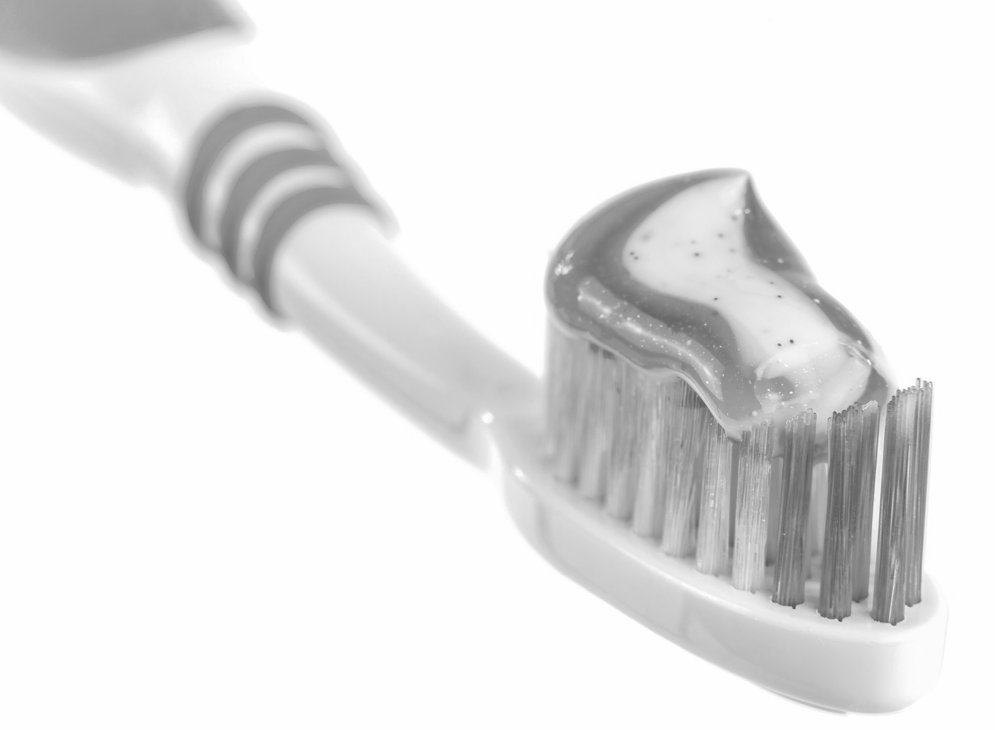
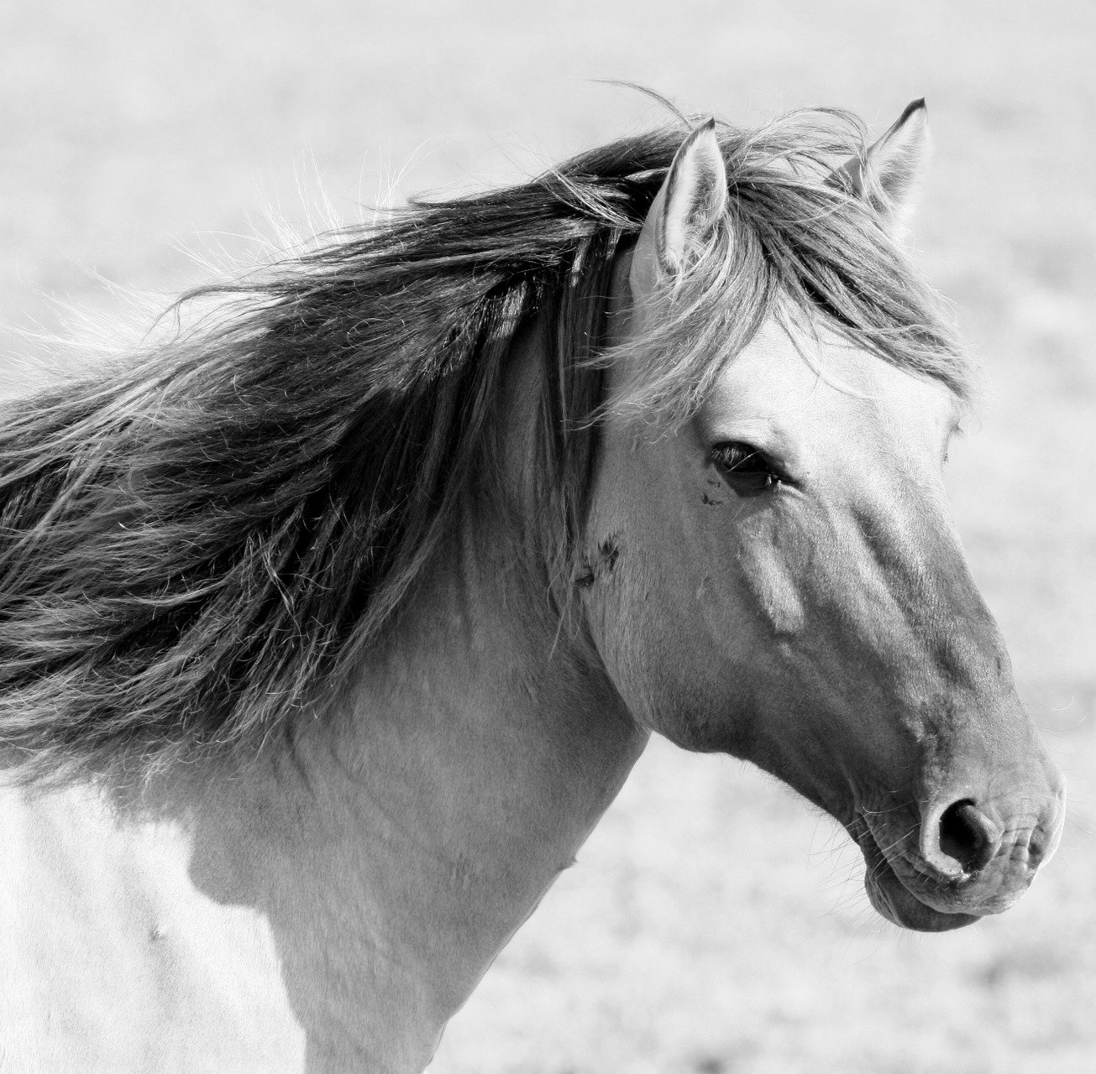
Can you sort the pictures into living and non-living things?
Living | Non- living
Pixabay

