Slide 1
Maths
Sine, Cosine and Area Rules – Mixed Problems
Mr Bond

Slide 2
Non right angled triangle problem solving
1. Here is a non right angled triangle.
a) Calculate the area of ABC.
b) Calculate the distance the AC.
2. Calculate the area of the triangle XYZ.
B
Y
43⁰
12 m
8 m
X
50⁰
7.3 m
A
C
75⁰
Z

Slide 3
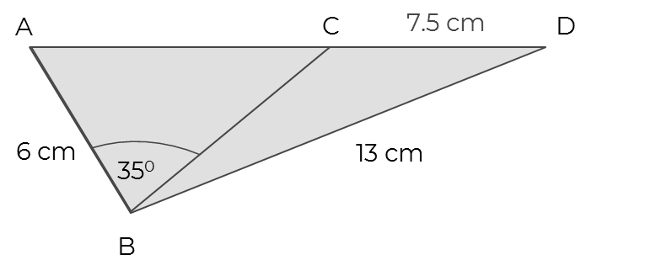
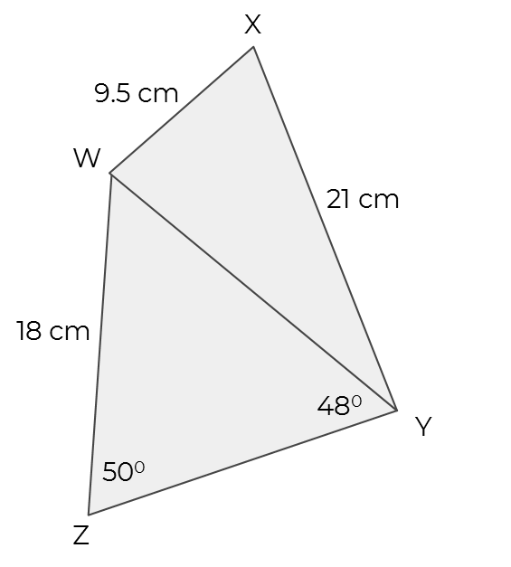
Non right angled triangle problem solving
3. The area of triangle ABC is 16.25 cm²
The area of ABC is 15.5 cm².
a) Calculate the length of BC.
b) Calculate angle BCD.
4. Calculate the size of angle XYW.

Slide 4
Answers

Slide 5
Non right angled triangle problem solving
1. Here is a non right angled triangle.
a) Calculate the area of ABC.
b) Calculate the distance the AC.
2. Calculate the area of the triangle XYZ.
B
9.2 m
Y
43⁰
12 m
55⁰
8 m
X
50⁰
7.3 m
A
C
75⁰
32.7 m²
Area = 27.5 m²
Z
8.2 m

Slide 6
Non right angled triangle problem solving
3. The area of triangle ABC is 16.25 cm²
The area of ABC is 15.5 cm². a) Calculate the length of BC.
b) Calculate angle BCD.
4. Calculate the size of angle XYW.
18.6 cm
9 cm
XYW = 26.9⁰
103.6⁰

