Slide 1
Line segments
Downloadable resource.
Lesson 2 of 8
Mathematics
Dr Rim Saada

Slide 2
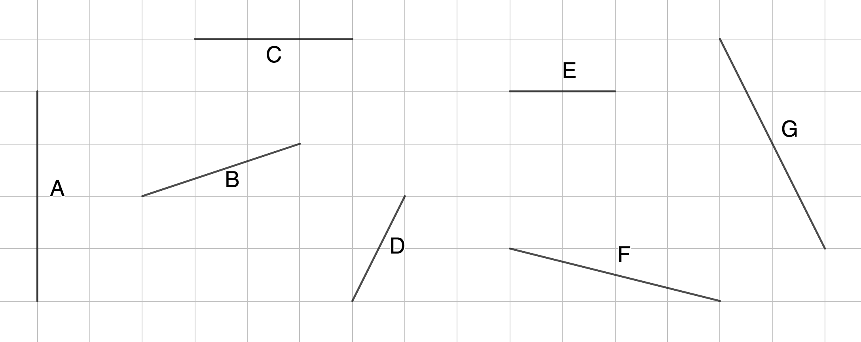
Put the line segments into order from shortest to longest.
Explain how you compared their lengths.
Hint: “D is longer than E as E is 2 along, but D is 2 up and 1 along”

Slide 3
Identify the triangles where the highlighted line segment is the same length:
Decide which of the line segments connecting each pair of coordinates is longest:
a) (4,0) to (7,0) or (8,0) to ( 12,0)
b) (9,0) to (7,0) or (0,0) to (0,3)
c) (4,2) to (9,2) or (−2,4) to ( −2,8)
d) (−2,3) to (−4,3) or (7,−5) to (3,−5)

Slide 4
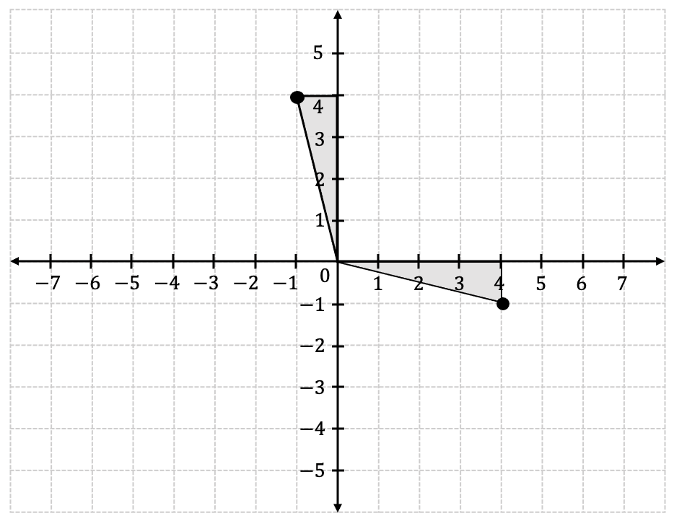
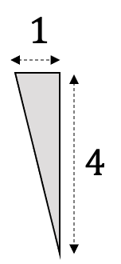
Tia used a triangle to find two points equidistant from the origin. Find more examples using this triangle.
(−1,4) and (4,−1) are equidistant from (0,0).

