Slide 1
Independent Task
To describe movements between positions as translations of a given unit left/right or up/down
Maths
Mr Critchlow

Slide 2
To Start
Can you work out what each symbol is worth in this maths square? Use the clues to help you.
=30
=
=32
=
=36
=
=27
=

Slide 3
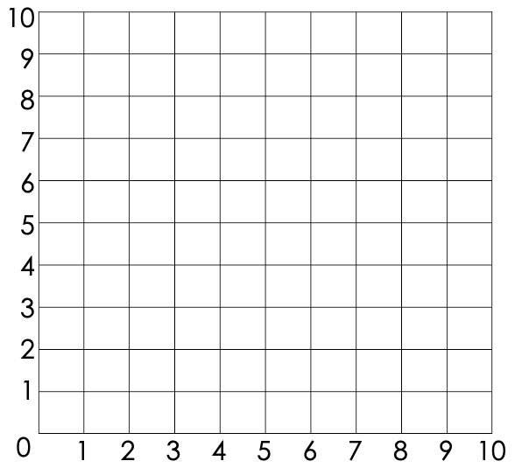
Moving On
Write the translation for each of these points in the correct format.
D
F
symbol | points | translation
 | A to B
 | C to D
 | E to F
 | G to H
C
H
G
B
A
E

Slide 4
Main Task
If each of X points is translated (2 right , 3 up), what will all the new positions be?
If each of the O points are translated (4 right , 1 up) what will the new positions be?
Write the final coordinates for each.
G
B
E
J
H
A
C
I
F
D

Slide 5
Main Task
If each of X points is translated (2 right , 3 up), what will all the new positions be?
If each of the O points are translated (4 right , 1 up) what will the new positions be?
Write the final coordinates for each.
Point | Final coordinate after translation
A
B
C
D
E
B
E
A
C
D

Slide 6
Main Task
If each of X points is translated (2 right , 3 up), what will all the new positions be?
If each of the O points are translated (4 right , 1 up) what will the new positions be?
Write the final coordinates for each.
Point | Final coordinate after translation
F
G
H
I
J
G
J
H
I
F

Slide 7
Challenge
Start
Can you work out the translation for the 3 points on the grid?
symbol | translation
Finish
Start
Start
Finish
Finish

