Slide 1
Circumference of a circle
Mathematics
Mr Coward

Slide 2
Try this
You will need a measuring tape OR a piece of string and a ruler
Find circular objects in your house and measure the circumference and diameter (to the nearest millimetre)
Object | Circumference | Diameter | Ratio
Sauce Pan | 66.5 cm | 21.2cm
Glass | 15.3 cm | 4.9 cm
Lampshade | 37.7 cm | 12.0cm
To find the ratio divide the circumference by the diameter

Slide 3
Independent task
1) Find the circumference of these shapes in exact form.
11 cm
6 cm
3 cm
8 cm
Area of square = 81cm
Perimeter of square= 100 cm

Slide 4
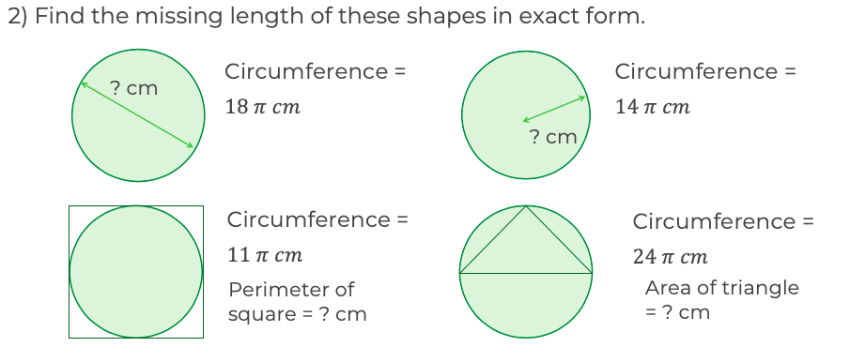
Independent task
2) Find the missing length of these shapes in exact form.
? cm
? cm
Perimeter of square = ? cm
Area of triangle = ? cm

Slide 5
Explore
Each pattern is made out of congruent semi-circular arcs. Find the length of each pattern. What do you notice?
12cm
12cm
12cm
12cm

