Slide 1
Enlarge an Object with a Positive Scale Factor from a Given Coordinate
Maths
Miss Davies

Slide 2
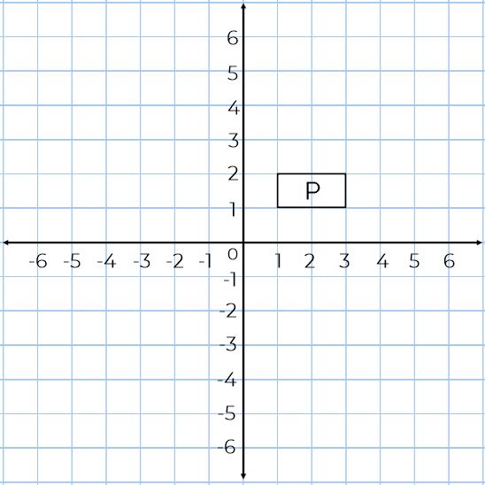
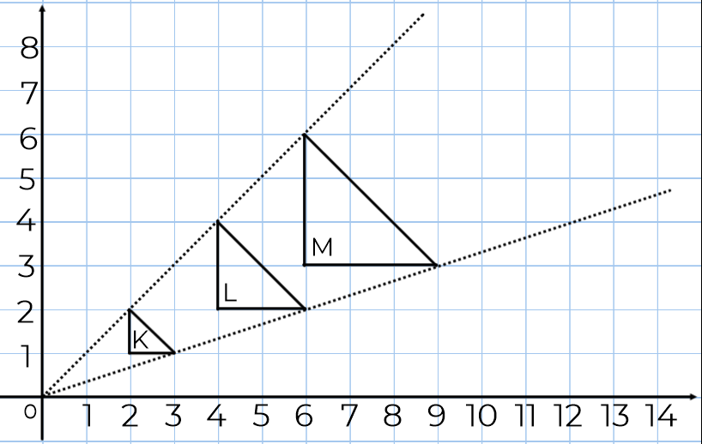
Enlarge an Object with a Positive Scale Factor from a given coordinate
1. M is an enlargement of K by scale factor 3 from centre of enlargement (0,0).
a) Describe the enlargement from K to L
b) K is enlarged by a scale factor of 4 from the same centre to give shape N.
Find the coordinates of the vertices of N.
2.
a) Enlarge P by a scale factor 3 from centre (2, 4). Label the new shape Q.
b) Enlarge P by a scale factor 4 from centre (3, 1). Label the new shape R.

Slide 3
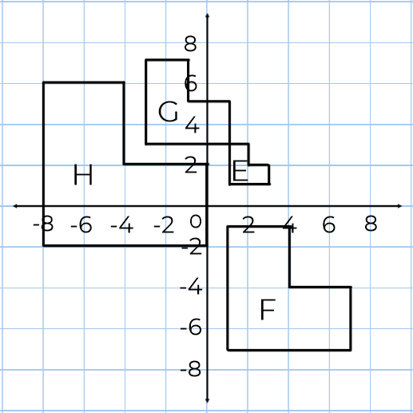
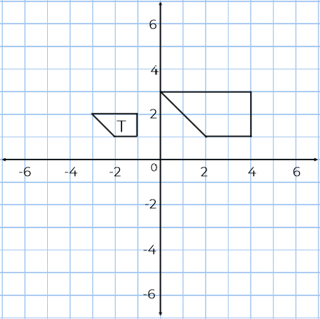
Enlarge an Object with a Positive Scale Factor from a Given Coordinate
3.
Describe fully the transformation that maps:
a) E onto F
b) E onto H
c) G onto H
4. Alex is enlarging shape T by a scale factor of 2, centre of enlargement (2, 1).
What error has Alex made?

Slide 4
Answers

Slide 5
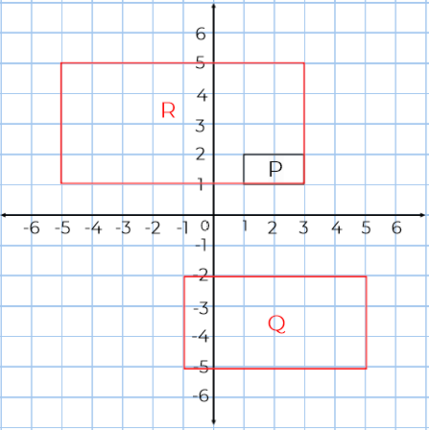
Enlarge an Object with a Positive Scale Factor from a Given Coordinate
1. M is an enlargement of K by scale factor 3 from centre of enlargement (0,0).
a) Describe the enlargement from K to L
Enlargement by SF 2 from COE (0,0).
b) K is enlarged by a scale factor of 4 from the same centre to give shape N.
Find the coordinates of the vertices of N.
2.
a) Enlarge P by a scale factor 3 from centre (2, 4). Label the new shape Q.
b) Enlarge P by a scale factor 4 from centre (3, 1). Label the new shape R.
(8,8), (8,4), (12,4)

Slide 6
Enlarge an Object with a Positive Scale Factor from a Given Coordinate
3.
Describe fully the transformation that maps:
a) E onto F Enlargement by SF 3 from C.O.E (1,5)
b) E onto H Enlargement by SF 4 from C.O.E (4,2)
c) G onto H Enlargement by SF 2 from C.O.E (2,8)
4. Alex is enlarging shape T by a scale factor of 2, centre of enlargement (2, 1).
What error has Alex made?
He has used the centre of enlargement as a vertex of the enlarged shape.

