Slide 1
Introduction to surds
Mathematics
Dr Saada

Slide 2
Decide if the following are rational or irrational.
Explain why.

Slide 3
1) Which of the following is not a surd.
2) Estimate the value of the following surds.
How many ways can you represent this?

Slide 4
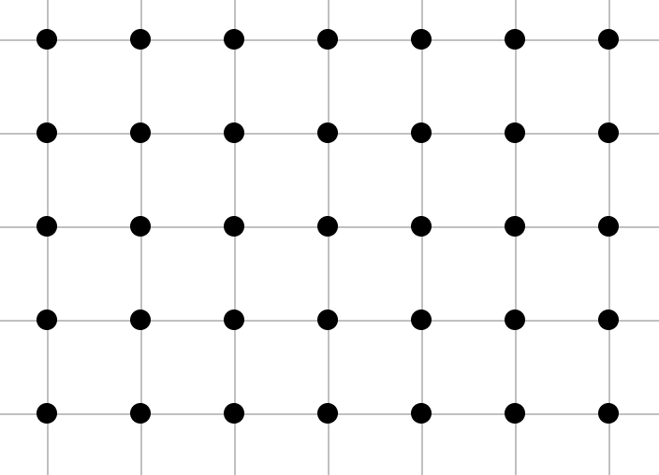
How many surd lengths can we draw?
Hint: Think about Pythagoras.

Slide 5
Share your work with Oak National
If you'd like to, please ask your parent or carer to share your work on Twitter tagging @OakNational and #LearnwithOak

