Slide 1
Reacting Masses - Higher
Combined Science - Chemistry - Key Stage 4
Quantitative Chemistry
Mrs. Begum

Slide 2
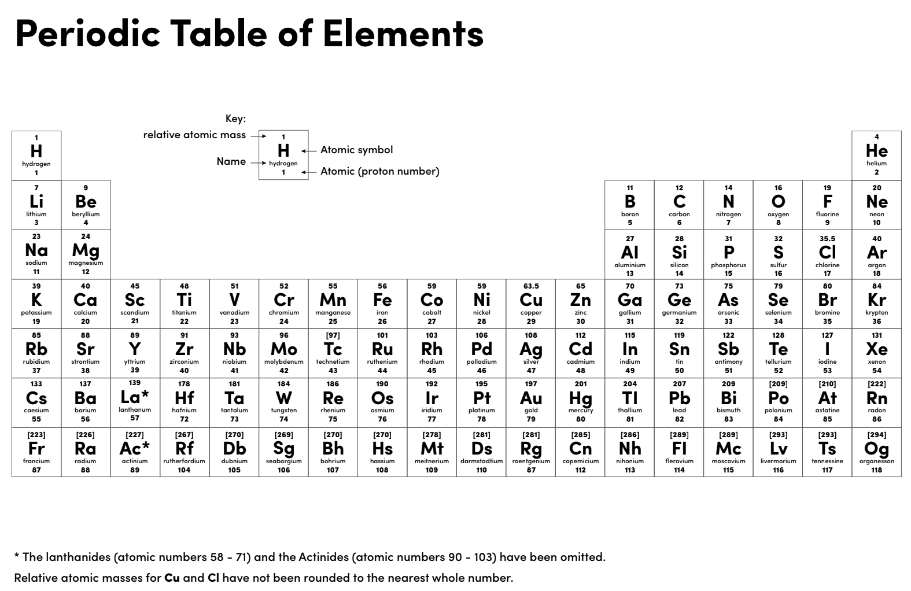

Slide 3
Independent practice
What mass of magnesium oxide is formed when 96 g of magnesium reacts with oxygen?
2Mg + O₂ 2MgO
What mass of aluminium oxide is produced when 108 g of aluminium is burned in oxygen? 2Al + 3O₂ Al₂O₃
What mass of hydrogen is produced when 192 g of magnesium is reacted with hydrochloric acid?
Mg + 2HCl MgCl₂ + H₂

Slide 4
Independent task
What mass of oxygen is needed to react with 8.5 g of hydrogen sulphide (H₂S)?
2H₂S + 3O₂ 2SO₂ + 2H₂O
What mass of potassium oxide is formed when 7.8 g of potassium is burned in oxygen? 4K + O₂ 2K₂O
What mass of aluminium oxide is produced when 135 g of aluminium is burned in oxygen?
4Al + 3O₂ 2Al₂O₃

Slide 5
Question 1
Some students investigated calcium oxide.
(a) Calcium oxide has the formula CaO.
(i) Calculate the relative formula mass (M_{r}) of calcium oxide.
Relative atomic masses: O = 16; Ca = 40.
____________________________________________________________
____________________________________________________________
Relative formula mass (M_{r}) = ___________________(1)
(ii) Calculate the percentage by mass of calcium in calcium oxide.
_____________________________________________________________
_____________________________________________________________
Percentage by mass of calcium in calcium oxide = _______%(1)

Slide 6
Question 1
(iii) Calculate the mass of calcium needed to make 30 g of calcium oxide.
______________________________________________________________
Mass of calcium = ___________________ g
(1)

Slide 7
Question 2
(a) The formula of iron(II) sulfate is FeSO₄
Calculate the relative formula mass (M_{r}) of FeSO₄
Relative atomic masses: O = 16; S = 32; Fe = 56.
___________________________________________________________________
The relative formula mass (M_{r}) = _______________ (2)
(b) What is the mass of one mole of iron(II) sulfate?
______________(1)
(c) What mass of iron(II) sulfate would be needed to provide 14 grams of iron?
Remember to give the unit.
______________(1)
(Total 4 marks)

Slide 8
Question 3
A bag of fertiliser contains 18.56 kg of ammonium nitrate (NH₄NO₃).
Relative formula mass (M_{r}): NH₄NO₃ = 80
Calculate the number of moles of ammonium nitrate in the bag of fertiliser.
Give your answer in standard form to 2 significant figures.
___________________________________________________________________
___________________________________________________________________
___________________________________________________________________
___________________________________________________________________
Moles of ammonium nitrate = _______________________ mol
(4)

Slide 9
Question 1 answers
(a) (i) 40 + 16 = 56
(ii) 40 / 56 x 100% = 71%
(iii) 71 /100 x 30 = 21.3 g

Slide 10
Question 2 answers
(a) 56 + 32 + (4 ×16) = 152
(b) 152g
(c) 152 / 4 = 38(g)

Slide 11
Question 3
Convert 18.56kg in to grams
mass = 18.56x 1000 = 18560 g
Moles = mass / Mr
= 18560 / 80
= 232 mol
= 2.3 × 10² mol

